Slide 1
MSCI Index comparison
Prepared for BMO
DEC 2019

Slide 2
MSCI world vs MSCI world ESG Leaders
Sector Weight |  | World | World ESG Leaders
Communication Services |  | 8.487% | 8.482%
Consumer Discretionary |  | 10.279% | 10.371%
Consumer Staples |  | 8.371% | 8.215%
Energy |  | 4.814% | 4.204%
Financials |  | 15.692% | 15.405%
Health Care |  | 12.956% | 12.952%
Industrials |  | 11.196% | 11.271%
Information Technology |  | 17.163% | 17.565%
Materials |  | 4.342% | 4.736%
Real Estate |  | 3.308% | 3.280%
Utilities |  | 3.392% | 3.518%
World Top 10 Constituents | Weight
APPLE MICROSOFT CORP AMAZON.COM FACEBOOK A JPMORGAN CHASE & CO ALPHABET C ALPHABET A JOHNSON & JOHNSON VISA A NESTLE | 2.78% 2.53% 1.74% 1.12% 0.97% 0.94% 0.90% 0.84% 0.73% 0.71%
World ESG Leaders Top 10 Constituents | Weight
MICROSOFT CORP ALPHABET C ALPHABET A JOHNSON & JOHNSON VISA A PROCTER & GAMBLE CO DISNEY (WALT) MASTERCARD A INTEL CORP VERIZON COMMUNICATIONS | 5.06% 1.88% 1.80% 1.67% 1.47% 1.41% 1.26% 1.22% 1.18% 1.15%
Data as of November 29, 2019.

Slide 3
Index Performance
Cumulative Index Performance – Net Returns
(CAD)
Returns
 | World | World ESG Leaders
YTD | 20.55 | 21.09
3 Year | 11.89 | 11.95
5 Year | 11.09 | 11.06
Key Metrics
 | World | World ESG Leaders
No. of Stocks | 1650 | 781
Div. Yield | 2.3584 | 2.3460
Payout Ratio | 0.4642 | 0.4744
P/E | 19.6850 | 20.2196
Data as of Nov 2019.

Slide 4
Risk profile

Slide 5
Historical PE - World vs World ESG Leaders

Slide 6
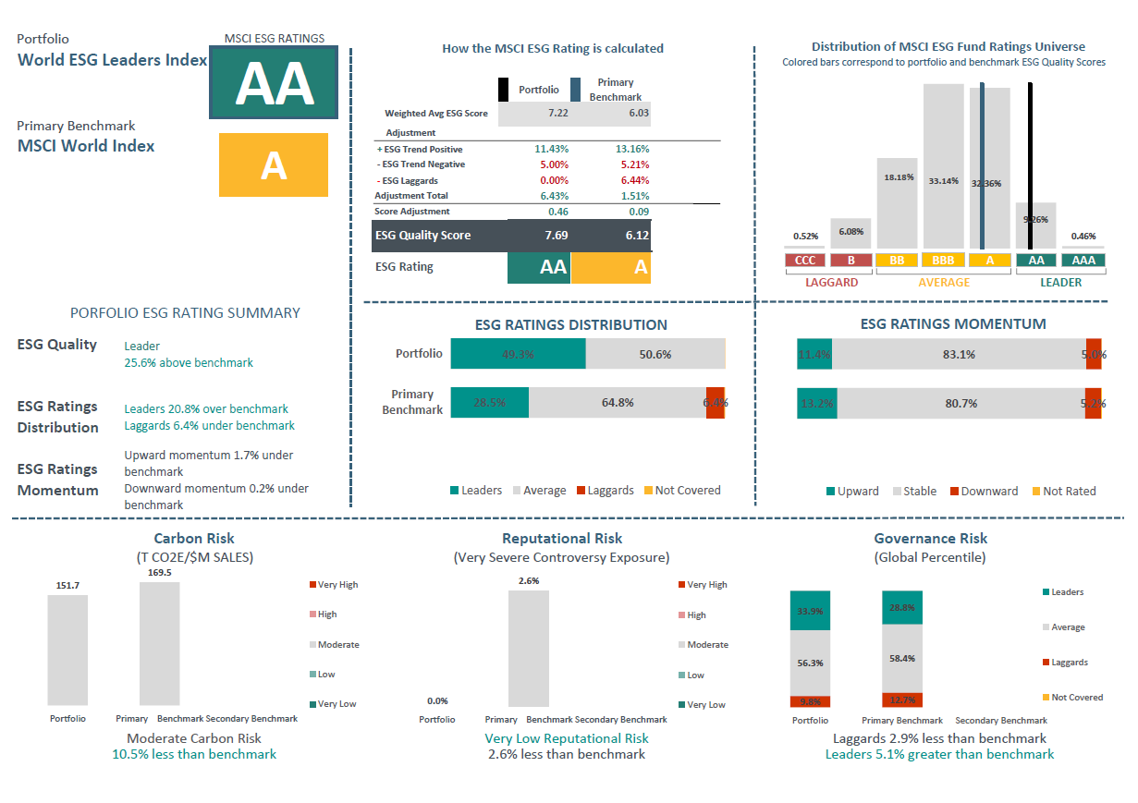
MSCI World ESG Leaders vs msci world
Data as of Dec 31 2019.

Slide 7
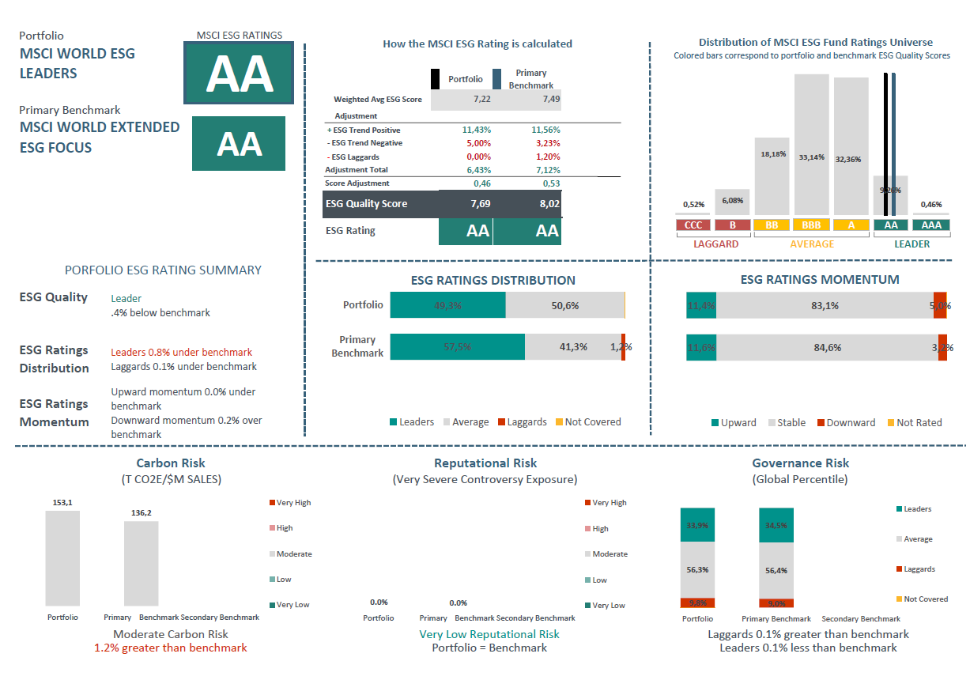
MSCI World ESG Leaders vs msci world extended ESG focus
Data as of Dec 31 2019.

Slide 8
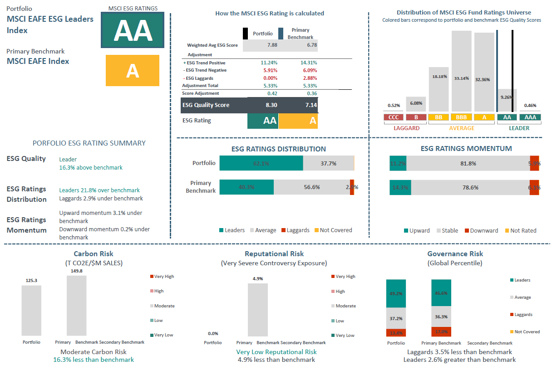
MSCI EAFE ESG Leaders vs msci EAFE
Data as of Dec 31, 2019.

Slide 9
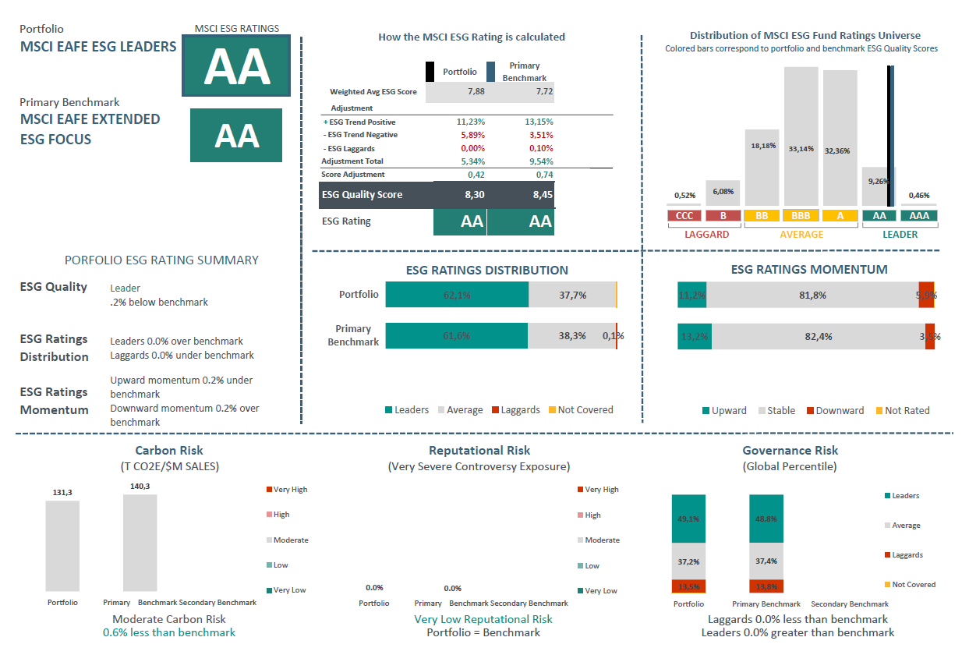
MSCI EAFE ESG Leaders vs msci EAFE extended esg focus
Data as of Dec 31 2019.

Slide 10
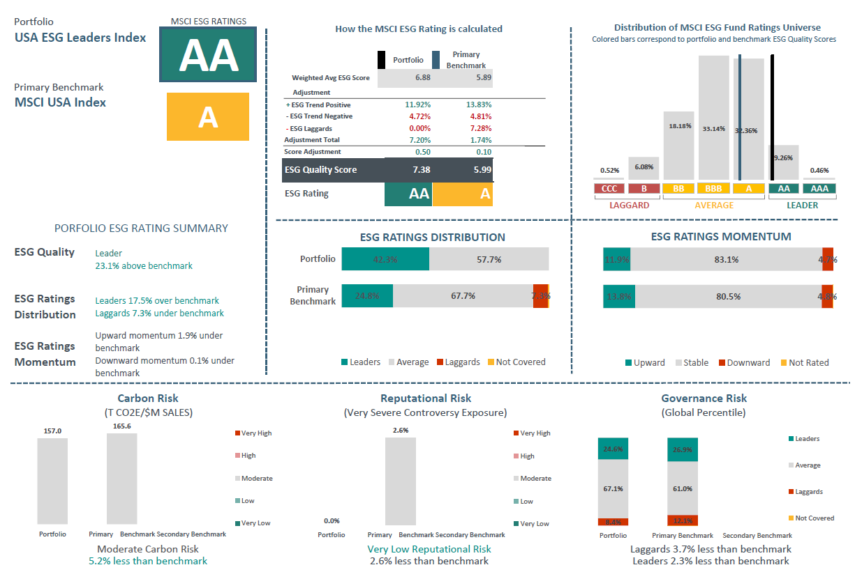
MSCI usa ESG Leaders vs msci usa
Data as of Dec 4 2019.

Slide 11
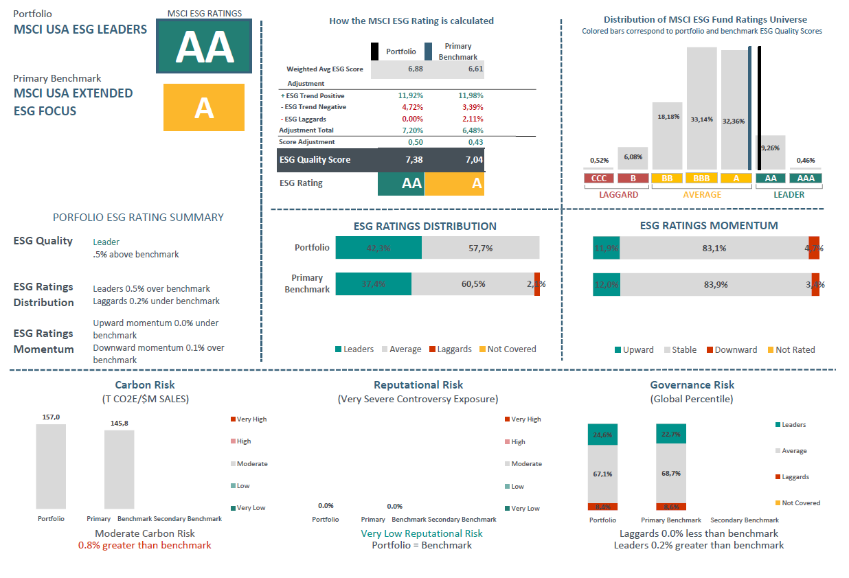
MSCI usa ESG Leaders vs msci usa extended esg focus
Data as of Dec 31 2019.

Slide 12
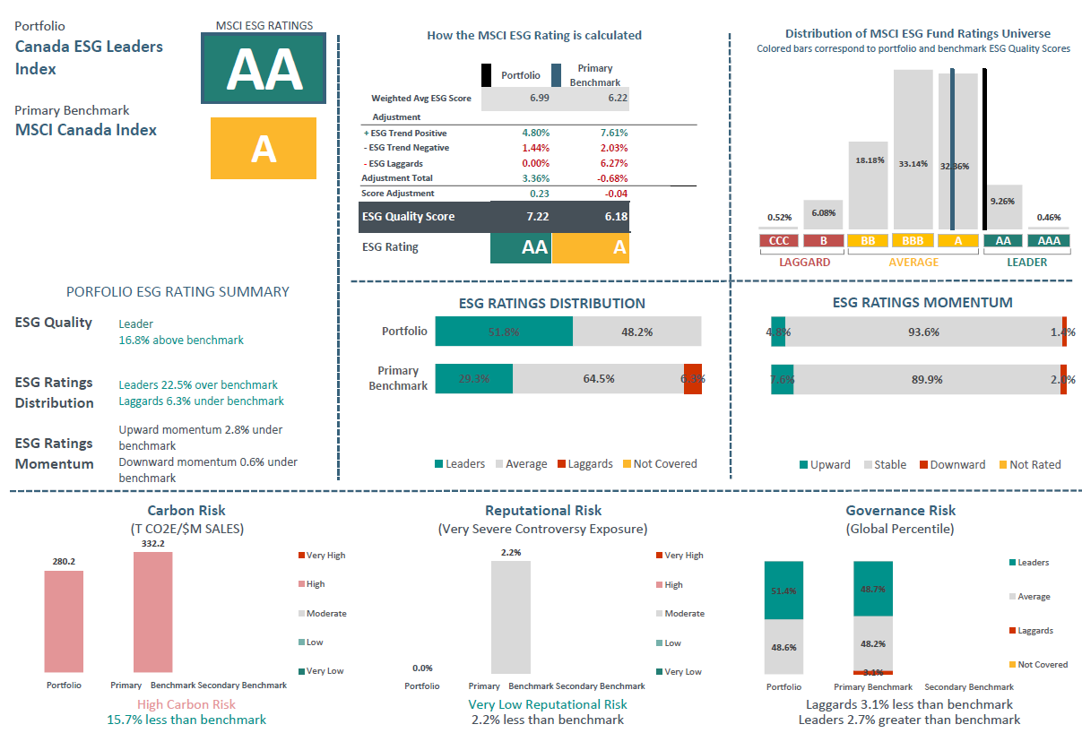
MSCI canada ESG Leaders vs msci canada
Data as of Dec 4 2019.

Slide 13
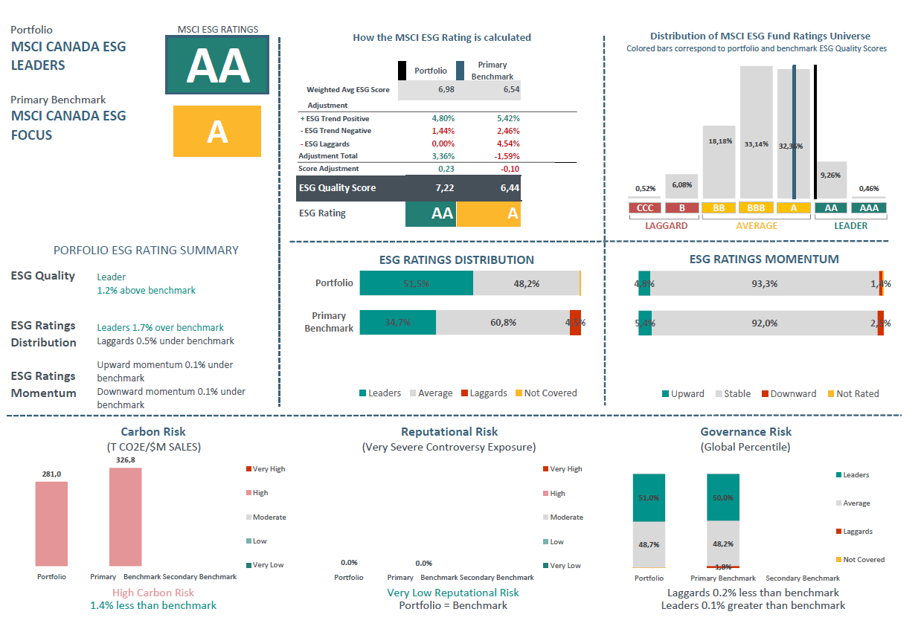
MSCI canada ESG Leaders vs msci Canada esg focus
Data as of Dec 31 2019.

Slide 14
Contact Us
AMERICAS
Americas 1 888 588 4567 *
Atlanta + 1 404 551 3212
Boston + 1 617 532 0920
Chicago + 1 312 675 0545
Monterrey + 52 81 1253 4020
New York + 1 212 804 3901
San Francisco + 1 415 836 8800
Sao Paulo + 55 11 3706 1360
Toronto + 1 416 628 1007
* = toll free
msci.com
clientservice@msci.com
EUROPE, MIDDLE EAST
& AFRICA
Cape Town + 27 21 673 0100
Frankfurt + 49 69 133 859 00
Geneva + 41 22 817 9777
London + 44 20 7618 2222
Milan + 39 02 5849 0415
Paris 0800 91 59 17 *
ASIA PACIFIC
China North 10800 852 1032 *
China South 10800 152 1032 *
Hong Kong + 852 2844 9333
Mumbai + 91 22 6784 9160
Seoul 00798 8521 3392 *
Singapore 800 852 3749 *
Sydney + 61 2 9033 9333
Taipei 008 0112 7513 *
Thailand 0018 0015 6207 7181 *
Tokyo 81 3 5290 1555

Slide 15
Notice and disclaimer
This document and all of the information contained in it, including without limitation all text, data, graphs, charts (collectively, the “Information”) is the property of MSCI Inc. or its subsidiaries (collectively, “MSCI”), or MSCI’s licensors, direct or indirect suppliers or any third party involved in making or compiling any Information (collectively, with MSCI, the “Information Providers”) and is provided for informational purposes only. The Information may not be modified, reverse-engineered, reproduced or redisseminated in whole or in part without prior written permission from MSCI.
The Information may not be used to create derivative works or to verify or correct other data or information. For example (but without limitation), the Information may not be used to create indexes, databases, risk models, analytics, software, or in connection with the issuing, offering, sponsoring, managing or marketing of any securities, portfolios, financial products or other investment vehicles utilizing or based on, linked to, tracking or otherwise derived from the Information or any other MSCI data, information, products or services.
The user of the Information assumes the entire risk of any use it may make or permit to be made of the Information. NONE OF THE INFORMATION PROVIDERS MAKES ANY EXPRESS OR IMPLIED WARRANTIES OR REPRESENTATIONS WITH RESPECT TO THE INFORMATION (OR THE RESULTS TO BE OBTAINED BY THE USE THEREOF), AND TO THE MAXIMUM EXTENT PERMITTED BY APPLICABLE LAW, EACH INFORMATION PROVIDER EXPRESSLY DISCLAIMS ALL IMPLIED WARRANTIES (INCLUDING, WITHOUT LIMITATION, ANY IMPLIED WARRANTIES OF ORIGINALITY, ACCURACY, TIMELINESS, NON-INFRINGEMENT, COMPLETENESS, MERCHANTABILITY AND FITNESS FOR A PARTICULAR PURPOSE) WITH RESPECT TO ANY OF THE INFORMATION.
Without limiting any of the foregoing and to the maximum extent permitted by applicable law, in no event shall any Information Provider have any liability regarding any of the Information for any direct, indirect, special, punitive, consequential (including lost profits) or any other damages even if notified of the possibility of such damages. The foregoing shall not exclude or limit any liability that may not by applicable law be excluded or limited, including without limitation (as applicable), any liability for death or personal injury to the extent that such injury results from the negligence or willful default of itself, its servants, agents or sub-contractors.
Information containing any historical information, data or analysis should not be taken as an indication or guarantee of any future performance, analysis, forecast or prediction. Past performance does not guarantee future results.
The Information should not be relied on and is not a substitute for the skill, judgment and experience of the user, its management, employees, advisors and/or clients when making investment and other business decisions. All Information is impersonal and not tailored to the needs of any person, entity or group of persons.
None of the Information constitutes an offer to sell (or a solicitation of an offer to buy), any security, financial product or other investment vehicle or any trading strategy.
It is not possible to invest directly in an index. Exposure to an asset class or trading strategy or other category represented by an index is only available through third party investable instruments (if any) based on that index. MSCI does not issue, sponsor, endorse, market, offer, review or otherwise express any opinion regarding any fund, ETF, derivative or other security, investment, financial product or trading strategy that is based on, linked to or seeks to provide an investment return related to the performance of any MSCI index (collectively, “Index Linked Investments”). MSCI makes no assurance that any Index Linked Investments will accurately track index performance or provide positive investment returns. MSCI Inc. is not an investment adviser or fiduciary and MSCI makes no representation regarding the advisability of investing in any Index Linked Investments.
Index returns do not represent the results of actual trading of investible assets/securities. MSCI maintains and calculates indexes, but does not manage actual assets. Index returns do not reflect payment of any sales charges or fees an investor may pay to purchase the securities underlying the index or Index Linked Investments. The imposition of these fees and charges would cause the performance of an Index Linked Investment to be different than the MSCI index performance.
The Information may contain back tested data. Back-tested performance is not actual performance, but is hypothetical. There are frequently material differences between back tested performance results and actual results subsequently achieved by any investment strategy.
Constituents of MSCI equity indexes are listed companies, which are included in or excluded from the indexes according to the application of the relevant index methodologies. Accordingly, constituents in MSCI equity indexes may include MSCI Inc., clients of MSCI or suppliers to MSCI. Inclusion of a security within an MSCI index is not a recommendation by MSCI to buy, sell, or hold such security, nor is it considered to be investment advice.
Data and information produced by various affiliates of MSCI Inc., including MSCI ESG Research LLC and Barra LLC, may be used in calculating certain MSCI indexes. More information can be found in the relevant index methodologies on www.msci.com.
MSCI receives compensation in connection with licensing its indexes to third parties. MSCI Inc.’s revenue includes fees based on assets in Index Linked Investments. Information can be found in MSCI Inc.’s company filings on the Investor Relations section of www.msci.com.
MSCI ESG Research LLC is a Registered Investment Adviser under the Investment Advisers Act of 1940 and a subsidiary of MSCI Inc. Except with respect to any applicable products or services from MSCI ESG Research, neither MSCI nor any of its products or services recommends, endorses, approves or otherwise expresses any opinion regarding any issuer, securities, financial products or instruments or trading strategies and MSCI’s products or services are not intended to constitute investment advice or a recommendation to make (or refrain from making) any kind of investment decision and may not be relied on as such. Issuers mentioned or included in any MSCI ESG Research materials may include MSCI Inc., clients of MSCI or suppliers to MSCI, and may also purchase research or other products or services from MSCI ESG Research. MSCI ESG Research materials, including materials utilized in any MSCI ESG Indexes or other products, have not been submitted to, nor received approval from, the United States Securities and Exchange Commission or any other regulatory body.
Any use of or access to products, services or information of MSCI requires a license from MSCI. MSCI, Barra, RiskMetrics, IPD, FEA, InvestorForce, and other MSCI brands and product names are the trademarks, service marks, or registered trademarks of MSCI or its subsidiaries in the United States and other jurisdictions. The Global Industry Classification Standard (GICS) was developed by and is the exclusive property of MSCI and Standard & Poor’s. “Global Industry Classification Standard (GICS)” is a service mark of MSCI and Standard & Poor’s.

