Slide 1
Market Trends & New ETFs
Directional insights based on ETFs
Notes:
Speaker note version – do not send out this presentation

Slide 2


Market Trends - Agenda
Overall Industry Insights
Flow of funds both retail and institutional into ETFs
Momentum analysis on asset classes, factors and sectors
Understanding ESG
ETF Product trends & new products
Bmoetfs.ca - “Your Connection”
7

Slide 3
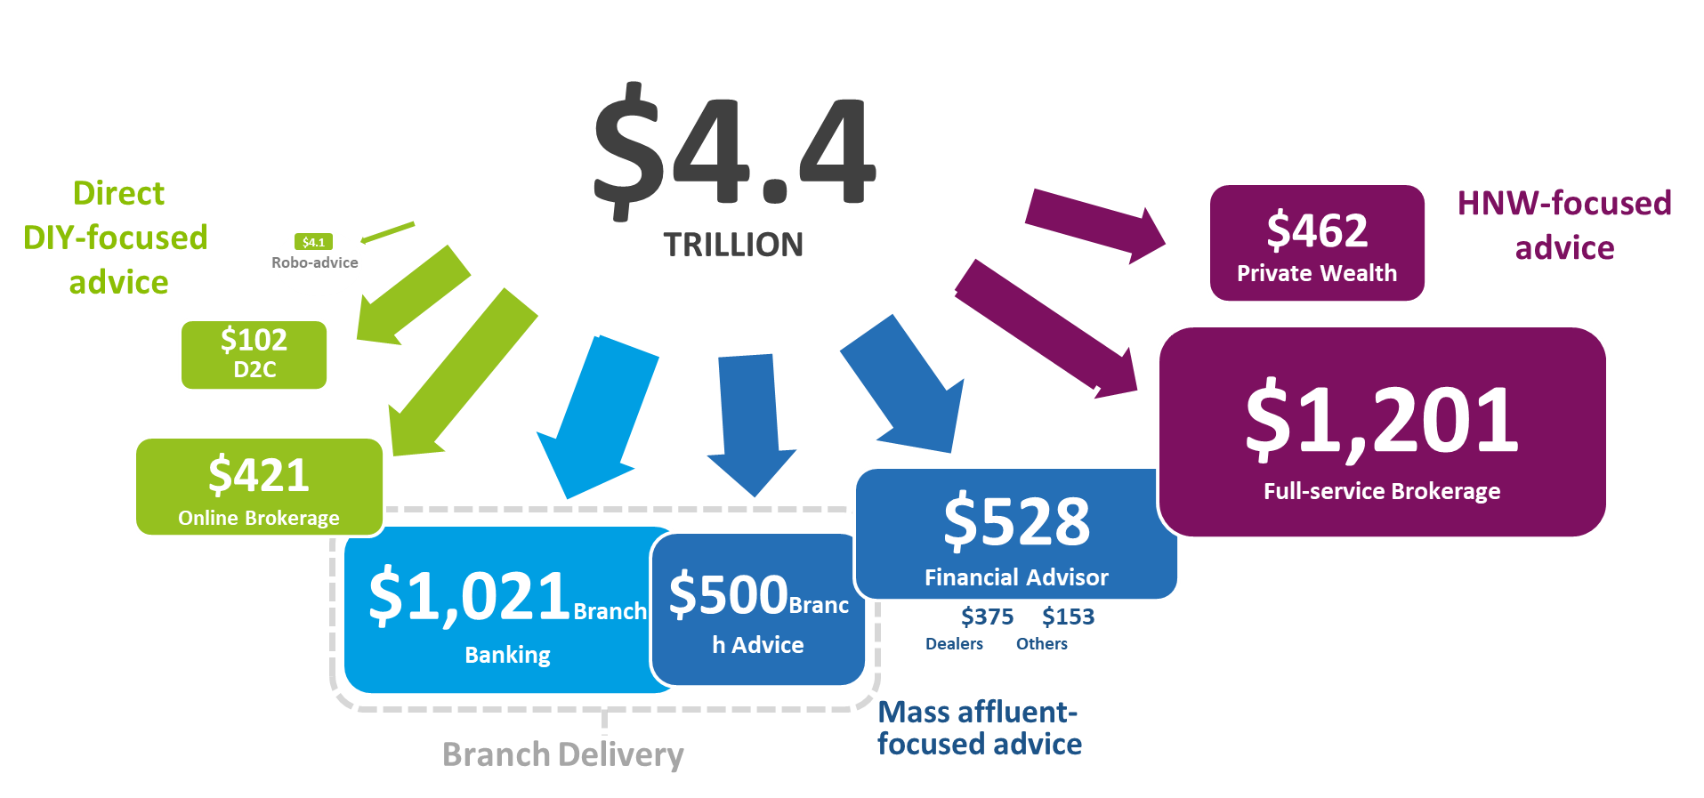
Advice Competitors Dominate Distribution Framework
Source: Strategic Insight, Assets in billions of dollars, December 2018
*Total financial wealth includes some assets not aligned to a distribution channel
Notes:
An overview of the investment service industry based on AUM, we can see that:
Full Service dominants
AUM within private wealth, financial advisors and bank advice shows there is opportunity to grow
Interesting to see the size of ROBO advice, lots of media, not lots of assets at this time

Slide 4
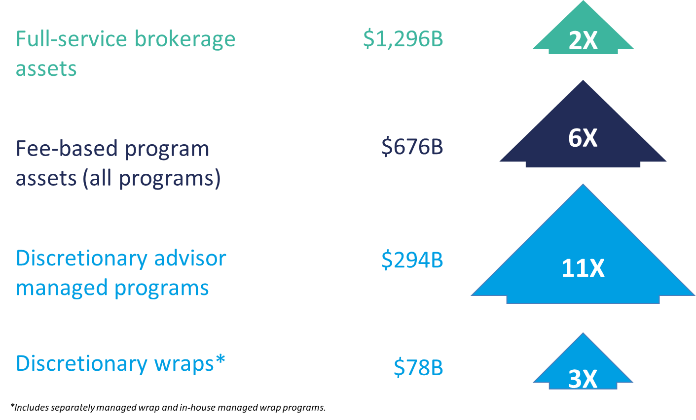
Evolving Practice Models: Fee-based Evolves
Source: Strategic Insights, March 2019 assets in billions of dollars—growth multiple over past 10 years
Notes:
Within Full service, we see that
Traditional accounts ( commission) are the slowest growing
Fee based has seen significant growth
Advisor as Portfolio Manager has seen dramatic growth
Both have helped the growth of ETFs as low cost tools for portfolio construction

Slide 5
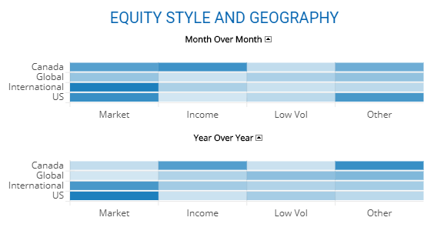
Flow of Funds – directional insights based on ETFs
Source: BMO Global Asset Management, Jan 2020
Notes:
Here is some insights on ETF industry flows directly from our ETF Dashboard (BMOETFS.ca)
Highlight some dark blue items for strong flows
Note that these flows are relative to others

Slide 6
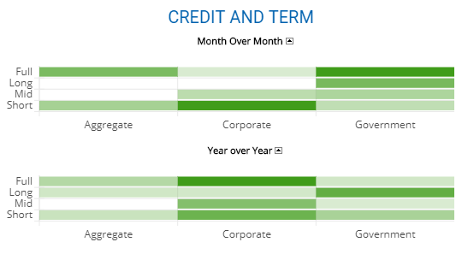
Flow of Funds – directional insights based on ETFs
Source: BMO Global Asset Management, Jan 2020
Notes:
Here is some insights on ETF industry flows directly from our ETF Dashboard (BMOETFS.ca)
Highlight some dark gree items for strong flows
Note that these flows are relative to others

Slide 7

BMO ETFs & Overall Industry
in Canadian net new assets 9 years in a row¹
#1
fixed income ETF provider in Canada based on AUM¹
Canadian smart beta ETF provider based on AUM²
#1
#1
Top 1
Canadian ETF Market
Assets $bn
BMO Global Asset Management has been a UN PRI signatory since 2006. PRI has rated BMO GAM an A+ on our active ownership for listed equity, as well as our strategy and governance.³
^{1,} Bloomberg December 2019. ^{2,} ETFGI December 2019. ³PRI 2019 Assessment Report.
Notes:
Key points:
BMO ETFs is a leader, with top growth in AUM for the past 9 years, is the top provider of Fixed Income and Smart Beta ETFs
Note that this success comes from Inst, Advisors and Direct, then thank the audience for entrusting us with their assets
The bar charts shows the annual growth of ETF industry in Canada, now over $200 billion, with BMO ETFs 30% of that
Lastly, to highlight our long term ESG efforts, we have been rated A+ in our active ownership (voting & engagement). This is across our product line at no extra cost.. We will cover this more in detail later but for now good to know no other ETF provider active in Canada has this rating

Slide 8
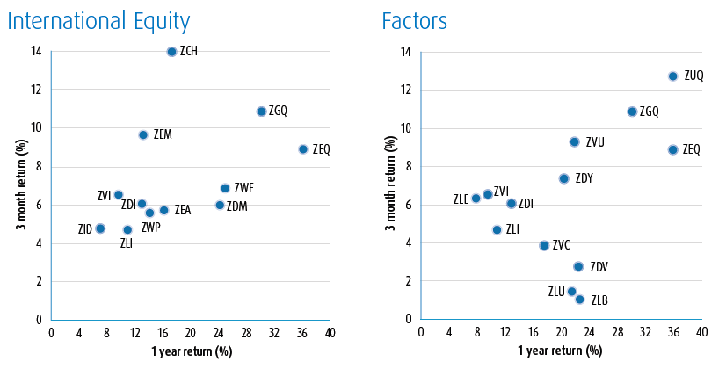
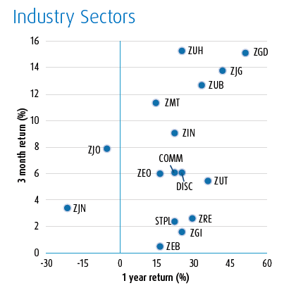
Relative Performance – directional insights based on ETFs
Note: Please refer to appendix for performance of ETFs
Notes:
Here is some more insights on ETF industry directly from our ETF Dashboard (BMOETFS.ca).
This is showing the momentum (3 months to 1 year) price movement
The ones in the top right have done well recently and over the past year
Pick a few to discuss to support a theme

Slide 9
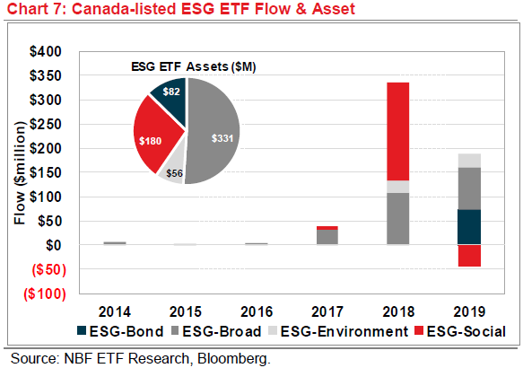
ETF Market Update
Environmental, Social and Governance (ESG) ETFs
iShares Jantzi Social Index ETF (2007) has quintupled to $178 million (from $30M) in 2 years.
In Canada, there are 30+ ESG ETFs with Total AUM of $650M.
US ESG ETF AUM doubled in 2019, growing $8.3B.
In the US, there are 80+ ESG ETFs with Total AUM of $17B.

Slide 10
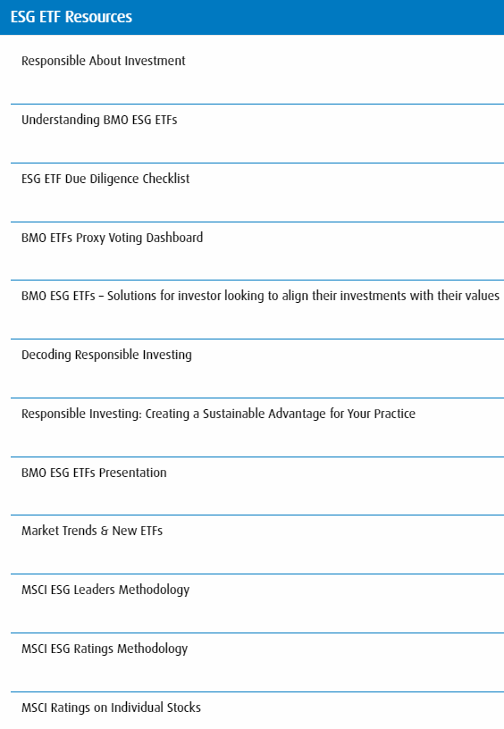
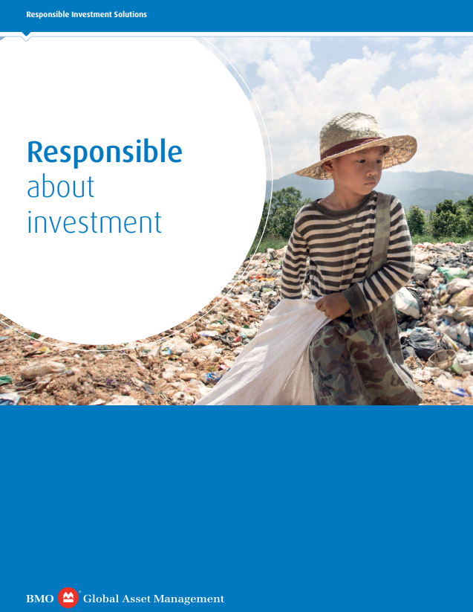
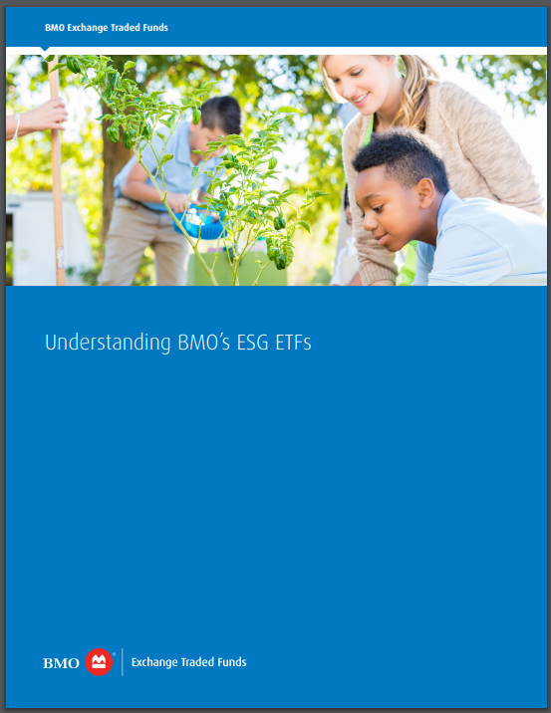
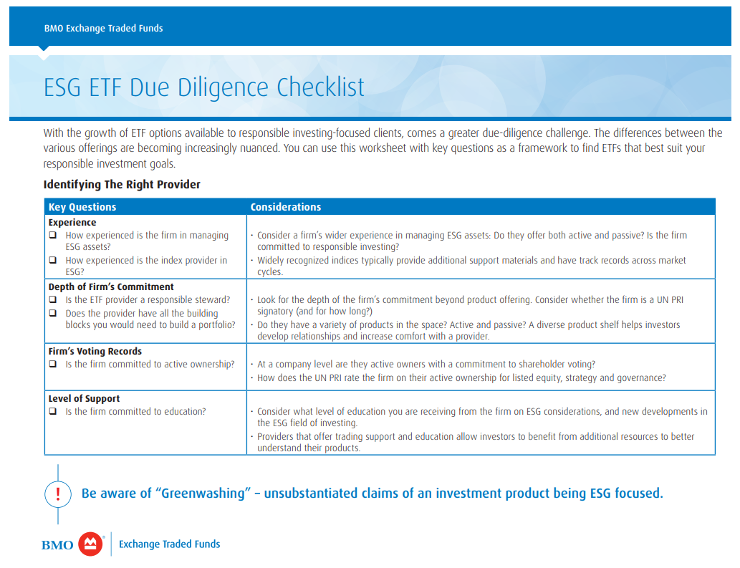
Resources to help you! www.BMOETFs.ca (reports and insights)
Notes:
To help you on your journey to learn more on ESG, here are some resources to help you in your journey… Including:
Education and product information
Due dil check list
Details on our voting records
MSCI ranking on stocks

Slide 11
Debunking common myths
Doesn’t responsible investment = ethical investment?
ESG is a
niche style of investing
Responsible
investment is a breach of my fiduciary duty
I don’t want to sacrifice returns to be a responsible investor
ESG is
a passing trend
Notes:
As ESG becomes more popular, the will be resistance to change and creation of myths along the way…
Here are some that we will deal with in this presentation

Slide 12
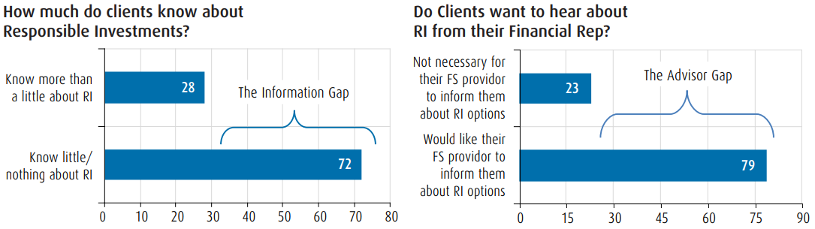
A Sustainable Advantage For Your Practice
Sources: (1) “Global perspectives on sustainable investing – Global Investment study” Schroders, 2017
- The Great Transfer of Wealth -
Approximately $ 30 billion of wealth transfer coming in the next two decades²
89% of millennials expect ESG investments from their advisor²
79% of Gen X feel sustainable investing is more important now than 5 years ago.³

Slide 13
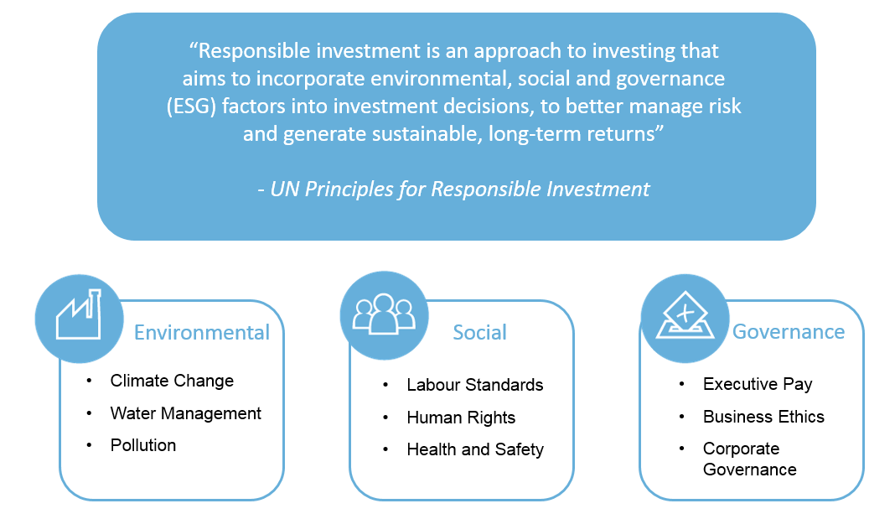
What is responsible investment?
Notes:
What is responsible investment and what is ESG? Start with a definition of RI from the main industry body.
Highlight that ESG is beyond just “environment” includes social and governance (pick some of the bullets as examples)
Note that the UN principles for responsible investment focuses on better managing risk (not avoidance) to generate sustainable and long term returns

Slide 14
Why ESG Now? - Corporate ESG Incident
Investors have become less tolerant of corporate ESG incidents
More scrutiny, and emerging ESG risk factors may impact profitability
Investors are making companies accountable for their actions.
*Source: https://www.fool.com/investing/general/2014/03/24/25-years-on-from-exxon-valdez-what-weve-learned-wh.aspx; Examples only. Past performance is not indicative of future results, which may differ materially.
Notes:
Investors have become less tolerant of corporate ESG incidents
BP – oil spill - 30 years ago, Exxon’s stock price barely moved when Exxon Valdez spilled 11mm gallons of oil on the Alaskan shore.*
Tepco – nuclear power – fukushima – containminated water leaks
Valeant – fraud, inflating drug costs, etc
Volkswagen – emissions scandal – “defeat devices” to pass tests
Equifax – massive data breach
In the era of social media we simply have to think and act differently

Slide 15
Why ESG Now? - The Rise of ESG Investing
Greater understanding of potential financial benefit
Increasing evidence that ESG data can improve risk-adjusted returns, and longer track records
“73% of Canadians believe responsible investment portfolios are the way of the future”
“81% of Canadians believe responsible investment offers the same of better returns that traditional investing”
Sustainable funds, which invest based on environmental, social or governance themes, pulled in $20.6 billion in new money in 2019
¹ RBC GAM ESG Survey Results 2020. ² Money Moving into Environmental Funds shatters previous records – CNBC Jan 14, 2020 https://www.cnbc.com/2020/01/14/esg-funds-see-record-inflows-in-2019.html
Notes:
Greater understanding of potential financial benefit – many now see ESG as a way to mitigate risk and help direct companies to do better with their capital

Slide 16
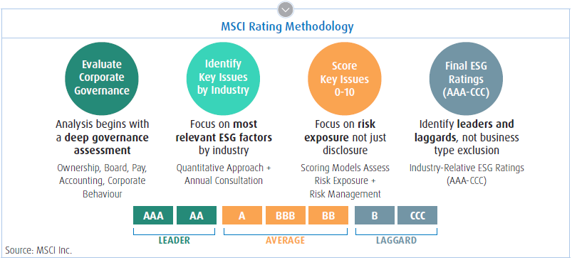
Why ESG Now? - ESG ‘Quantamentals’
Improved ESG ratings to measure what was unmeasurable
Ratings make it possible to measure what was once unmeasurable
Source: MSCI
Notes:
One of the key differences is that we now have the standardized data to allow us to move beyond beliefs to look at multiple factors across sectors and industries to truly identify those companies that are making a difference.
Here are showing MSCI’s approach to the data where they look industry specific ESG considerations then rank them with a scoring similar to ones used for bonds
Note we have a link to MSCI scoring on our BMOETFs.ca, under reports and insight, ESG section

Slide 17
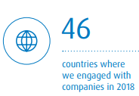
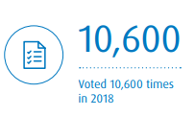
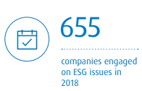
Committed to Responsible Investing – no “Greenwashing”
 | BMO Global Asset Management | BlackRock | JP Morgan Investment Management | UBS Global Asset Management | RBC Global Asset Management | CIBC Global Asset Management | TD Asset Management
UN PRI Stats
Signatory since: | 2006 | 2008 | 2007 | 2009 | 2015 | 2017 | 2008
Score for "active ownership" | A+ | "above peers" | not disclosed | A | A | not disclosed | A
Size of dedicated RI Team | 16 | 31 | 30* | 20 | 4 | not disclosed | not disclosed
US Investor Stewardship Group | "Endorser“* | "Signatory" | "Signatory" | "Endorser" | "Signatory" | Not signed | “Signatory”
Votes against management
North America | 24.5 | 4.1 | 4.6 | 12.1 | 9.4 | 6.7 | 9.8
Europe | 14.5 | 9.9 | 7.4 | 10.2 | 8.8 | 6.7 | 10.1
Rest of World | 24.7 | 8.2 | 9.7 | 12.1 | 10.6 | 8.1 | 9.6
Specific issues:
Remuneration | 48.1 | 13.4 | 12.2 | 27.2 | 22.9 | 13.1 | 17.8
Director elections | 22.6 | 3.9 | 6.7 | 9.0 | 4.6 | 3 | 6.3
Sources: PRI (2018 report), Investor Stewardship Group, Proxy Insight - % Votes against management. *cross-functional
BMO ETFs – passive holdings with active ownership
Source: Proxy Insight, PRI. * Regarding “endorser” status on the US Investor Stewardship Group, International investors with home-country governance or stewardship principles, or who have signed corporate governance or stewardship codes in other jurisdictions that may be inconsistent with the Framework, can endorse the Framework to demonstrate their support for these US-specific corporate governance and stewardship principles.
Notes:
Active ownership is engagement with, and voting on, companies.
Companies that belong to the PRI (Principles for Responsible Investment) or the RIA (Responsible Investment Association) provide public disclosure of their voting. - BMO has been a member since 2006
BMO has a record of A+ with close to 25% of votes against management and has voted 10,000+ times in just 2018
BMO is engaged with 650 + companies with ongoing engagement on ESG issues to help good companies become great
Not only do we do this with our $300 + billion in AUM but also on behalf of others inst representing an additional $200 billion

Slide 18

Firm’s Engagement in practice: Amazon.com
Amazon.com
actions
Appointed first Head
of Sustainability
Committed to net zero carbon emissions by 2040
Announced increase in US and UK minimum wage
2011
2012
2013
2014
2015
2016
2017
2018
2019
Call with VP,
Human Resources
Sold Amazon.com from ethical fund
BMO GAM
engagement
Initiated engagement
Call with Head of Sustainability
Second investor collaboration letter
Co-filed shareholder
resolution asking for enhanced sustainability reporting
Set up $2.3trn collaboration; wrote to CEO-Chair to request further dialogue
Engagement continuing
Source: BMO Global Asset Management. For illustrative purposes only. This is not a recommendation to buy or sell the mentioned security.
Notes:
Amazon an example of engagement:
We started speaking in 2011 about both environmental and labour issues. But we found we weren’t getting anywhere.
2013 we co-filed a shareholder resolution, putting a resolution on the annual general meeting agenda to ask for better ESG and climate change reporting.
2014 we got an agreement from the company to improve its reporting, pleased at the new head of sustainability role
With limited success in engagement, we spoke with other asset managers to join with us to push the company and make our voice louder. Now $2 trillion in assets represented, we got the discussion calls we were looking for to really push the case on labour management.
Response: some important announcements on minimum wages, and a net zero carbon target.
But we’re still not getting the pace of change we’d hoped for. Responsible Global Equity fund, sold Amazon, progress was just too slow and worries about ESG standards were one of main reasons behind the decision. It is also not in our ESG ETFs
We’ve not given up and we’re still continuing to engage the company as we represent our non-ESG mandates too.

Slide 19


MSCI – Our Valued Partner
MSCI is The Leading Voice in ESG:
Thought Leadership and Strong Commitment to Education
#1
40+
Top 5
Worlds largest provider of ESG indexes and research
Years of experience measuring/modeling ESG performance¹
Wealth advisory firms are using MSCI ESG
Strength of MSCI Research¹
210+ ESG Analysts
150+ sources of data
Ratings & scores on 350,000 securities
37 key issues selected annually for each industry
Voted best firm for SRI research, corporate governance research and Indexes for the
fourth consecutive year
Source: SRI connect and Extel survey – 2015, 2016, 2017
¹ MSCI Inc
Notes:
Here are showing MSCI’s approach to the data where they look industry specific ESG considerations then rank them with a scoring similar to ones used for bonds

Slide 20
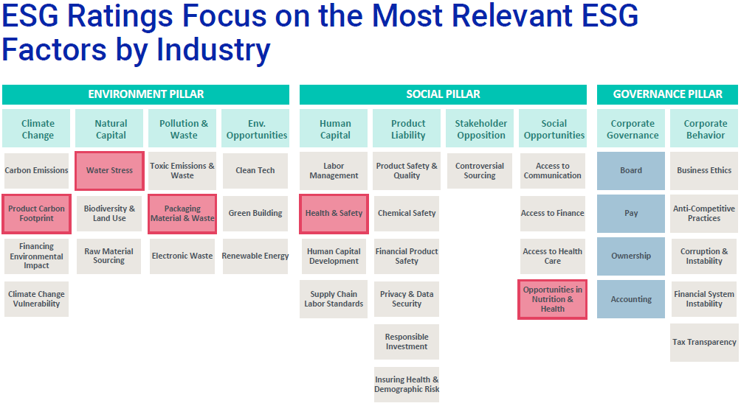
MSCI ESG Ratings
Key Issues selected annually within each GICs sub-industry.
Weights (5-30%) are set to determine a contribution to the overall ESG rating.
Soft Drink Sub-Industry: e.g. Coca-Cola
Search by company or ticker

Slide 21
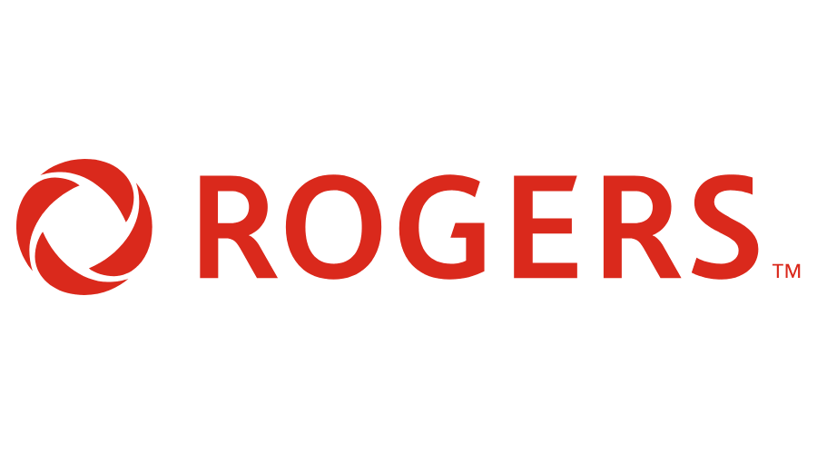







MSCI Leaders Process
Universe
Better
Best
Controversies
# removed due to controversy score and business involvement
# of securities eligible but not included due to sector relative ESG profile rankings
# removed due to low ESG rating
90
82
74
41
8
8
33
Total Constituents MSCI Canada index
Final Constituents MSCI ESG Leaders Canada index
Source: MSCI
Notes:
Our ESG ETFs focus on the leaders in the respective industry. The simple goal is that if we invest in the best, we encourage the rest to become better…
We start with 90, remove the low ESG rated, then remove companies with controversies, lastly we invest in the to 50% ESG rated companies in their respective sector.
Canadian Natural Resources: B Rated - CNRL’s oil sands operations are highly resource-intensive and expose the company to increased operating costs and potentially heavy impacts on ecosystems and communities. highly exposed to potential increased costs linked to carbon regulatory caps. CNRL’s average oil spill intensity was four times higher than the average.
Saputo: B rating - Saputo remains exposed to heightened water-related risks following its acquisition of the UK-based Dairy Crest Group and Murray Goulburn in Australia between 2018 and 2019 where water is scarce. Saputo
reported a 14% increase in its water consumption from FY 2018 to FY 2019 (19.93 vs 22.66 million m3). In addition, Saputo’s quality management measures appear to be poorly implemented as evidenced in the multiple recalls faced from 2015 to 2018.
CP Rail – BBB Rated - increase in train accidents. also continues face litigation associated with historic derailments and resulting in employee injuries/fatalities and public safety concerns.
Barrick: BBB Rated - Purported Investigation by the Serious Fraud Office over Alleged Involvement in Corruption. Barrick continues to hold interests in several controversial projects and mines such as the Pascua-Lama, North Mara, Porgera, and Pueblo Viejo mines. In May 2019, the NationalEnvironment Management Council of Tanzania imposed a USD 2.4 million penalty for alleged environmental breaches at its North Mara mine operations.
Bombardier: BB Rated - Bombardier faces high labor risks in the near-term associated with its ongoing restructuring and downsizing. This includes around 5,000 job cuts over 18 months. Further, it faces high risks of incurring fines or facing
suspension from participating in government or international contracting owing to bribery allegations related to a 2013 contract for a World Bank funded contract in Azerbaijan.
BCE: BB rated - BCE continues to lag its peers in managing labor management risks as it lacks comprehensive compensation and outplacement programs, which is exacerbated by job cuts in its Bell Media unit. Its
data protection measures are also found to be moderate compared to its peers. In January 2018, the company also experienced another data breach affecting 100,000 customers, which highlights the need
for more robust measures. Meanwhile, the company’s governance performance remains above average as its accounting and disclosure practices remain sound.
Example of companies that make it in the portfolio: Rogers & BMO
BMO – AA rated - The bank exhibits strong ESG practices by maintaining best practices in IT security, as well as green financing and impact investing initiatives. Robust cybersecurity policies, green financing initiatives. BMO assisted the Ontario government’s CAD 1 billion green bond as a joint/lead bookrunner and has also partnered with the World Bank for managing sustainable development bonds in 2018. In addition to being an Equator Principles signatory, the bank has been supporting the Task Force on Climate-related Financial Disclosure since 2017.
Rogers – AA rated - Robust labor management and data security initiatives. exhibit industry-leading practices in labor management and privacy and data security. --Despite its recent restructuring activities and operations in Canada which is historically known for laborrelated risks, Rogers has sustained its top employer status among its home market peers through its robust employee engagement initiatives and continued commitment towards diversity and inclusion in its workforce. --The company continues to implement robust data privacy and security programs, such as cyber security awareness for its employees and customers, as well as IT systems and technologies that prevent unauthorized access, monitor security risks, and mitigate potential damages caused by cyber attacks.

Slide 22
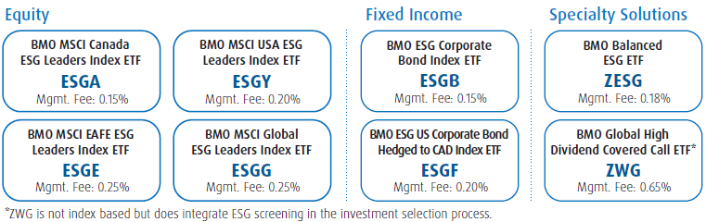

BMO ETFs - ESG
BMO Global Asset Management has been a UN PRI signatory since 2006. PRI has rated BMO GAM an A+ on our active ownership for listed equity, as well as our strategy and governance.³
Sustainalytics
*ZWG is not index based but does integrates ESG screening in the investment selection

Slide 23
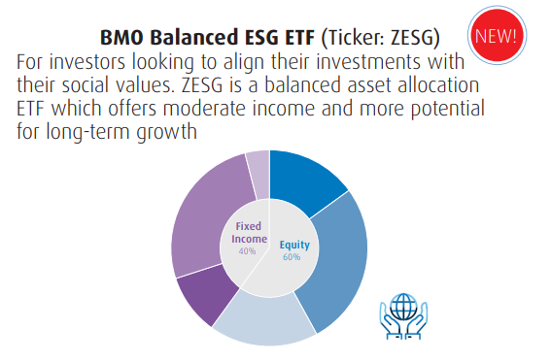
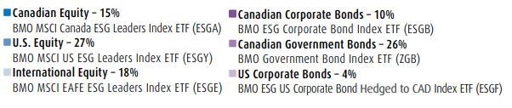
Portfolio solutions
ZESG
Mgmt Fee: 0.18%
BMO Balanced ESG ETF
First Balanced ESG ETF in Canada
Low cost all-in-one solution
Notes:
For those looking for a place to start in building a portfolio, simply start with our new ESG Asset allocation portfolio
For 18 bps cost you get a 60% equities and 40% fixed income diversified basket of ETFs. All meeting the ESG requirements for inclusion
Good for a place to start or as an all-in-one approach for RESPs and TSFAs

Slide 24

Looking for ESG income?
ZWG
Mgmt Fee: 0.65%
BMO Global High Dividend Covered Call ETF
First ESG covered call solution in Canada
Follows similar rules to our existing high dividend covered call methodologies
Targeted yield: 6.5%
Notes:
If you need income, you can add in our new ZWG ETF.
It pays a tax efficient 6.5% yield.
This uses ESG companies, that are quality dividend growers, then overlays a covered call strategy.
The holding are global to provide diversification and act as a complement to any portfolio

Slide 25
So, why not?… MSCI World ESG Leaders Index
Fundamentals
 | Div Yield (%) | P/E | P/BV
MSCI World ESG Leaders | 2.32 | 17.59 | 2.97
MSCI World | 2.32 | 17.00 | 2.57
Calendar Year Returns
Name | 2008 | 2009 | 2010 | 2011 | 2012 | 2013 | 2014 | 2015 | 2016 | 2017 | 2018 | 2019
MSCI World GR USD | -40.22 | 33.20 | 11.22 | -4.90 | 15.18 | 28.22 | 5.42 | -0.55 | 7.93 | 21.69 | -7.22 | 28.40
MSCI World ESG Leaders GR USD | -40.33 | 30.79 | 12.34 | -5.02 | 16.54 | 27.37 | 5.50 | -0.32 | 8.15 | 23.07 | -8.20 | 28.91
Risk
Name | Beta | Tracking Error | Turnover | St Dev 3 Yr | St Dev 5 Yr | St Dev 10 Yr | Sharpe 5 Yr | Sharpe Yr 10 | # of Holdings
MSCI World ESG-Leaders GR (USD) | 1 | 1.12 | 7.60 | 10.94 | 11.37 | 12.82 | 0.74 | 0.75 | 779
MSCI World GR (USD) | 1 | 0 | 2.56 | 11.28 | 11.68 | 12.99 | 0.72 | 0.75 | 1,646
Carbon Footprint
 | MSCI Canada Index | MSCI Canada ESG Leaders
Carbon Emissons (t CO2e// $M Invested) | 141 | 125
Carbon Intensity (t CO2e/ #M Sales) | 251 | 242
Source: MSCI, as of Dec 31 2019
Notes:
If you need more growth, you can add ESGG ETF
Over the long term it has performed the same as the MSCI world. (there are two lines in this graphic – that is how close)
This just show that there is no trade off for focusing on ESG.
So why not do it? In most cases, you can lower your risk by mitigating event risk while keeping the potential for upside… all for a similar cost.

Slide 26

The ESG Big Picture: Key take-aways
Demand
is growing –
and clients want
to be asked
their preferences
Need
for clarity
on responsible
investment styles
and options
Increasing
focus
on ownership
practices
Notes:
So to summarise key trends:
As responsible investing has come more into focus there has been a rush to “greenwash” – now seeing investors get smarter about differentiating between what’s real and what’s greenwash – how to spot greenwash? Ask for reporting (brandish annual review? Impact reports?) – dig under the surface, ask for tangible examples, look for any evidence the PM has actually thought about it
Diversification by asset class – mainstreaming – not just niche equity funds – ESG relevant to most investments
Greater focus on positive aspects and impact – and real demand for EVIDENCE
Also clear expectation of corporate commitment – won’t be doing this effectively if it’s one small group operating without the support of the organisation – it’s an ethos that comes from the top and permeates the organisation

Slide 27
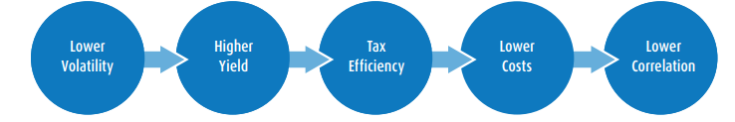

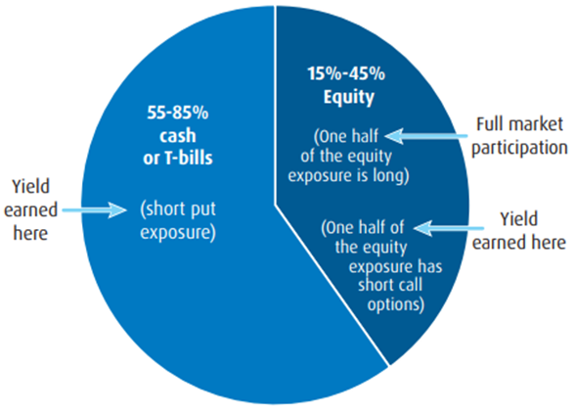
BMO Premium Yield ETF (ZPAY/ZPAY.U/ZPAY.F)
Uses option strategies on high quality US stocks to generate yield while maintaining lower risk and lower correlation to both equity and fixed income
Available in C$ hedged, unhedged, and US$
Targeted Yield 6%
Mgmt Fee 0.65%

Slide 28
  These ETFs deliver ESG exposure by following the best in class approach to the MSCI ESG Leaders Indexes.
  ² MSCI Inc Jan 2020, https://www.msci.com/documents/10199/07e7a7d3-59c3-4d0b-b0b5-029e8fd3974b
  ³ Global perspectives on sustainable investing – Global Investment study” Schroders, 2017
  ^{M/®} Trade-marks/registered trade-marks of Bank of Montreal, used under licence.
  ® "BMO (M-bar roundel symbol)" is a registered trade-mark of Bank of Montreal, used under licence.
  The information provided herein does not constitute a solicitation of an offer to buy, or an offer to sell securities nor should the information be relied upon as investment advice. Past performance is no guarantee of future results.
  Certain statements included in this material constitute forward-looking statements, including, but not limited to, those identified by the expressions "expect", "intend", "will" and similar expressions. The forward-looking statements are not historical facts but reflect BMO AM’s current expectations regarding future results or events. These forward-looking statements are subject to a number of risks and uncertainties that could cause actual results or events to differ materially from current expectations. Although BMO AM believes that the assumptions inherent in the forward-looking statements are reasonable, forward-looking statements are not guarantees of future performance and, accordingly, readers are cautioned not to place undue reliance on such statements due to the inherent uncertainty therein. BMO AM undertakes no obligation to update publicly or otherwise revise any forward-looking statement or information whether as a result of new information, future events or other such factors which affect this information, except as required by law.
  The BMO ETF or securities referred to herein are not sponsored, endorsed, sold or promoted by MSCI ESG Research, Bloomberg , or Barclays, and they bear no liability with respect to any such BMO ETFs or securities or any index on which such BMO ETFs or securities are based. The ETF's prospectus contains a more detailed description of the limited relationship MSCI ESG Research, Bloomberg , and Barclays have with the Manager and any related ETFs.
  BMO Global Asset Management is the brand name for various affiliated entities of BMO Financial Group that provide investment management, retirement, and trust and custody services. BMO Global Asset Management comprises BMO Asset Management Inc., BMO Investments Inc., BMO Asset Management Corp. and BMO’s specialized investment management firms. Certain of the products and services offered under the brand name, BMO Global Asset Management are designed specifically for various categories of investors in a number of different countries and regions and may not be available to all investors. Products and services are only offered to such investors in those countries and regions in accordance with applicable laws and regulations.
  All Rights Reserved. The information contained herein: (1) is confidential and proprietary to BMO Asset Management Inc. (“BMO AM”); (2) may not be reproduced or distributed without the prior written consent of BMO AM; and (3) has been obtained from third party sources believed to be reliable but which have not been independently verified. BMO AM and its affiliates do not accept any responsibility for any loss or damage that results from the use of this information.

Slide 29
Appendix

Slide 30
Appendix
Source: BMO Asset Management, As of Nov 1 2019

Slide 31
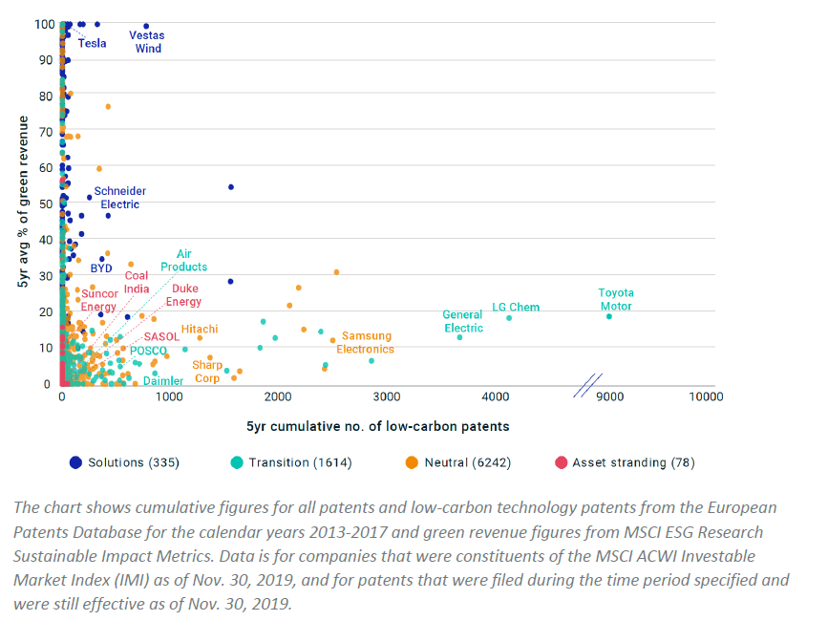
To Exclude or To Prioritize Objectives?
The companies many investors may choose to exclude hold patents which may lead the drive to renewable energy commercialization.
Exclusion is ineffective because there will be vicarious exposure through other industries or companies;
Excluding eliminates the possibility to influence from within;
Excluding eliminates the opportunity to participate in Proxy voting.

Slide 32
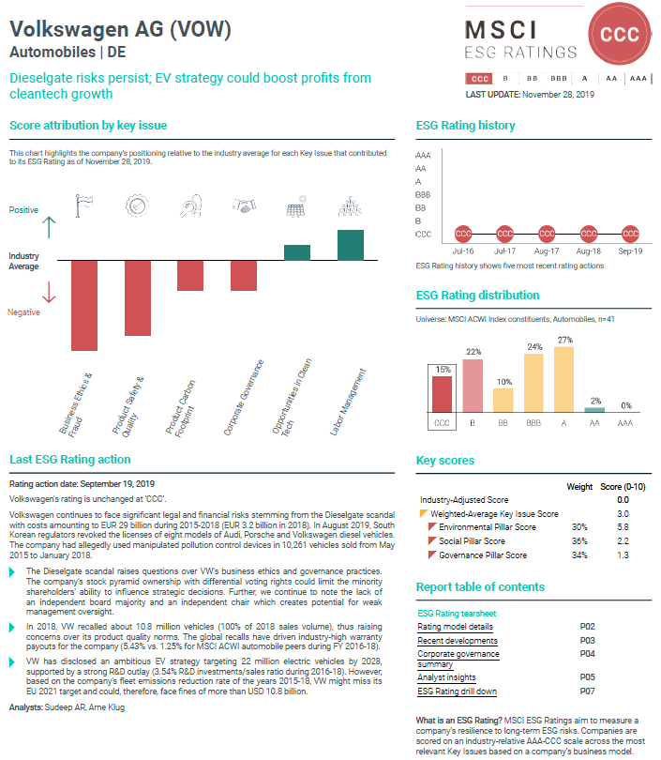
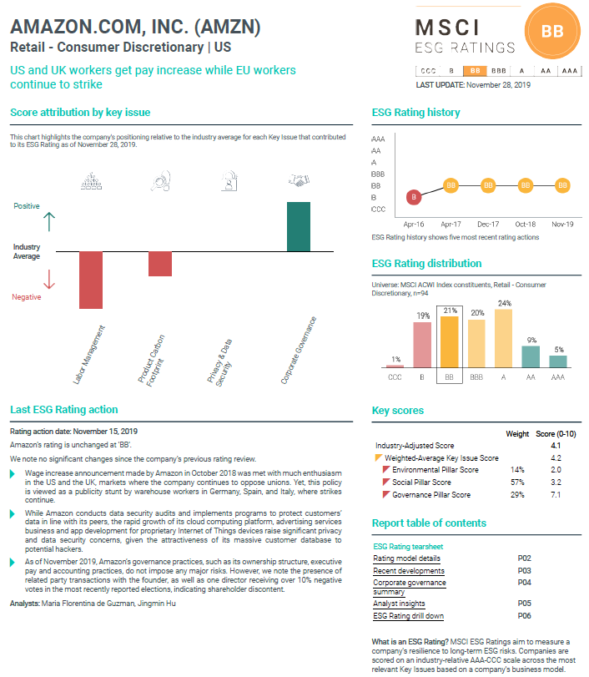
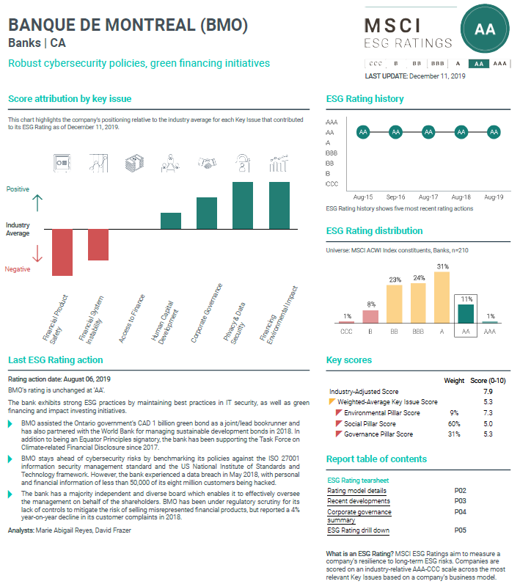
MSCI ESG Ratings

Slide 33
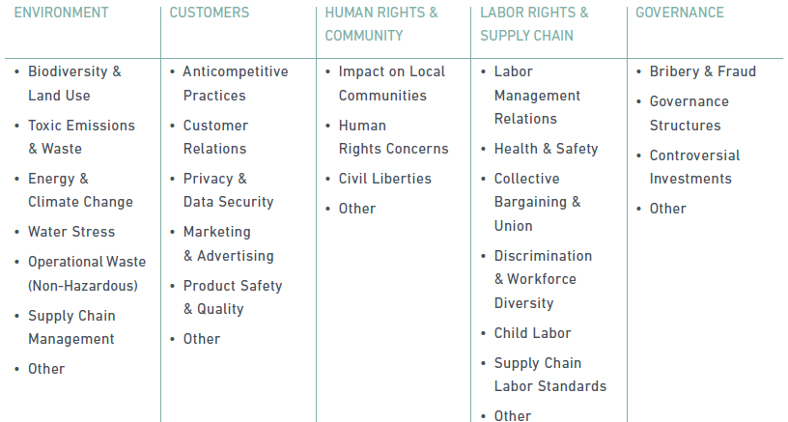
MSCI ESG Controversies Scores
Timely and consistent assessments in five categories of 28 indicators.
Consistent with norms represented by the UN Declaration of Human Rights, the ILO Declaration on Fundamental Principles and Rights at Work, and UN Global Compact.

Slide 34
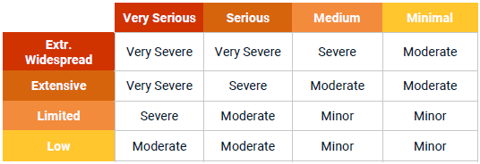
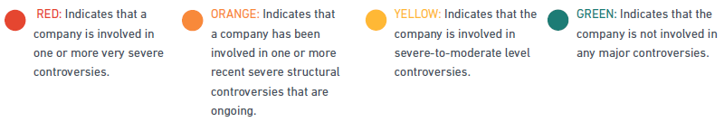
MSCI ESG Controversies Scores
Rate Controversies from “Minor” to “Very Severe” based on “Impact” and “Scale”.
Scores 0-10, with “0” being the most severe controversy.

Slide 35
MSCI ESG Leaders Index Methodology
MSCI ESG Rating (≥BB)
– MSCI ESG Controversy Score (≥3*)
– Controversial Business Involvement
Controversial Business Involvement
Exclude Alcohol, Tobacco, Gambling, Nuclear Power, Conventional and Controversial Weapons, Civilian Firearms.
* ≥1 to remain in the index

