Slide 1
Investing 101:
The Basics of Mutual Funds, ETFs & Investment Accounts
CLIENT SEMINAR
Presented by: insert fp/pb name
Date: Day, Month, Year

Slide 2
Agenda
Continuous Savings Plan (CSPs) & Dollar-Cost Averaging (DCA)
Mutual Fund Overview
04
01
Exchange Traded Funds Overview
02
Different Investment Accounts:
TFSAs, RRSPs, FHSAs
05
Different Investment Accounts
03

Slide 3
Mutual Fund Overview

Slide 4
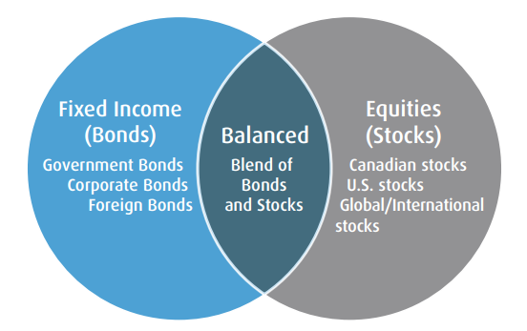
What is a Mutual Fund?
A mutual fund is a pool of investments that includes securities such as stocks or bonds and are entirely managed by a team of investment professionals.
Rather than handpicking only a few securities, mutual fund investors benefit from having a diversified portfolio.

Slide 5

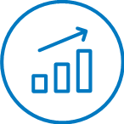



Benefits of Mutual Funds
Professional Management
Be at ease knowing your investments are in the hands of investment professionals
Low minimums to start investing
TITTLE 05
Flexibility
Diversified Portfolio
Reduce your risk by spreading investments across more securities
TITTLE 05
Broad range of investments
Invest throughout the world across sectors and asset classes
TITTLE 05
Ability to buy and sell daily
Conveniently access your money when you need it
TITTLE 05

Slide 6
Mutual Fund Assets by Type
Balanced: Invests money across asset classes, including a mix of low to medium-risk stocks and bonds.
Bond: Invests primarily in a portfolio of fixed-income securities.
Equity: Invests primarily in a portfolio of stocks.
Money Market: Invests in high-quality, short-term debt instruments, cash, and cash equivalents.
Specialty: Invests primarily in a single industry, sector, or region of the world.
Source: 2022 IFIC Investment Funds Report

Slide 7
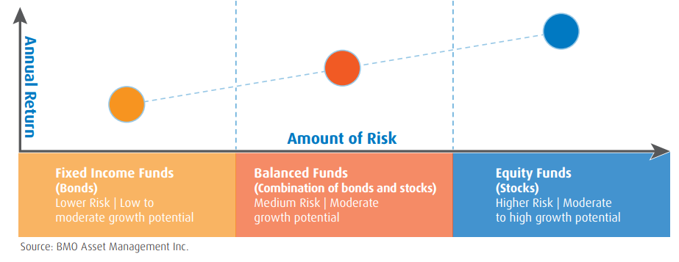
The Risk Reward Trade-off
Investing decisions involve a trade off between risk and return. Investments that have the highest return potential fluctuate more with the market in the short term and a have greater possibility of gaining value over the long term. The opposite is true for lower risk funds.
Fixed Income Funds (Bonds)
Lower Risk | Low to moderate growth potential
Balanced Funds
(Combination of bonds and stocks)
Medium Risk | Moderate growth potential

Slide 8


Things to ask yourself before investing
How long is your investment time horizon?
How long will you be invested before you need to begin withdrawing your money?
What’s your risk/return comfort level?
How comfortable are you with potential fluctuations in the portfolio?
A financial professional can help guide clients to the most appropriate Investor Profile so the right product solutions can be recommended to meet their long-term goals.

Slide 9
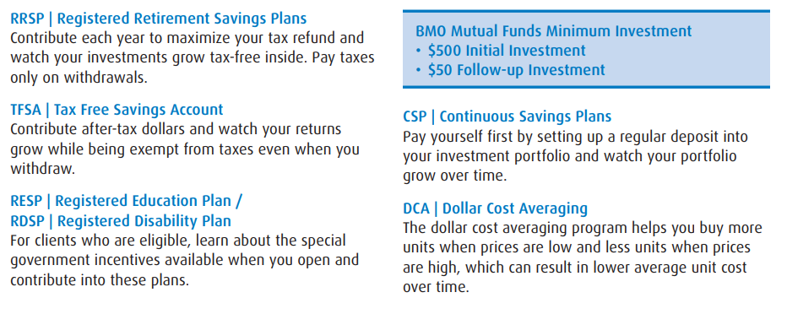
Useful information about investing in Mutual Funds
Financial planning is all about using the right tools to maximize your money.
Here are some popular investment terms

Slide 10
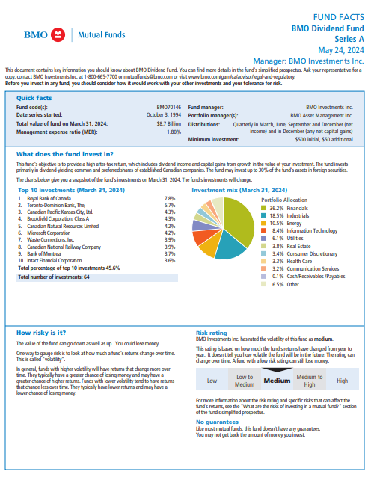
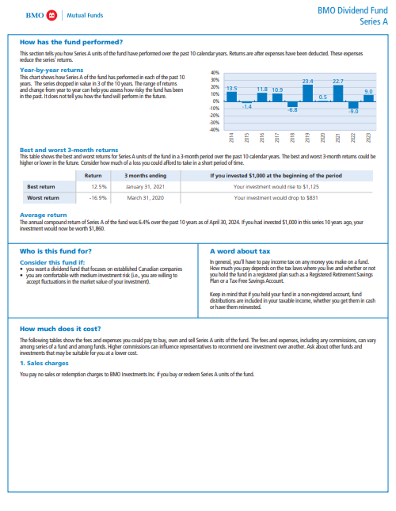
Mutual Fund - Fund Facts Overview
Fund Facts are a short, easy-to-read document designed to provide investors with key information about a mutual fund.
The document contains key information about the mutual fund, including a description of the fund and its performance, as well as the risks and costs of owning it.
Mutual fund dealers are required to deliver Fund Facts to investors prior to the purchase of a mutual fund.
All investments involve risk. The value of a Mutual Fund can go down as well as up and you could lose money. The risk of a Mutual Fund is rated based on the volatility of the Mutual Fund’s returns using the standardized risk classification methodology mandated by the Canadian Securities Administrators. Historical volatility doesn’t tell you how volatile a Mutual Fund will be in the future. A Mutual Fund with a risk rating of “low” can still lose money. For more information about the risk rating and specific risks that can affect a Mutual Fund’s returns, see the BMO Mutual Fund’s simplified prospectus.

Slide 11

Quick Summary
Diversified, cost-efficient and professionally managed
Available for all account types including your TFSA
Your money is grouped with people who have similar goals and can be invested in stocks, ETFs, bonds, cash or other mutual funds

Slide 12
Exchange Traded Funds (ETFs) Overview

Slide 13
Exchange Traded Funds (ETFs)
An Exchange Traded Fund (ETF) is an open-ended fund that is listed and traded on a stock exchange which can be bought or sold directly during trading hours, much like a stock.
The asset mix of an ETF generally aims to track the performance of an index or asset class.
There are different types of ETFs available in the marketplace and can be broadly classified into equity, bond, and commodity ETFs.
An ETF is a basket of securities which may consist of stocks, bonds, or other assets such as commodities.
Notes:
An exchange traded fund or more commonly known as an ETF is very similar in concept to a mutual fund
The main difference is that it is traded on an exchange
Just like mutual funds they allow investors to pool their money together to invest in a certain strategy or mandate
They sell on an exchange just like stocks
Holds a basket of securities similar to a mutual fund

Slide 14
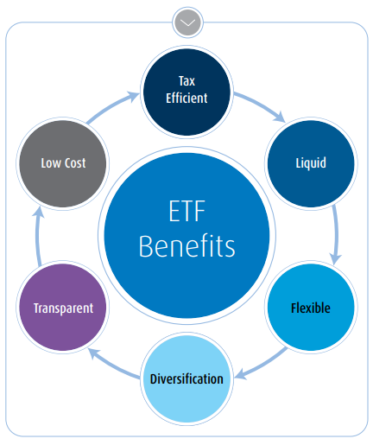
Benefits of ETFs
Lower cost – ETFs tend to charge lower management fees and expenses than many other diversified investment options.
Portfolio Transparency – An investor can view the current trading price of an ETF at any time during the course of a regular trading day.
Liquidity & Flexibility – Unlike other investments, ETFs enable investors to buy and sell at any point while the markets are open.
Diversification – ETFs aim to incorporate all, or a representative sample of the securities that make up an index, regardless of the number of securities involved.
Notes:
An exchange traded fund or more commonly known as an ETF is very similar in concept to a mutual fund
The main difference is that it is traded on an exchange
Just like mutual funds they allow investors to pool their money together to invest in a certain strategy or mandate
They sell on an exchange just like stocks
Holds a basket of securities similar to a mutual fund

Slide 15
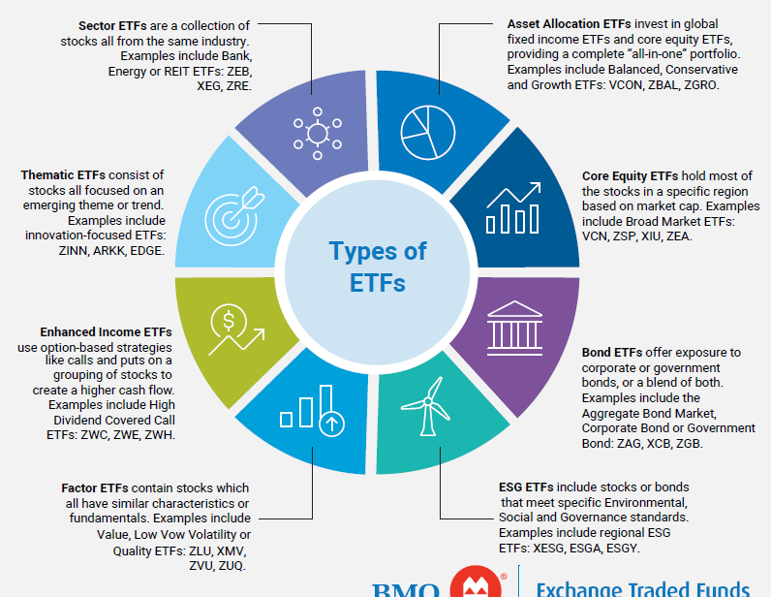
Types of ETFs
The types of ETFs can be broken down into primary categories, beginning with the main investment asset classes, then by investment style, sector, strategy or regional exposure.
For example, asset classes include stocks, bonds, commodities and currencies.
There are also ETFs that invest in multiple assets, ETFs that use alternative strategies like futures or options and ETFs with a focus on sustainability.
Source: BMO ETFs and Build Wealth Canada, For Illustrative purposes only.
Notes:
There are many different types of ETFs and here we’ll walk through a few examples.
Sector type ETFs are a collection of stocks all from the same industry. This can be an ETF that captures all of the top 6 Canadian banks, or an ETF that captures many types of energy stocks within Canada.
Core equities capture many stocks in a specific region based on their market capitalization. This can be an ETF that tracks the S&P/TSX 60 index or the S&P 500 for example.
Environmental social governance ETFs that meet very specific ESG standards or practices. These would all be captured in one ticker within a stock exchange.
Thematic ETFs that hold stocks focused on an emerging trend or theme. This can involve green energy themes, or metaverse themes for example.

Slide 16




Evaluating ETFs for your Portfolio
The Canadian ETF market has expanded significantly. With hundreds of Canadian listed ETFs currently available, it has become increasingly important for investors to understand how to evaluate ETFs.
Choose Your Exposure
Choose How the Portfolio is Weighted
First, review the merits of diversification available through a wider exposure ETF against the precise targeting allowed by an industry ETF. For example, an investor looking to invest in Canadian banks could use broad market equity ETFs, dividend ETFs, financial sector ETFs, or a bank specific ETF.
While ETFs may target the same market segment or industry, they could use a different weighting scheme such as market capitalization, equal weighting, or factor weighting. The appropriate choice may differ across asset classes or through the preferences of specific investors.
Choose How to Access the Exposure
Choose a Trusted Provider
The majority of Canadian ETFs attain exposure by holding physical securities. A subset of ETFs use total return swaps to get market exposure. These ETFs receive the return of an index from a financial institution. An investor should analyze the added counterparty risk and additional fees against the advantages offered through the swap.
It is important to look at the track record, the product shelf, the ability to recognize investment trends, the capability to initiate industry development and the financial soundness of a provider. As the industry matures, ETF closures may occur, putting greater importance on using established providers.

Slide 17
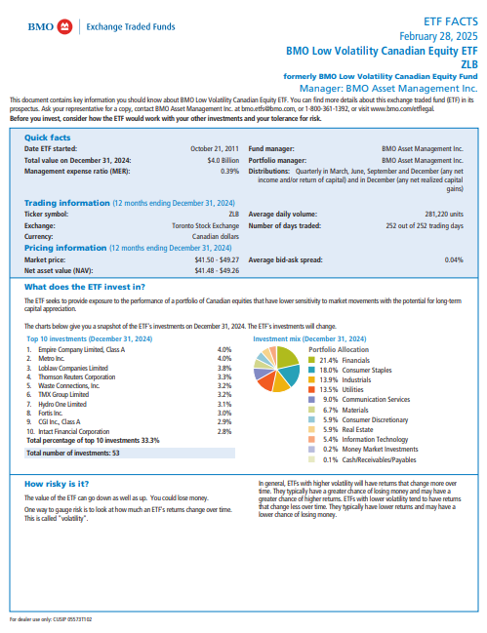
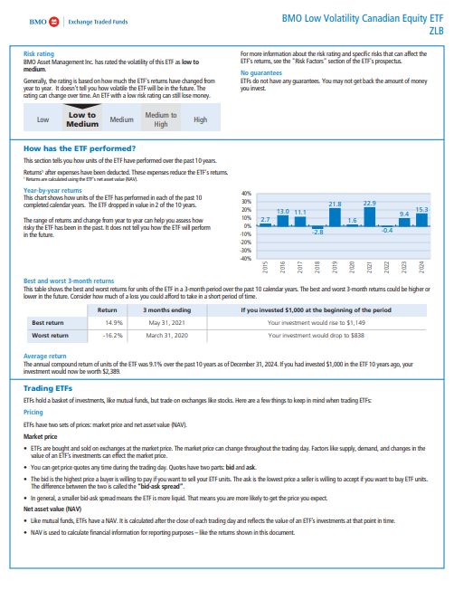
ETF - Fund Facts Overview
A fund fact is an easy-to-read document that outlines key information about the investment product.
It's designed to help investors make informed investment decisions by including information about the fund's holdings, risk, performance, costs, etc.
Each time a new Canadian-based ETF is purchased in either a self-directed or BMO account, you’ll receive your ETF's fund fact.
All investments involve risk. The value of an ETF can go down as well as up and you could lose money. The risk of an ETF is rated based on the volatility of the ETF’s returns using the standardized risk classification methodology mandated by the Canadian Securities Administrators. Historical volatility doesn’t tell you how volatile an ETF will be in the future. An ETF with a risk rating of “low” can still lose money. For more information about the risk rating and specific risks that can affect an ETF’s returns, see the BMO ETFs’ simplified prospectus.

Slide 18
Quick Summary
Diversification, liquidity, and flexible trading
Cost efficient from lower management fees
Wide selection of exposures with complete portfolio transparency

Slide 19
Continuous Savings Plan (CSP) & Dollar-Cost Averaging (DCA)

Slide 20

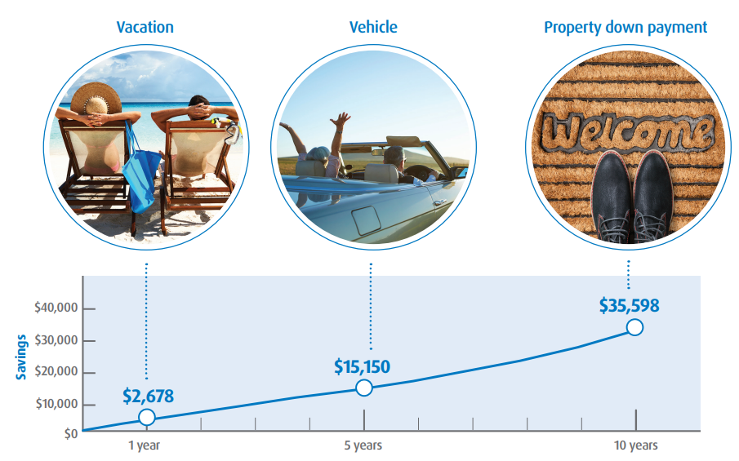
Continuous Savings Plan (CSPs)
See how quickly your savings grow when you invest regularly.
It can be hard to find the money to make large, lump sum investments during the year. Consider the benefits of making automatic, monthly contributions to your investment account with a BMO Continuous Savings Plan (CSP). Smaller amounts on a regular basis can make a big difference over the long term.
"For illustrative purposes only"
The examples provided above are for illustrative purposes only and are not, and should not be construed as, investment advice to any individual. Investments should be evaluated relative to each individual’s investment objectives and professional advice should be obtained with respect to any circumstance. The examples provided above assume that payments are made at the end of each month and a nominal annual rate of return of 6% compounded monthly. BMO Mutual Funds are offered by BMO Investments Inc., a financial services firm and a separate legal entity from Bank of Montreal. Commissions, trailing commissions, management fees and expenses all may be associated with mutual fund investments. Please read the fund facts or prospectus before investing. Mutual funds are not guaranteed, their values change frequently and past performance may not be repeated. ® “BMO (m-bar roundel symbol)” is a registered trade-mark of Bank of Montreal, used under licence.

Slide 21
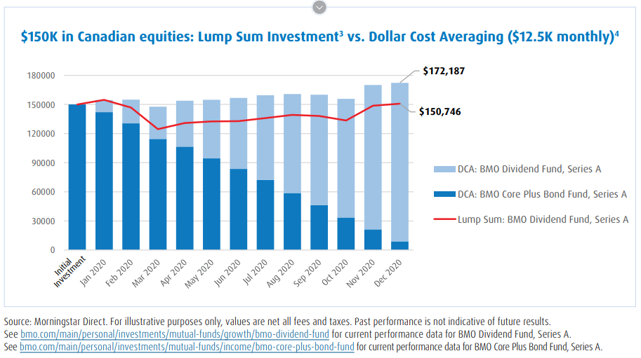
Dollar-Cost Averaging (DCA)
With dollar cost averaging, you buy more units of mutual funds when prices are low and fewer when prices are high. Over time, this can reduce your average cost per unit.
The chart illustrates the impact to an initial investment of $150,000 dollars from December 2019 to December 2020 in the BMO Dividend Fund Series A. It is not intended to reflect future returns on investments in the BMO Dividend Fund Series A. Historical Performance: 2.17 YTD; 12.35 1YR; 5.22 3YR; 11.86 5YR; 7.08 10YR; 9.62 Since inception. As of March 31st 2025
The chart illustrates the impact to an initial investment of $150,000 dollars from December 2019 to December 2020 in the BMO Core Plus Bond Fund Series A. It is not intended to reflect future returns on investments in the BMO Core Plus Bond Fund Series A. Historical Performance: 1.61 YTD; 6.77 1YR; 1.70 3YR; 0.02 5YR; 0.87 10YR; 1.34 Since inception. As of March 31st 2025

Slide 22
Quick Summary and Main Differences: CSPs & DCA
 | CSP Program | DCA Program
Minimum Investment | As little as $50 a week | Initial investment of $5,000 Minimum transfer amount to any one BMO Fund each time is $50
How it works | During market dips, your CSP contributions will buy more shares As the market goes up over time, those shares increase in value | You can arrange for transfer to a maximum of five other Funds of your choice Each Fund must be of the same currency and load Frequency options range from weekly to annually
Benefits | Helps keep you focused on long-term goals. Helps you avoid market timing and emotional investment decisions

Slide 23
Tax-Free Savings Account (TFSA)

Slide 24

What is a Tax-Free Savings Account (TFSA)?
Tax-free savings accounts (TFSAs) are so much more than a savings account. Your savings grow tax-free and can hold various investment types, making TFSAs a great option to help you reach all of your savings and investing goals.
Invest in your TFSA up to the annual limit and watch it grow, tax-free
You can fill your TFSA with various investments, such as stocks, bonds, ETFs, mutual funds and Guaranteed Investment Certificates (GICs)
Tax-free savings accounts allow you to make withdrawals, without penalty, whenever you’d like
WHO CAN OPEN A TFSA?
Anyone 18 years of age or older
Canadian Resident with a valid social insurance number (SIN)

Slide 25
How to make the most out of your TFSA
1.
2.
3.
4.
Make sure you have the right investments
Make sure the investments you hold in a TFSA align with your risk profile and investment horizon. Saving for retirement? Stocks, ETFs and mutual funds are great choices.
Max out contributions
Know your limits and invest within them. This year, the limit for your TFSA is $7,000. The maximum you can contribute to your TFSA, if you haven’t already funded it, is $102,000.
Save early and often
The key to growing your TFSA is to take advantage of it as soon as possible. The earlier you start contributing to your TFSA, the more time your money can grow tax-free. For easy savings, check out our Continuous Savings Plan.
Take advantage of our savings account rates
On top of everything else a TFSA can do for you, here’s another great reason to save: Special rates and offers to help you make real financial progress right from the start. It’s easy to get started today.
Risk Profile - Comprised of a client’s risk tolerance (i.e. client’s willingness to accept risk) and risk capacity (i.e. a client’s ability to endure potential financial loss).

Slide 26

Quick Summary
Review contribution limits to TFSA before contributing
TFSA is a flexible option for students earning tax-free growth
Continuous Savings Plans make regular investment contributions easy
Diversification is an important and powerful strategy to use when building your investment portfolio

Slide 27
Registered Retirement Savings Plan (RRSP)

Slide 28

What is a Registered Retirement Savings Plan (RRSPs)?
Registered Retirement Savings Plans (RRSPs) are accounts specifically designed to help Canadians invest for retirement. See how investing with BMO can help you achieve your retirement dreams.
Invest in your RRSP up to the annual limit and watch it grow, tax-free
Fill it with a mix of investments, like, stocks, mutual funds and savings accounts
Get a tax break on any income you invest in your RRSP

Slide 29
How to make the most of your RRSP
Here are a few ways to make sure your RRSP is working hard for you.
1.
2.
3.
4.
Start planning early
The secret to RRSP growth is to take advantage of it as soon as possible. The earlier you start contributing to your RRSP with a Continuous Savings Plan, the more time your money has to grow tax-free.
Max out contributions
We know that life happens and it’s not always easy to put a ton away for retirement. But making small, regular contributions can help you get closer to hitting that limit each year. Did you know? You can maximize your RRSP contribution with an RRSP loan. Learn more.
Make up for missed contributions
If you fell short of your maximum contribution, it’s not too late. The room you have left will roll over into next year, so you have another shot at saving as much as you can.
Take advantage of our savings account rates
On top of everything else an RRSP can do for you, here’s another great reason to start: Great rates and offers to help you make real financial progress right from the start. It’s easy to get started today!

Slide 30
Quick Summary
More growth, faster returns
With an RRSP, you won’t pay tax on any growth on investments while it’s in your account. That’s a big deal, because it can help you achieve your goals faster.
The right investment mix
You can mix things up by holding various investment types in an RRSP, including stocks, bonds, GICs, ETFs and mutual funds. That means you can create a custom portfolio to help you reach your goals.
Save on taxes
Get a tax deduction when you contribute to your RRSP -- any money you put in your RRSP will be subtracted from your income, so you’ll pay less in taxes.
Reach your retirement goals faster
Discover how to achieve your retirement dreams with our simple RRSP CALCULATOR.

Slide 31
First Home Savings Account (FHSA)

Slide 32

What is a First Home Savings Account (FHSA)?
A First Home Savings Account is a registered savings account that gives Canadians a tax advantageous way to save for the down payment on their first home.
It can hold various investment types to help you grow your money tax-free.
It is available for Canadians who are 18+ and haven’t owned a home or lived in a home owned by their spouse or common-law partner in the current calendar year and previous four calendar years.
An FHSA can remain open for 15 years or until the end of the year in which you turn 71, whichever event happens first.
Eligible Canadians can make a tax-free withdrawal at any time for a single property purchase.

Slide 33
Quick Summary
Save for your first home
With a $40,000 lifetime contribution limit over a maximum span of 15 years and a tax-free withdrawal for a single property purchase, the FHSA was designed to provide first-time homebuyers with a savings account geared towards buying a home. You can carry forward unused contribution room for as long as you have the account.
A flexible account
With a FHSA, you won’t pay tax on any growth on investments while it’s in your account and you have the flexibility to transfer your FHSA funds to an RRSP or RRIF.
The right investment mix
You can grow your FHSA with a mix of BMO Guaranteed Investment Certificates (GICs), and BMO Mutual Funds. Customize your portfolio to suit your risk tolerance and investing horizon. Get started by setting up a Continuous Savings Plan (CSP) and paying yourself first to take advantage of compound savings growth.
Your first home is closer than you think
The FHSA is a versatile account that provides you with numerous tax benefits. You can also use your FHSA contributions alongside your RRSP Home Buyers’ Plan (HBP) for the same qualifying home purchase.

Slide 34



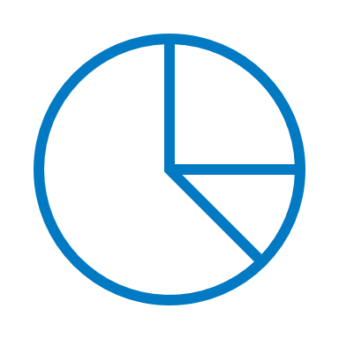
What can I hold in my TFSA, RRSP, and FHSA accounts?
Stocks
A single security that represents ownership in one company
Cash
Liquid cash
Bonds
A bond is a fixed-income instrument and investment product where individuals lend money to a government or company at a certain interest rate for an amount of time.
Exchange Traded Funds (ETFs)
A basket of securities designed to offer exposure to a certain segment(s) of the market; most ETFs track an index – aligned to a specific goal
Mutual Funds
A portfolio that pools together money from many investors to purchase a collection of stocks, bonds, or other securities – aligned to a specific goal
Guaranteed Investment
Certificate (GIC)
Safe, secure investment that protects the principal investment, no matter what happens within the market
Disclaimer: Some specific investments may not be registered plan eligible within these broad categories.

Slide 35
Have Questions? Or want to start investing today?
Mon to Fri – 8:30am to 5:00pm EST
Mutual Funds
Call: 1-800-668-7327
Fax: 1-800-200-2497
clientservices.mutualfunds@bmo.com
Exchange Traded Funds
Call: 1-800-361-1392
Fax: 1-866-486-2846
bmo.etfs@bmo.com

Slide 36
Disclaimer
Commissions, trailing commissions (if applicable), management fees and expenses all may be associated with mutual fund investments. Please read the fund facts or prospectus of the relevant mutual fund before investing. Mutual funds are not guaranteed, their values change frequently and past performance may not be repeated. Distributions are not guaranteed and are subject to change and/or elimination.
Investment Professionals include Financial Planners who are representatives of both Bank of Montreal and BMO Investments Inc. ("BMO II"), a financial services firm and separate legal entity from Bank of Montreal. Financial Planners provide financial planning, investment & retirement planning services – including mutual funds investing advice – through BMO II. Ask us to learn more about the services BMO II does and doesn’t provide – click here to learn how it gets paid.
This presentation is for information purposes only. The information contained herein is not, and should not be construed as investment, tax or legal advice to any party. Particular investments and/or trading strategies should be evaluated and professional advice should be obtained with respect to any circumstance.
The viewpoints expressed by the presenters represents their assessment of the markets at the time of publication. Those views are subject to change without notice at any time. The information provided herein does not constitute a solicitation of an offer to buy, or an offer to sell securities nor should the information be relied upon as investment advice. Past performance is no guarantee of future results. This communication is intended for informational purposes only.
Any statement that necessarily depends on future events may be a forward-looking statement. Forward-looking statements are not guarantees of performance. They involve risks, uncertainties and assumptions. Although such statements are based on assumptions that are believed to be reasonable, there can be no assurance that actual results will not differ materially from expectations. Investors are cautioned not to rely unduly on any forward-looking statements. In connection with any forward-looking statements, investors should carefully consider the areas of risk described in the most recent simplified prospectus.
The portfolio holdings are subject to change without notice and only represent a small percentage of portfolio holdings. They are not recommendations to buy or sell any particular security.
Past Performance is not indicative of future results.
Commissions, management fees and expenses (if applicable) all may be associated with investments in mutual funds and ETFs. Trailing commissions may be associated with investments in certain series of securities of mutual funds. Please read the ETF facts, fund facts or simplified prospectus of the relevant mutual fund or ETF before investing. The indicated rates of return are the historical annual compounded total returns including changes in share or unit value and reinvestment of all dividends or distributions and do not take into account sales, redemption, distribution or optional charges or income taxes payable by any securityholder that would have reduced returns. Mutual funds and ETFs are not guaranteed, their values change frequently and past performance may not be repeated.
For a summary of the risks of an investment in BMO Mutual Funds or BMO ETFs, please see the specific risks set out in the simplified prospectus of the relevant mutual fund or ETF . BMO ETFs trade like stocks, fluctuate in market value and may trade at a discount to their net asset value, which may increase the risk of loss. Distributions are not guaranteed and are subject to change and/or elimination.
BMO Mutual Funds are offered by BMO Investments Inc., a financial services firm and separate entity from Bank of Montreal. BMO ETFs are managed and administered by BMO Asset Management Inc., an investment fund manager and portfolio manager and separate legal entity from Bank of Montreal.
BMO Global Asset Management is a brand name under which BMO Asset Management Inc. and BMO Investments Inc. operate.
“BMO (M-bar roundel symbol)” is a registered trademark of Bank of Montreal, used under licence.

Slide 37
Definitions
Total Return Swap = A total return swap is a swap agreement in which one party makes payments based on a set rate, either fixed or variable, while the other party makes payments based on the return of an underlying asset, which includes both the income it generates and any capital gains.
Market capitalization ("market cap") = is the total value of a company's outstanding shares, used by investors to gauge its size rather than relying on sales or asset value.
Equal Weighting = a type of proportional measuring method that gives the same importance to each stock in a portfolio, index, or index fund. So stocks of the smallest companies are given equal statistical significance, or weight, to the largest companies when it comes to evaluating the overall group's performance.
Factor Weighting = is an investment strategy that involves choosing securities based on attributes that are associated with higher returns. This type of investing aims to reduce risk that may otherwise be hidden in a portfolio of securities with similar exposure.

