Slide 1
怎样避免 6大投资陷阱
插入演讲人姓名
Notes:
[DO] Welcome attendees and thank them for joining you today.
[SAY] For the next 30 minutes, we are going to look at the top investing mistakes most of us make and how you can avoid them.

Slide 2
说明
在这里插入您的专业头像
根据以下指引在这里插入您的个人信息：
大家好，我是 [插入姓名]；
您的角色是什么以及您能带来 什么价值
个人化一些
人性化一些
展示“您是来提供帮助的”
Notes:
Personal Reflection Slide – Speaking Points are on Slide:
Purpose: To build rapport; sharing something personal about the presenter beyond the professional bio; helps resonate with various members of the audience as they may also relate in some elements.
SAY: We all lead different lives with different priorities and we all have multiple roles. I’d like to share my story with you and then I will ask a few of you to volunteer your story.

Slide 3
投资的陷阱
认清这些错误 与风险，对帮助你实现目标大有裨益。
Notes:
[SAY] So, we’re here to talk about the biggest pitfalls that people fall into when they invest their money. Whether you’re a seasoned investor or just looking at your options, recognizing these mistakes and hazards can go a long way to helping you reach your goals, whatever you’re saving for: early retirement, a new home, your kids’ education, your small business, or something else.
Why don’t we start out with a little activity. How many of you would say you’re fairly seasoned investors – you’ve been around the block a few times, you’ve been investing a while. Maybe we’ll never see you speaking on BNN, but you have a pretty good sense of how the markets work? [Attendees put up hands]
And how many of you are maybe a bit newer, or at least not quite as savvy when it comes to equities and fixed income, indices and ETFs, carburetors and transmissions? OK, maybe not those last two – but how many of you are maybe less knowledgeable about investing? [Attendees put up hands]
I think it would be interesting to see how each group

Slide 4
投资的陷阱
?
你们认为6大投资陷阱是什么？
Notes:
[Take suggestions from the 2 groups, to see what they think are the biggest investing pitfalls]
I’d like to hear what each group thinks are the biggest investing pitfalls. It will be interesting to see how the answers differ and see how many of your answers match what we’ll be talking about tonight.

Slide 5
讨论题目
游戏——不投资的理由
6大投资陷阱
BMO互惠基金的故事
问答环节
Notes:
Read agenda items on the slide.

Slide 6
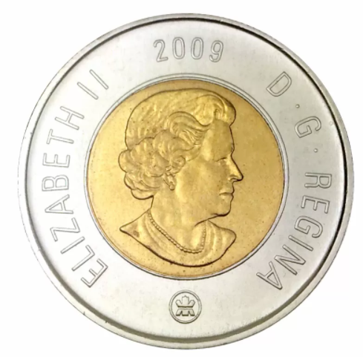
游戏
您从口袋中拿出一枚硬币。
还记得铸造这枚硬币 这年发生过什么新闻吗？
Notes:
[SAY] Let’s start things off with a little game.
[DO] Ask an audience member to pull out a coin and tell you the year on it.
[ASK] Who remembers what was in the news that year?
[DO] Referring to the chart on the next slide, say what happened in that year which kept some people out of the market
[DO] Repeat the above: Ask for another coin, and share what happened that year, referring to the chart on the next slide.

Slide 7
您始终可以找到一个不投资的理由
年 | 标普500 | 标题 | 年 | 标普500 | 标题
1950 | 17.05 | 朝鲜战争（韩战） | 2000 | 1,394.46 | 电脑千年虫后续影响 │ 科技泡沫
1952 | 24.14 | 杜鲁门总统接管炼钢厂 | 2001 | 1,366.01 | 经济衰退19/11
1954 | 26.08 | 美军–麦卡钖共产党员听证会 | 2002 | 1,130.20 | 公司会计丑闻
1956 | 43.82 | 苏伊士运河危机 | 2003 | 855.70 | 布什总统向伊拉克宣战
1958 | 41.70 | 艾森豪威尔衰退 | 2004 | 1,131.13 | 美国出现巨额贸易和预算赤字
1960 | 55.61 | 苏联击落美国侦察飞机 | 2005 | 1,181.27 | 油气价格创纪录
1962 | 68.84 | 19621年闪电崩盘 │ 古巴导弹危机 | 2006 | 1,280.08 | 房地产泡沫破裂
1964 | 77.04 | 北越 │ 东京湾事件 | 2007 | 1,438.24 | 次贷危机
1966 | 92.88 | 越南战争升级 | 2008 | 1,378.55 | 银行业和信贷危机
1968 | 92.24 | 美国普韦布洛号军舰被扣 | 2009 | 825.88 | 就业衰退 │"信贷紧缩"
1970 | 85.02 | 冲突蔓延至柬埔寨 | 2010 | 1,073.87 | 主权债务危机
1972 | 103.94 | 美国历史上最大的贸易赤字 | 2011 | 1,286.12 | 欧元区危机
1974 | 96.57 | 40年来市场最大的跌幅 | 2012 | 1,312.41 | 美国财政悬崖
1976 | 100.86 | 经济从73-74年的危机中复苏 | 2013 | 1,498.11 | 美联储开始缩减量化宽松
1978 | 89.25 | 利率不断上升 | 2014 | 1,782.59 | 埃博拉疫情爆发
1980 | 114.16 | 债券收益率达到历史峰值（10年 = 15%*） | 2015 | 2,130.82 | 商品出现抛售
1982 | 120.4 | 40年来最严重的衰退 | 债务危机 | 2016 | 2,190.15 | 英国脱欧
1984 | 163.41 | 美国联邦赤字创历史高位 | 2017 | 2,673.61 | 油价下挫
1986 | 211.78 | 市场达到高点 │英国“金融大爆炸”冲击波 | 2018 | 2,506.85 | 股市出现抛售
1988 | 257.07 | 黑色星期一后担心衰退 | 2019 | 3,230.78 | 美中贸易战
1990 | 329.08 | 海湾战争 │ 16年来最严重的市场衰退 | 2020 | 3,269.96 | 新冠疫情全球大流行
1992 | 408.78 | 美国大选 │ 市场呆滞 | 2021 | 4,766.18 | 新冠疫情地方性流行 | 供应链危机
1994 | 481.61 | 主权债务抛售 │ 利率不断上升 | 2022 | 3,585.62 | 俄乌战争 | 通胀创纪录
1996 | 636.02 | “非理性繁荣”——格林斯潘 | 2023 | 4,769.83 | “七大科技股”主宰股市
1998 | 980.28 | 亚洲／俄罗斯危机 │ LCTM 公司破产 | 2024 | 5,881.63 | 以色列／哈马斯战争
资料来源：BMO资产管理有限公司，2024 年 12 月 31 日。上述历史以标普500价格指数的年终收盘值显示。
Notes:
[SAY]
This chart just shows that there is always a reason not to invest. There is always some economic uncertainty, political instability, or other wild card that will keep some people out of the markets. But what I hope today’s presentation will show you is that when you take steps to avoid the biggest investing pitfalls, you can have confidence that you’re on the right track to realize your financial goals – a comfortable retirement, money to travel or cover your kids’ education, a cottage to enjoy summer weekend getaways – whatever you’re saving for, even when the markets seem a bit unwelcoming.

Slide 8
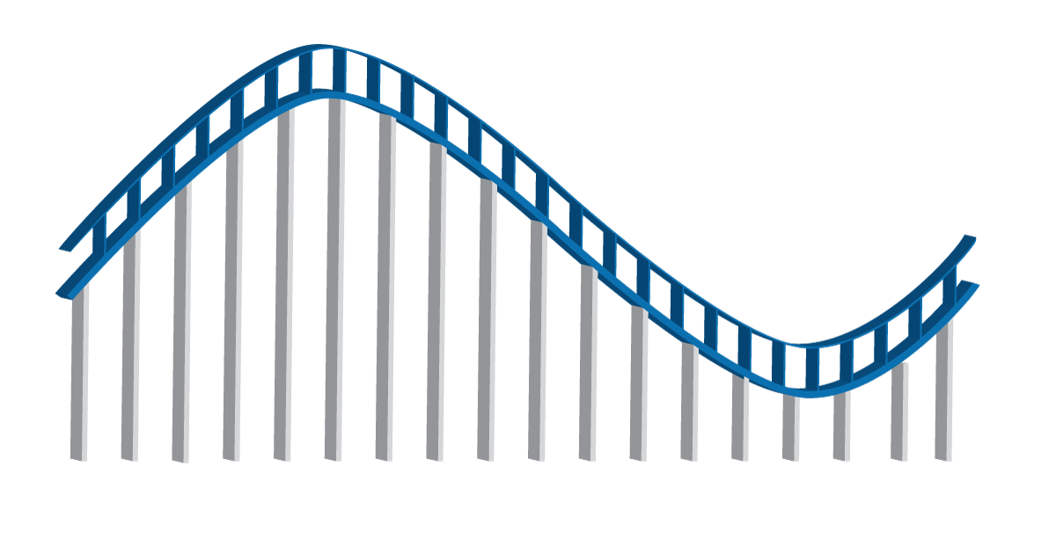
陷阱 #6：基于情绪的投资
6
焦虑
欣快
否认
大部分人 在这个点卖出
激动
恐惧
兴奋
绝望
乐观
恐慌
投降
乐观
大部分人 在这个点投资
泄气
宽慰
沮丧
希望
最大的 机会点
情绪过山车能导致您做出坏的投资选择——请勿坐上去。
Notes:
[SAY]
So let’s introduce investing mistake #6: Emotional investing.
Have you ever fallen in love with an investment?
This sounds like an odd question, but the truth is that investing can sometimes feel a lot like new love. You’re full of hope and excitement about your new relationship, and you feel that thrill when things advance to the next level, as your investment keeps reaching higher highs. When this happens, you’re in the stages on the far left on our chart – optimism, excitement, euphoria.
Maybe after a little while you notice some things that you want to change, but it’s not a deal-breaker for you – yet. You rationalize it and explain it away when the investment has some missteps. You’re in this for the long-haul, and you believe that they’ll change. Poor performance, hints of financial trouble, some deals that don’t work out - now we’re scratching the anxiety and denial part of our chart.
[SAY]
It can be very hard to know what to do when you’re on that ride. Some investments do end up having great long-term performance, but many don’t. What if you’ve invested both your emotions and your money into an investment that doesn’t perform how you had hoped, in spite of all the chances you’ve given it? Is it time to break up? Now you’re moving quickly to the bottom of the chart – fear, panic, depression. Should you cut your losses and sell?
Maybe. But be careful not to decide based on your emotions.
[SAY]
Any time you make an investment decision – to buy, sell, or keep holding, there should always be a strong reason. You may not always make the right decision, but the chances are you’ll make better decisions than investors who are on the emotional roller coaster and decide based on feelings instead of facts.
The first step to avoid the roller coaster is to be aware that it exists. This way you can catch yourself when your emotional investment is as big as your financial investment.

Slide 9
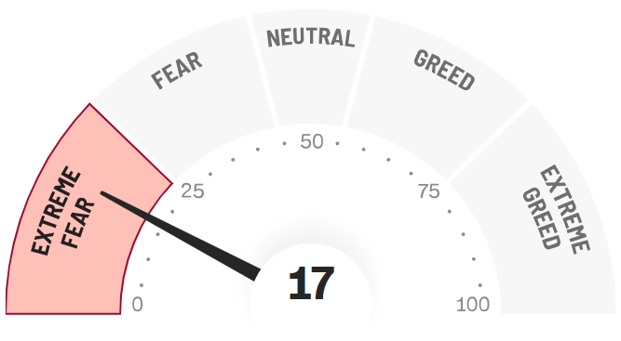
陷阱 #6：基于情绪的投资
6
CNN恐惧与贪婪指数
中性
现在：恐惧
17
恐惧
贪婪
极度恐惧
极度贪婪
极度恐惧
极度贪婪
请勿让贪婪或恐惧控制您的投资决定。
资料来源：CNN
Notes:
[SAY] What we’ve just talked about is what an individual investor feels. But what if a large number of people are feeling the same thing at the same time about the same investment? This can happen too. It’s like when you tell all your friends about the amazing person you’ve just met – well, in this case, thousands of people are talking about the same person. And there’s going to be a lot of disappointment if those hopes weren’t built on something solid.
Remember, stock markets can be volatile, especially over the short term, and prices can sometimes move in ways that don’t reflect what they’re worth.
When headlines in the papers and business analysts on TV are touting some stock that is supposed to outperform the market, it’s easy to get caught up in the hype – even when the facts don’t support it.
If someone you know has also gotten on board with that hot investment that’s the talk of Wall Street at the moment, this can be a powerful one-two combo that’s hard to dodge. Maybe its your colleague, your in-law, your golf partner – this immediately gives it an aura of credibility. Just as we’re more likely to trust someone that our friends trust, we’re more likely to trust an investment if someone we know, and respect also trusts it. Your friends may be good judges of character – after all, they’re friends with you! – but this probably doesn’t carry over to knowing what investments are right for you.
Your financial decisions are just too important to base on second-hand hopes and assurances. There has to be something more before you place down your money.
[ASK] Does anyone remember any tech companies that imploded when the tech bubble popped? (Some answers: 1)The Learning Company (Creator of Where in the World is Carmen Sandiego? Acquired by Mattel for $3.6 billion in 1999, and sold for one tenth that price a year later 2) Pets.com, online pet supply retailer, shares went from $14 to under $1 before the company folded in 2000 3) Etoys, online toy retailer , went from $86 to 9 cents per share and shut down in 2001 (although it actually came back to life later under new ownership).
[SAY]
In reality, many of the new internet businesses were run poorly with no real long-term strategy, and it was inevitable that this bubble would pop spectacularly, which happened in 2000-2001, when companies with sky-high stock prices a few short years before filed for bankruptcy.
It works the other way as well. Sometimes, investors rush to sell off their shares of a company that has good management and products, healthy finances and a strong market. When this happens, it will push the company’s share price down over the short-term, and many investors will interpret this as confirmation that the company really is a loser, even if the facts don’t support this. If you follow the crowd, you may end up selling a good investment for a lower price than it’s really worth.
CNN has an interesting tool called the “Fear and Greed Index” on their website [Action: CLICK ON GRAPHIC TO OPEN HYPERLINK], which reports the sentiment of the market in real time, and shows just how quickly it can shift – going from extreme greed to extreme fear, often with little warning. [Action: LEAVE CNN PAGE AND RETURN TO POWERPOINT]
It may make sense for you to buy or sell, or maybe not – just make sure you have a strong reason in either case. Don’t let fear or greed control your investment decisions
The lesson is clear: Following your heart might be a good idea for your love life, but it’s rarely a good idea for your investments.
That’s why even the pros use models or even AI to help take the emotion out of investing – after all, we’re all human – and portfolio managers use special models and processes that help them stay true to what their investors are counting on them to do – invest according to the fund’s mandate, and not let their own emotions drive their decisions.

Slide 10
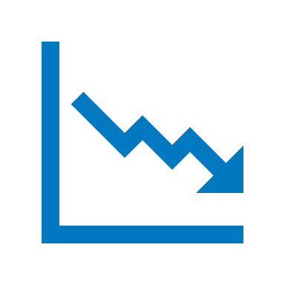
陷阱 #6：基于情绪的投资
6
如果拾到$100，您会有多快乐？
如果掉失$100，您会有多沮丧？
研究显示，同样的价值，我们害怕损失的反应，大过获得相同价值的反应两倍。这实在不合理，但这正影响我们怎样投资。
记着要从正确的角度看事情的好坏。
Notes:
[SAY] Before we move onto the next pitfall, let’s finish with a little thought experiment to show how our emotions affect the way we look at money and investing:
Imagine that you’re walking down the street, and you find a nice, crisp $100 bill right in front of you on the sidewalk Nobody’s around, and you have no way to know who it belongs to. It’s yours now. How would you feel? Pretty good, right? Has this ever happened to you? Solicit reactions from audience.
Now, imagine that you get home and the bills gone. You must have somehow dropped it outside, unbelievable! How would you feel? Would you say, “Easy come, easy go”? Or would it bother you a bit more than that? Solicit reactions from audience.
Research shows that people tend to fear a given loss twice as much as they value an equivalent gain. This means that in our thought experiment, for a lot of people, losing the $100 is enough to ruin their whole day. But this doesn’t make sense, does it? After all, you just wound up back at zero, right? Getting upset about this makes as much sense as getting upset that you didn’t find $100 today.
But even though this doesn’t make sense, this is how a lot of people think about their investments. They feel the losses more than the gains. Now, I’m not talking about losses they can’t afford – I’m talking about the normal ups and downs that always happen with any investment. A lot of people feel the loss a lot more than the gains, and they end up selling at times that don’t necessarily make sense for their overall goals. Which leads us nicely to our next mistake…

Slide 11
陷阱 #5：投资过于保守
5
5
您认为长期投资者面临的最大风险是什么？
短期的市场波动？
通胀？税款？利率？
最大的风险是不能达成投资目标！
不应害怕风险。相反，应当管理风险。
波动率：衡量证券、衍生工具或指数的价格波动幅度。
Notes:
[ASK] So what do you think is the biggest risk for long-term investors? (Solicit answers). Is it short-term volatility? Inflation? Taxes? Interest rates
[SAY]
The risk for long-term investors is not hitting their investment goals.
This leads us right to our next mistake: investing too conservatively.
This is a basic principle of investing: the higher the risk, the higher the return you may earn. The lower the risk, the lower the return will likely be on your investment. There is no free lunch for investors – although you’re welcome to our snacks right there (pointing at snacks)! Virtually any investment has some risk. The trade-off for that risk is the chance to earn a higher return on your investment.
When you’re building your portfolio, the key is to find the sweet spot, where you have the best chance of reaching your goals without taking on too much risk for your own circumstances. This sweet spot will be different for every person in this room.
If you invest too conservatively, you may run the risk of falling short of what you’re saving for: a comfortable retirement, money for the kids’ education, money to buy a cottage – whatever your goals are. On the other hand, you don’t want to bet the farm and lose more than you can afford, especially if you’re in the later stages of your career with less time to recoup any losses on your investments.
The lesson is this: Risk isn’t something to be avoided in your portfolio. Instead, risk should be managed – according to your own situation.

Slide 12
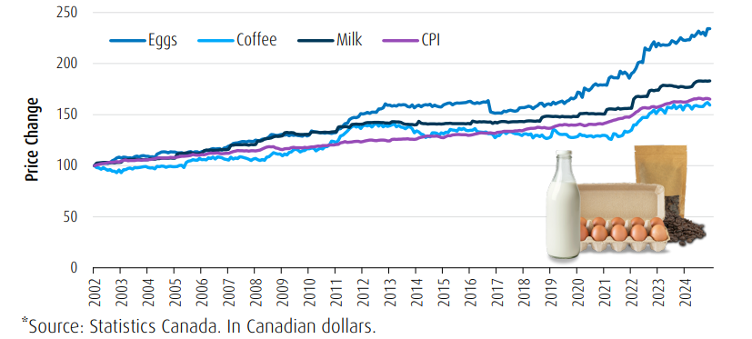
陷阱 #5：投资过于保守
5
鸡蛋
咖啡
牛奶
消费物价指数
价格变动
*资料来源：加拿大统计局（Statistics Canada）。以加元计算
这个图表显示了加拿大一年中购买一打鸡蛋、 一升半脱脂牛奶和一条面包的总平均成本。
若要跟得上生活成本的上升，并最终得享财务稳建的退休生活， 您需要确保您的储蓄增长率高于通胀率。
资料来源：加拿大统计局（Statistics Canada）。BMO环球资产管理。 上述成本显示一公升牛奶、一打鸡蛋和一条面包的总成本。
Notes:
[SAY]
Let me ask you a question: How much do you think a cup of coffee at Tim Horton’s cost in 1964? (Take guesses from audience).
In 1964, a cup of coffee at Tim Horton’s cost just 10 cents. Today it is $2.29 - that’s a huge increase! This shows how much inflation can threaten the value of your portfolio. If your portfolio is too conservative, there’s a real risk that it won’t even keep pace with inflation, let alone outperform the market and give you the higher returns you’re looking for.
1964 was a long time ago. But if you think that inflation isn’t a threat over the shorter term, think again. Have a look at this chart:
In the 10-year period from 2008 through 2018, we see a 18% increase in the average cost of groceries. That’s a big increase. What you bought at the grocery store for $100 in 2008 cost you $118 by the end of 2018. Maybe you don’t really notice it when bread goes up 10 cents, or milk goes up 15 cents. It doesn’t seem like a lot, but make no mistake, inflation really adds up over time.
And it doesn’t just affect things you buy every day like food or clothing. It is also one of the biggest threats to the real value of your portfolio, especially if cash, GIC’s or bonds make up a large part of it.
Who here likes GICs? Don’t get me wrong – it may make sense for you to hold some of your money in GICs. But if too much is in GICs, it’s unlikely that you’ll see the growth you need, especially after inflation eats away at your returns.
[SAY]
Remember, it isn’t enough for your investments to grow. They need to grow at a higher rate than inflation. Otherwise, you’re not getting any richer. And even beating inflation probably isn’t enough – you need to beat it by enough for your returns after inflation and taxes to meet your goals. So inflation is just one hurdle to get over.

Slide 13
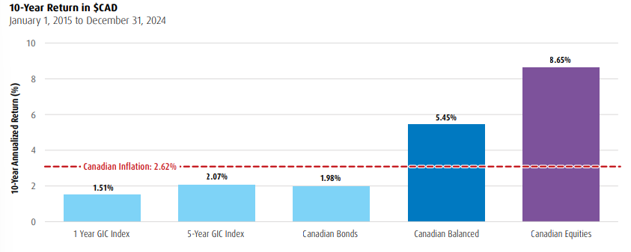
陷阱 #5：过于保守地投资
5
5
5
10年期回报率（加元）
2015年1月1日至2024年12月31日
8.65%
5.45%
10年的年化回报率（%）
加拿大通胀： 2.62%
2.07%
1.98%
1.51%
1年期GIC指数
5年期GIC指数
加拿大债券
加拿大平衡
加拿大股票
您知道吗？
通胀对我们的日常生活有很大的影响。Tim Hortons咖啡店的一杯咖啡在1964年只要10分。现在，相同的一杯咖啡要花$2.07。*
资料来源：Tim Hortons，2025年2月
资料来源：Morningstar，截至2024年12月31日。过往表现并不代表未来回报。加拿大股票以标普／多伦多综合总回报指数表示；加拿大债券以富时加拿大 债券指数表示。加拿大平衡基金以各占50%比例的加拿大债券和加拿大股票表示（每月重新平衡）。1年期和5年期GIC指数，以主要金融机构发布的GIC利率的加权平均数表示。BMO 环球资产管理（BMO Global Asset Management）为品牌名称，旗下包括 BMO 资产管理有限公司（BMO Asset Management Inc.） 及 BMO 投资有限公司（BMO Investments Inc.）。“BMO（M-条形圆盘标志）”是蒙特利尔银行的注册商标，获授权使用。
Notes:
[SAY]
So what can you do to protect your capital from inflation? The key is to make sure that your portfolio holds enough in equity-based investments, like mutual funds that invest in stocks. Over the long term, equities have proven to be an effective way to help insulate your portfolio from inflation.
Looking back to rolling 10-year time periods, equities have proven to significantly outperform both 1-year and 5-year GICs. This means that if you’re looking to grow your wealth with an investment time horizon of more than 10 years, long-term equity investments are your most effective option. Long-term investment in equities is the best way for you to maximize upside potential and reach your financial goals.
[ASK]
Does anyone know what an index is? The first person to answer wins a free Dow Jones! (Let attendees share answers)
[SAY]
Basically, an index is a grouping of a certain type of investments like stocks or bonds that is used to measure how that type of security is performing in general. For example, the S&P 500 index contains the stocks of 500 of the biggest American companies, and it gives an idea of how the stocks of large American companies are performing in general.
So moving on, what do we see? Inflation averaged 1.59% per year during this time. The 1-year GIC Index trailed inflation, at 0.93%, so clearly 1-year GIC’s weren’t the way to go in terms of beating inflation. The 5-year GIC index beat inflation, but just barely, with a 1.65% average return. Canadian bonds and Canadian balanced (a mix of bonds and stocks) beat inflation handily, but the real star of this show is Canadian equities, which returned close to 5.2% per year.
Cash, GICs and bonds may play other important roles in your portfolio, but equities are key to help protect your portfolio from inflation.

Slide 14
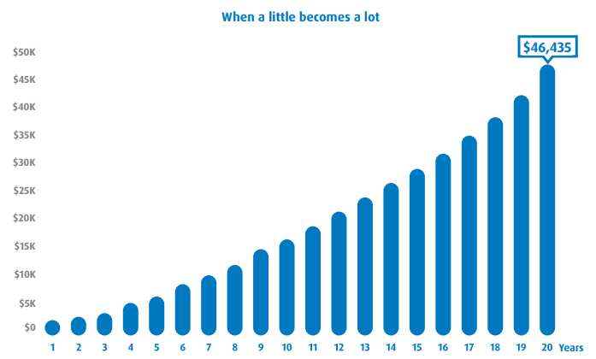
陷阱 #4：低估复利的力量
4
积少成多
若您在20年的时间里每月投资$100，且年度复利回报率为6%，则您最终将获得$46,435！注册退休储蓄计划（RRSP）、免税储蓄账户（TFSA）和注册教育储蓄计划（RESP）是几类常见的税务优化工具，可有效助力财富保值。
$50K
$45K
$40K
$35K
$30K
$25K
$20K
$15K
$10K
$5K
$0
$46,435
年数
"只作举例之用"
投资不仅是关于有多少资金；而是关于您有多少投资时间。
资料来源：情境假设某投资者在20年的时间里每月投资$100，年度复利回报率为6%。https://www.bmo.com/en-us/main/personal/calculators/
Notes:
Compounding is one of the most effective ways for investors to increase their wealth over time. Compounding is the reinvestment of earnings back into the initial investment, meaning you can earn income on top of income. By making regular contributions you can enjoy the long term benefit of compounding. The longer you stay invested, the longer your money works for you and the more your wealth can grow!
Making use of RRSPs, TFSAs, and perhaps spousal RRSPs, RESPs, and RDSPs can help your money grow further by protecting your assets from the taxman. All of these can help you build and protect your wealth.
Let’s quickly look at some of the main ways that these plans can help.
Contributions to your RRSP reduce the taxable income you have to report when you do your taxes. This is an immediate benefit, and one of the main reasons why it makes sense to maximize your contributions each year – something most Canadians don’t do. Once your money is in your RRSP, it is free to grow and compound tax-sheltered, as long as it stays in your RRSP. Since RRSPs are about saving for retirement, you will probably be in a lower tax bracket once you do start to take money from your RRSP, which means that you’ll probably pay less taxes. It just makes sense – reduce your taxable income today, grow your money without the burden of taxes, and then take it out when you’re in a lower tax bracket.
TFSAs are another great option available to Canadians. You can contribute up to $6,000 this year, and you may be able to contribute as much as $63,500 this year if you’ve never contributed before. While your TFSA contributions aren’t tax-deductible like RRSP contributions, you will never be taxed on your TFSA. Tax-free growth on $6,000 can really add up over the years. Plus, unlike RRSP’s, there is no maximum age, so a TFSA can help you build your wealth for the rest of your life.
Have a look at this chart. It shows just how powerful TFSAs can be – a difference of more than $100 thousand from investing $6,000 annually for 25 years, assuming an 6% annual return, when compared with a non-registered account with earnings taxed annually at 40%.
RESPs are also a great way for you to save for a loved one’s post-secondary education, which I’m sure you know can be very expensive. A 4-year university degree often costs upwards of $60,000, and this cost is expected to keep growing. An RESP can help you tackle high tuition costs by providing valuable grants and bonds to eligible beneficiaries: Including up to $7,200 per beneficiary for the CESG grant, up to $2,000 Canada Learning Bond per beneficiary, plus other grants or bonds that may be available.
An RESP can go a long way toward making post-secondary affordable.

Slide 15
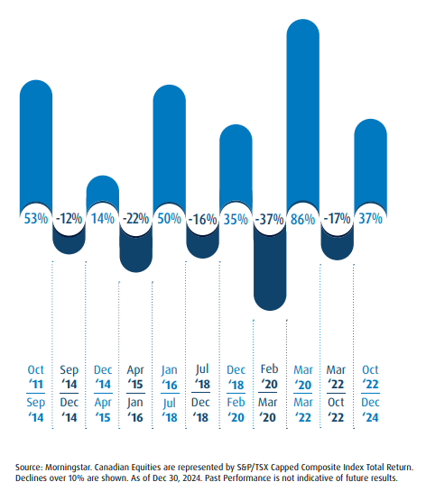
陷阱 #3：没有坚持投资
3
持续长期投资， 可受惠于升市。
日常的波动和股市噪音会让您作出反应，并有可能错过股市机会。这跟判断市场 时机无关，而是留在市场，长期定会获得回报。
53%
-12%
14%
-22%
50%
-16%
35%
-37%
86%
-17%
37%
10月
11年
9月
14年
12月
14年
4月
15年
1月
16年
7月
18年
12月
18年
2月
20年
3月
20年
3月
22年
10月
22年
9月
14年
12月
14年
4月
15年
1月
16年
7月
18年
12月
18年
2月
20年
3月
20年
3月
22年
10月
22年
12月
24年
资料来源：晨星加拿大股票以标普/多伦多上限综合总回报指数表示。
显示超过10%的下跌。截至2024年12月30日。过往表现并不代表未来回报。
Notes:
[SAY]
Our next mistake is Not staying invested.
At any moment, you can find a dozen reasons not to stay invested, or not to invest in the first place. In just the last 30 years of so, we’ve seen crisis after crisis: the Black Monday stock market crash in 1987, wars and terrorism, the subprime mortgage crisis and credit crunch in 2007-8, and the trade disputes and political discord making headlines in many countries today, to name a few.
As we talked about for emotional investing, the stock market can be volatile, especially over the short-term. These day-to-day fluctuations and noise in the market can be scary and cause you to miss out on opportunities.
However, over the longer term historically, stock market returns have tended to be a lot more attractive, with a bias to the upside, meaning that those investors who kept a diversified portfolio were generously rewarded over the long term.
Have a look at this graph: it shows that Canadian equities have significantly recovered after taking falls, while also beating inflation and 5 year GICs. In fact, during the time this chart covers, Canadian equities would have given you over 10 times the return on your initial investment, even with all of the short-term turmoil that took place during that time period.

Slide 16
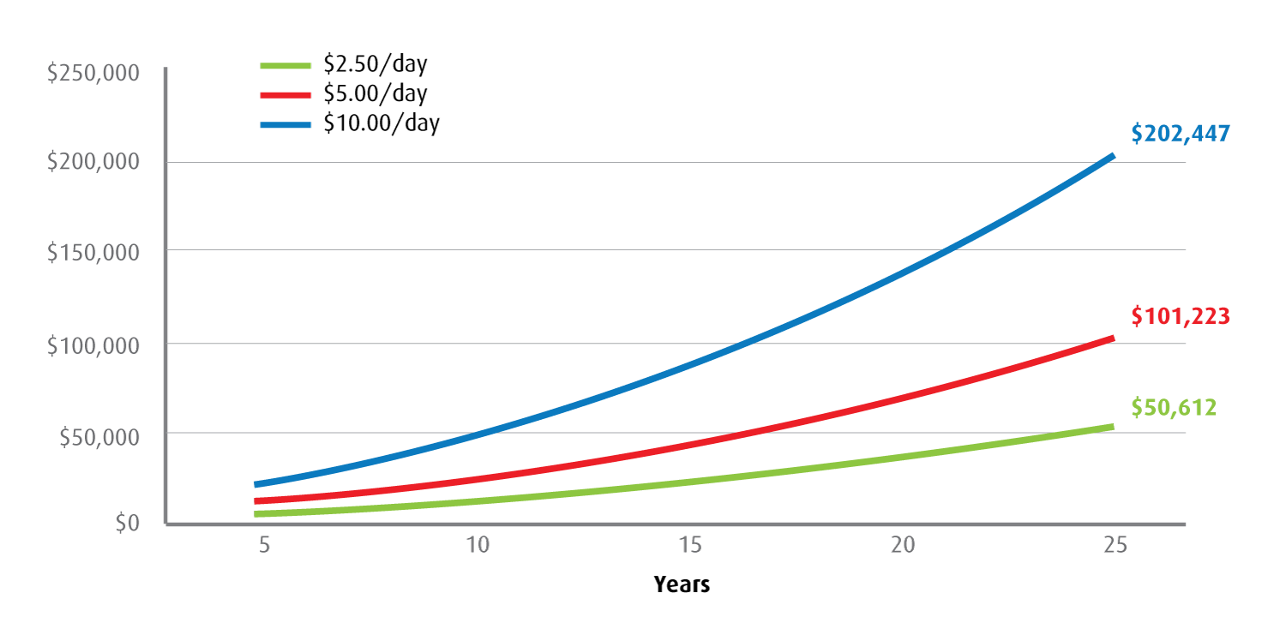
陷阱 #3：没有坚持投资
3
3
$250,000
$200,000
$150,000
$100,000
$50,000
$0
$2.50/天
$5.00/天
$10.00/天
$202,447
$101,223
$50,612
年数
"只作举例之用"
持续储蓄计划（CSP）是您开始为长期目标投资的一种简单而容易负担的方式。
假设：每个月底进行支付，并且以6%的名义年回报率每月进行复利计算。
资料来源：BMO投资有限公司。
Notes:
[SPEAKING POINTS]
The key is to start investing as early as possible, so that your investments have the most time to benefit from the potential long-term growth of the equity markets.
One great way to do this is by setting up a Continuous Savings Plan (CSP). A CSP helps you build and preserve your wealth by automatically investing into mutual funds on a set schedule, like every month or every week, using money in your bank account. This simple approach is convenient and affordable, and also helps to take emotions out of investing.
I’m sure you’ve heard the expression “Buy low, sell high”. This is Investing 101. A CSP can help with the “Buy low” half of this equation, by something called “dollar cost averaging”. What this means is that when you regularly invest a set amount, like $100 per month, you will end up buying more mutual fund units when prices are low, and fewer when prices are high, and this helps reduce the average cost that you pay per unit. This is especially useful when markets are volatile, and potentially gives you a better return. Just have a look at this chart.
Another long-term benefit of CSPs is compounding. Compounding is one of the most effective ways for you to increase your wealth over time. Compounding is the reinvestment of earnings back into your initial investment, meaning that you can earn income on top of income. The longer you stay invested, the longer your investments have to grow from compounding to help you build your wealth.
With a CSP, even a small amount regularly adds up over a small time!

Slide 17
陷阱 #2：将所有鸡蛋放到一个篮子里
2
把投资分散于不同的资产类别，可有助保护您的投资组合，同时又可保留上升的空间。
Notes:
[SPEAKING POINTS]
The next mistake we’ll talk about is putting all of your eggs into one basket.
As an investor, it is crucial to hold the right mix of asset classes for your investment goals and your risk level. Studies have shown that the mix of asset classes can explain up to 92% of the variation in returns on long-term investments.
First, what is an asset class? An asset class is a type of investment like equities (such as stocks), fixed income (like bonds), real estate or cash. Canadian stocks are an asset class. US stocks are another. So are corporate bonds, Japanese stocks, and commodities, to name a few. There are a lot of asset classes you can get exposure to through your investments, and each one will react to what’s happening in the economy and the markets in its own way.
Some have the potential for higher returns than others. Some tend to be quite risky, like emerging markets stocks, and some are very safe, like Treasury bills. Generally, the higher the potential return, the higher the risk. That’s the trade-off.
We touched on this fact when we talked about how Canadian equities have outperformed 5-year GIC’s over the long term.

Slide 18
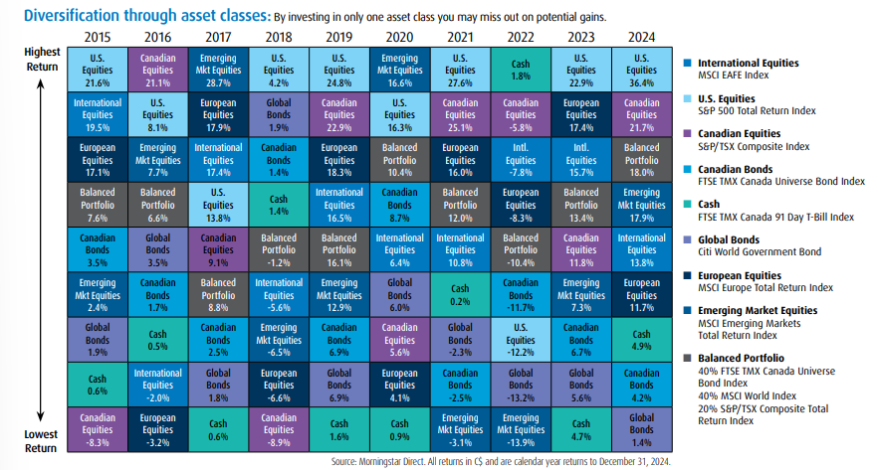
陷阱 #2：将所有鸡蛋放到一个篮子里
2
2
主要资产类别的表现：2015 - 2024
通过资产类别实现多元化：只投资于一种资产类别，您可能会错过潜在收益。
2015 | 2016 | 2017 | 2018 | 2019 | 2020 | 2021 | 2022 | 2023 | 2024
美国 股票 21.6% | 加拿大 股票 21.1% | 新兴市场股票 28.7% | 美国 股票 4.2% | 美国 股票 24.8% | 新兴市场股票 16.6% | 美国 股票 27.6% | 现金 1.8% | 美国 股票 22.9% | 美国 股票 36.4%
国际股票 19.5% | 美国 股票 8.1% | 欧洲 股票 17.9% | 全球 债券 1.9% | 加拿大 股票 22.9% | 美国 股票 16.3% | 加拿大 股票 25.1% | 加拿大 股票 -5.8% | 欧洲 股票 17.4% | 加拿大 股票 21.7%
欧洲 股票 17.1% | 新兴市场股票 7.7% | 国际 股票 17.4% | 加拿大 债券 1.4% | 欧洲 股票 18.3% | 平衡 投资组合 10.4% | 欧洲 股票 16.0% | 国际 股票 -7.8% | 国际 股票 15.7% | 平衡 投资组合 18.0%
平衡 投资组合 7.6% | 平衡 投资组合 6.6% | 美国 股票 13.8% | 现金 1.4% | 国际 股票 16.5% | 加拿大 债券 8.7% | 平衡 投资组合 12.0% | 欧洲 股票 -8.3% | 平衡 投资组合 13.4% | 新兴市场股票 17.9%
加拿大 债券 3.5% | 全球 债券 3.5% | 加拿大 股票 9.1% | 平衡 投资组合 -1.2% | 平衡 投资组合 16.1% | 国际 股票 6.4% | 国际 股票 10.8% | 平衡 投资组合 -10.4% | 加拿大 股票 11.8% | 国际 股票 13.8%
新兴市场股票 2.4% | 加拿大 债券 1.7% | 平衡 投资组合 8.8% | 国际 股票 -5.6% | 新兴市场股票 12.9% | 全球 债券 6.0% | 现金 0.2% | 加拿大 债券 -11.7% | 新兴市场股票 7.3% | 欧洲 股票 11.7%
全球 债券 1.9% | 现金 0.5% | 加拿大 债券 2.5% | 新兴市场股票 -6.5% | 加拿大 债券 6.9% | 加拿大 股票 5.6% | 全球 债券 -2.3% | 美国 股票 -12.2% | 加拿大 债券 6.7% | 现金 4.9%
现金 0.6% | 国际 股票 -2.0% | 全球 债券 1.8% | 欧洲 股票 -6.6% | 全球 债券 6.9% | 欧洲 股票 4.1% | 加拿大 债券 -2.5% | 全球 债券 -13.2% | 全球 债券 5.6% | 加拿大 债券 4.2%
加拿大 股票 -8.3% | 欧洲 股票 -3.2% | 现金 0.6% | 加拿大 股票 -8.9% | 现金 1.6% | 现金 0.9% | 新兴市场股票 -3.1% | 新兴市场股票 -13.9% | 现金 4.7% | 全球 债券 1.4%
最高 回报
国际股票
MSCI欧澳远东（EAFE）指数
美国股票
标普500总回报指数
加拿大股票
标普／多伦多综合指数
加拿大债券
富时TMX加拿大91天国债指数
现金
富时TMX加拿大91天国债指数
全球债券
花旗全球政府债券
欧洲股票
MSCI欧洲总回报指数
新兴市场股票
MSCI新兴市场
总回报指数
平衡投资组合
40% 富时TMX加拿大全债指数 + 40% MSCI 全球指数 + 20% 标普/多伦多交易所综合 总回报指数
最低 回报
资料来源：晨星全球投资研究平台（Morningstar Direct）。所有加元回报为截至2024年12月31日的年度回报。
一个充分多元化的投资组合，拥有合适的资产类别配置， 能够在不承担太多风险的情况下，尽量争取最高的潜在回报。
Notes:
[SPEAKING POINTS]
So why do you need to have a variety of asset classes? If stocks are doing well, why shouldn’t you invest your whole portfolio in stocks? How can you have too much of a good thing?
The reason is simple: You shouldn’t put all of your eggs in one basket. By spreading out your investments across asset classes, you’re spreading out your risk. This gives you more safety while keeping some potential for growth.
How does this work? Lets say that stocks start to underperform. Well, if you’re also holding fixed income (like bonds or mutual funds that invest in bonds), those fixed income investments may perform better than stocks, and this might offset some or all of the stock underperformance.
How much you should hold in equities, fixed income, or other asset classes will depend on things like how soon you’ll need draw on your investments, your income, your debt level, your personal assets, etc.

Slide 19
简要概括主要的投资错误
错误
主要教训
6
基于情绪的投资
决策应基于计划
5
投资过于保守
应该管理风险，而不是惧怕风险
4
低估复利的力量
利用免税和延税账户的优势
3
没有坚持投资
坚持投资的时间愈长，获得长期 增长的机会愈大
2
将所有鸡蛋放到一个篮子里
想保护您的投资组合免受下行风险，投资多元化是关键
Notes:
[SPEAKING POINTS]
This point about not putting all of your eggs in one basket leads directly to our number one mistake investors make. But before we look at this, let’s have a quick recap of what we’ve talked about so far:
Number 6: Investing Based on Emotions
Number 5: Investing Too Conservatively
Number 4: Underestimating the Impact of Tax on Your Wealth
Number 3: Not Staying Invested
Number 2: Putting All Your Eggs Into One Basket

Slide 20
投资者常犯的
1
个错误是……
Notes:
[SPEAKING POINTS]
So let’s have a drum roll for number one…

Slide 21
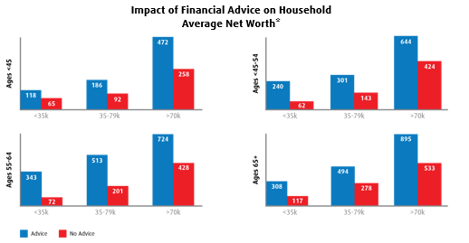
陷阱 #1：没有财务规划
1
1
理财建议对家庭的影响
平均净值*
年龄<45岁
年龄<45-54岁
<35k
35-79k
>70k
<35k
35-79k
>70k
年龄55-64岁
年龄 65+
<35k
35-79k
>70k
<35k
35-79k
>70k
有理财建议
没有理财建议
财务规划长期可带来巨大价值。
资料来源：《实现你的财务目标》（Reach Your Financial Goals），加拿大投资基金协会（IFIC），2016年4月， 引用自Pollara调研公司《加拿大投资者对互惠基金和互惠基金行业的看法》（Canadian Investors’ Perceptions of Mutual Funds and the Mutual Fund Industry），2016年
Notes:
[SPEAKING POINTS]
Not having a financial plan. Everything we’ve talked about so far leads to this, and it is the single biggest investing mistake you can make. A financial plan can help you avoid all of the other mistakes we’ve looked at.
Lets look at a couple of statistics. What percentage of Canadians do you think plan to rely on lottery winnings to help fund their retirement? (Solicit guesses from audience). 34%! I wonder how many of these people would say investments are too risky, while betting their retirement goals on something that they’re virtually guaranteed to lose money on.
What percentage of Canadians have a financial plan? Only 50% and only a 3rd of those with a plan updated it in the last year. So most Canadians either have no plan, or have an outdated plan that may no longer be optimized to meet their needs.
But what about those people that do have a financial plan that is regularly updated to meet their needs? These investors have confidence and peace of mind: In fact,
93% of survey respondents agreed they can trust their advisor to give sound advice, and 84% agreed they realize a better return on their investment.

Slide 22
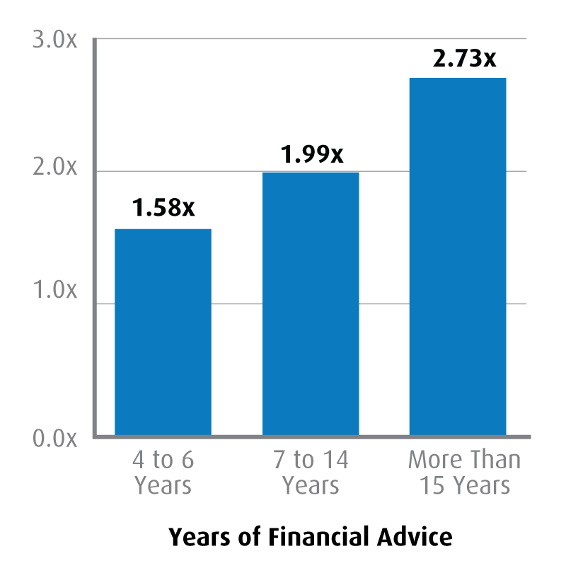
陷阱 #1：没有财务规划
1
与没有财务建议的家庭相比， 财务建议对家庭资产水平的影响
3.0倍
2.3倍
研究显示，接受财务建议能比放弃财务建议带来更多资产。实际上，您接受建议的时间愈长，投资成绩就愈好。
与未接受建议的账户相比，财务建议可以增加多达3倍的净回报。*
2.0倍
2.1倍
1.58倍
1.0倍
0.0倍
4至6年
7至14年
15年以上
接受财务建议的年数
财务规划长期可带来巨大价值。
**资料来源：论理财顾问的核心价值，Claude Montmarquette 与 Alexandre Prud’Homme合著， 魁北克大学产业经济研究中心（CIRANO），2020年发布。 持续咨询理财顾问超过15年的家庭，其平均资产规模是未聘请顾问的同类家庭的2.3倍。
Notes:
[SPEAKING POINTS]
There’s also a lot of confusion about what a plan is. Many Canadians would say, “I do have a plan. I have an RRSP”. An RRSP, a TFSA, a pension plan – these are just vehicles to get you where you want to go. Having an RRSP without a financial plan is like driving a car with no destination.
Let’s say that you’re taking a trip. Maybe you decide to drive to Florida with the family for a vacation – you would never just drive due south and hope you’ll eventually get there without driving into the ocean. No – you would bring a map, or a GPS, to make sure you arrive safely and on schedule – according to plan.
An RRSP without a plan is like getting on a plane without knowing where it will take you – something I doubt most of us would do.
As ridiculous as these examples sound, this is how many people invest and plan for their future financial goals – they have no real plan other than to “make money”.
Or maybe they used to have a plan, but it’s gone so far off-target over the years that they’ll never reach their goals if they don’t stop to figure out where they are and what direction they’re heading.
A financial plan should take stock of your own situation right now, and be regularly reviewed to make sure you’re still on track. It provides a framework to assess how close you are to your goals, and has a strategy to get there.
A BMO Financial Planner can provide you with the roadmap you need to reach your financial goals.
Everything depends on a plan, and that plan is as unique as you are, reflecting your lifestyle and values.
There is no one size-fits all solution. This image shows just some of what goes into a BMO financial plan. Your plan is comprehensive – it takes into account your income and expenses today and in the future, your personal assets, your personal and family situation, current and future economic circumstances and much more. This is the level of detail you need in order to have real confidence. A lot of things can impact your finances along the way, for good or for bad, and a financial plan will help you stay on track when there are some bends in the road.

Slide 23
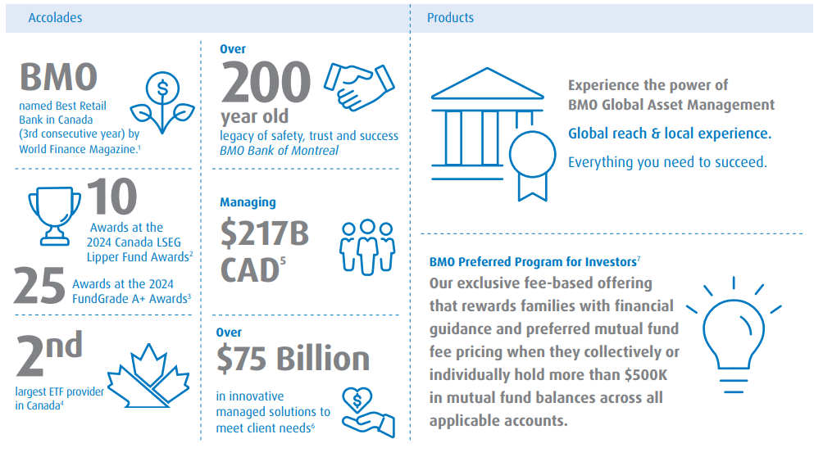
您首选的综合性、屡获殊荣的投资方案供应商
屡获殊荣
产品
超过
200
年历史
BMO
体验BMO环球资产管理的实力
全球布局本地智慧
助您成就卓越
连续第3年被《世界金融杂志》评为加拿大最佳零售银行。¹
安全、信任与成功的传承 蒙特利尔银行
10
管理资金
2,170亿加元⁵
项2024年加拿大LSEG理柏基金奖²
25
BMO投资者优选计划⁷
我们独家推出的付费服务专为家庭设计，当客户在其所有适用账户中的互惠基金总余额（个人或家庭合计）超过$500,000时，即可享受两大专属权益：财务指引与互惠基金费率优惠。
个2024年FundGrade A+奖项³
第2大
超过
$750亿
加拿大ETF供应商⁴
创新管理方案， 以满足客户需求⁶
参见脚注：https://bmogamhub.com/system/files/bmo_gam_accolades_retail_eng.pdf
Notes:
[SPEAKING POINTS]
So we know that a plan is absolutely crucial to having piece of mind about your retirement and financial goals. But why should you make BMO your partner as you work toward those goals?
The answer is simple: We have the most comprehensive suite of wealth management solutions. No other group in Canada can match our range of capabilities to provide the right solutions, to the right clients, at the right time.
BMO Global Asset Management is one of the top 10 asset managers in Canada, managing more than $380 billion on behalf of clients.
We have wide selection of investment options and products to let you benefit from our expertise ranging from Mutual Funds, Managed Solutions, Speciality Funds and more…
Most importantly, we’re committed to providing advice-led, outcome-oriented investment solutions to exceed your expectations.
Please feel free to speak to me after the presentation if you have any questions or would like to book an appointment with a Financial Planner.

Slide 24
BMO财务规划师竭诚为您服务
插入财务规划师的照片
财务规划师姓名 – 财务规划师
电话号码
email@bmo.com
储蓄和投资
购买金额大的物品和管理债务
退休和教育储蓄
BMO财务规划师是您的合作伙伴，帮您实现财务目标。
Notes:
[SPEAKING POINTS]
So the most important question is this: Do you have a plan? Or if you do have a plan, are you sure that it’s on track? Can you and your loved ones afford to be unsure?
If you don’t have a plan, a BMO Financial Planner can create a plan that is customized for you. Your Planner will take the time to get to know you and understand your goals and your needs – now and in the future, and build a plan that fits with the rest of your life and your values.
Your Planner will guide you through the important steps and decisions to keep you moving forward from day 1.
You might have more than one goal – with some nearer than others. Maybe you want to buy a summer cottage in 3 years, your daughter will go to university in 6 years, or you’re planning to retire in 15 years. Your BMO Financial Planner can build a plan to help you get there.
Aside from creating a customized investment plan to meet your needs, a BMO Financial Planner can help you with estate planning, managing debt, and other goals.
A “set-it-and-forget-it” approach to planning sounds easy, but it won’t work for something this important. Instead, your Planner will be a partner over the years to help you fine-tune your plan along the way as your life changes, to make sure you stay on track.
If you already have a financial plan, a BMO Financial Planner can give you a free review to see how close you are to reaching your goals, and help you make any adjustments.
A financial plan will help you avoid all of the mistakes we’ve talked about: It will keep you rooted and help you avoid the flash-in-the-pan market frenzies. It will give your portfolio the right mix of investments to help you reach your goals without taking on too much risk. It will structure your investments to protect your wealth from inflation and taxes. A financial plan can do all of this and more, and a BMO Financial Planner can be your partner to help you save and invest for the future while enjoying your life today.
[SAY]
Please feel free to speak to (Name of FP) of I after the presentation, or call 1-888-389-8030 to get started.

Slide 25
有任何疑问？
Notes:
[SPEAKING POINTS]
Does anyone have any questions?
(After questions have been answered) I would like to thank you all for coming this presentation.

Slide 26
谢谢！
欲了解更多信息，请访问 www.bmo.com/mutualfunds

Slide 27
免责声明
任何必需取决于未来事件的陈述都可能是前瞻性陈述。前瞻性陈述并不是业绩的保证。这些陈述涉及风险、不确定性和假设。虽然这类陈述是基于合理的假设，但 并不能确保实际结果不会大幅偏离预期。投资者要注意不要不适当地依赖任何前瞻性陈述。涉及任何前瞻性陈述时，投资者要仔细考虑最新基金简章内提及的风险。
本报告中所述观点仅代表报告发布时作者对市场的个人看法。这些观点可随时更改，恕不另行通知。本文提供的资讯并不构成购买证券的要约或出售证券的要约， 也不应将这些资讯视为投资建议。过往表现并不代表未来回报。本文仅作提供信息之用。
本文件所含外部链接非BMO环球资产管理公司所有或管理。任何来自第三方网站的内容或链接均未经我们审视或认可。您使用任何外部网站或第三方内容的风险由您自行承担。因此，我们对第三方内容不承担任何责任。
本文件内的若干陈述属于前瞻性陈述，包括（但不限于）“预期”、“打算”、“将”等表述的陈述。此类前瞻性陈述并非历史事实，仅反映BMO资产管理公司对未来结果或事件的当前预期。前瞻性陈述会受多种风险及不明朗性所影响，致令实际结果或事件与目前预期有重大差异。虽然BMO资产管理公司相信前瞻性陈述内的假设合理，但前瞻性陈述并不保证将来的表现。因此，我们要提醒读者不要对这类陈述过份依赖，因为其内含不明朗性。BMO资产管理公司并无责任就新信息、未来事件或其他这类影响陈述资料作出公开更新或修改，除非法律规定。
BMO 环球资产管理（BMO Global Asset Management）是 BMO 金融集团（BMO Financial Group）旗下多家关联机构的统一品牌名称，该等机构提供投资管理、退休金、信托和托管服务。BMO 环球资产管理（BMO Global Asset Management）旗下包括 BMO 资产管理有限公司（BMO Asset Management Inc.）、BMO 投资有限公司（BMO Investments Inc.）、BMO 资产管理有限公司（BMO Asset Management Corp.）、BMO 资产管理有限公司（BMO Asset Management Limited）和 BMO 的多间专业投资管理公司。以BMO 环球资产管理（BMO Global Asset Management）品牌名称提供的某些产品和服务，是为多个不同国家和地区的各类投资者而设计，未必会提供给所有投资者。产品和服务仅根据适用法律法规提供给这些国家和地区的投资者。
版权所有。本文所含信息：（1） 是BMO资产管理公司（“BMO AM”）的机密和专有信息；（2） 未经BMO资产管理公司事先书面同意，不得复制或分发；以及 （3）是从被认为可靠的第三方来源获取，但未经BMO AM独立核实。BMO资产管理公司及其关联公司对使用此信息造成的任何损失或损害不承担任何责任。
关于“LSEG理柏基金奖”：“LSEG理柏基金奖”每年颁发一次，旨在表彰在风险调整后业绩表现方面持续优于同业的基金及基金管理公司。“LSEG理柏基金奖”基于“理柏稳定回报领袖”（Lipper Leader for Consistent Return），该评级是一项风险调整后的绩效指标，计算周期涵盖36个月、60个月及120个月。获奖规则：在符合资格的基金类别中，“理柏稳定回报领袖”（有效回报）得分最高的基金将获得“LSEG理柏基金奖”。想了解详情，请浏览 lipperfundawards.com。LSEG理柏虽然已尽力使本文数据准确和可靠，但并不保证其准确性。评级分布：排名前20%的基金被评为“理柏稳定回报领袖”；随后的20%基金评级为4；中间20%评级为3；接下来的20%评级为2；最后20%评级为1。

Slide 28
免责声明
BMO互惠基金由BMO投资有限公司管理，后者是一间投资基金管理公司，为独立于满地可银行的法律实体。
投资专业团队包括财务规划师，他们同时作为蒙特利尔银行（Bank of Montreal）及 BMO 投资公司（BMO Investments Inc.，简称"BMO II"）的代表。BMO II是一家金融服务机构，与蒙特利尔银行互为独立法律实体。财务规划师通过 BMO II 提供财务规划、投资及退休规划服务，包括互惠基金投资建议。如需了解 BMO II 提供及不提供的具体服务范围，请咨询我们点击此处查看其收费方式说明。
关于Fundata基金评级A+（FundGrade A+®）
本评级获Fundata加拿大公司授权使用，该公司保留所有权利。Fundata Canada Inc.每年颁发FundGrade A +®大奖，以表扬加拿大投资基金中的“最佳”基金。FundGrade A +®的计算，是每月FundGrade评级的补充，并在每年底进行。FundGrade评级系统以“风险调整后”的绩效为基础 来评估基金表现，该绩效通过夏普比率、Sortino比率，和信息比率来衡量。每个比率的分数都是个别计算，涵盖2到10年间的所有期间。然后把 分数作平均加权，计算每月的FundGrade。最高的10％为A级；随后的20％为B级；随后的40％为C级；随后的20％为D级；最低的10％为E级。 要符合资格，基金必须在上一年的每个月都获得FundGrade评级。FundGrade A +®使用GPA方式计算，每个从“ A”到“ E”的每月FundGrade，分别获得4到0的分数。基金当年的平均分数决定其GPA。GPA 3.5或更高的基金都会获得FundGrade A +®奖。想了解详情，请浏览 http://www.fundgradeawards.com。Fundata虽然已尽力使本文数据准确和可靠，但并不保证其准确性。FundGrade A +奖及FundGrade评级， 都是根据由CIFSC建立的指定类别内投资基金的绩效比较计算出来的。
互惠基金投资或会涉及佣金、尾随佣金（如适用）、管理费及开支。投资前请仔细阅读有关互惠基金的基金说明书或简章。互惠基金并无保证， 其价值经常变动，过往投资表现可能不会重现。派息没有保证，并可能会有变更及／或取消。
有关BMO互惠基金投资风险的摘要，请参阅简章内列出的特有风险。
“BMO（M-条形圆盘标志）”是蒙特利尔银行的注册商标，获授权使用。

