Slide 1
How to Avoid the Top Six Investing Pitfalls
Insert presenter name
Notes:
[DO] Welcome attendees and thank them for joining you today.
[SAY] For the next 30 minutes, we are going to look at the top investing mistakes most of us make and how you can avoid them.

Slide 2
Introduction
Insert your professional
head shot here
Insert your personal information here using the following guidelines:
Hello, my name is [insert name];
What is your role and what value can you add
Make it personal
Make it human
Show “You’re here to help”
Notes:
Personal Reflection Slide – Speaking Points are on Slide:
Purpose: To build rapport; sharing something personal about the presenter beyond the professional bio; helps resonate with various members of the audience as they may also relate in some elements.
SAY: We all lead different lives with different priorities and we all have multiple roles. I’d like to share my story with you and then I will ask a few of you to volunteer your story.

Slide 3
The Pitfalls of Investing
Recognizing these mistakes and hazards can go a long way to helping you reach your goals.
Notes:
[SAY] So, we’re here to talk about the biggest pitfalls that people fall into when they invest their money. Whether you’re a seasoned investor or just looking at your options, recognizing these mistakes and hazards can go a long way to helping you reach your goals, whatever you’re saving for: early retirement, a new home, your kids’ education, your small business, or something else.
Why don’t we start out with a little activity. How many of you would say you’re fairly seasoned investors – you’ve been around the block a few times, you’ve been investing a while. Maybe we’ll never see you speaking on BNN, but you have a pretty good sense of how the markets work? [Attendees put up hands]
And how many of you are maybe a bit newer, or at least not quite as savvy when it comes to equities and fixed income, indices and ETFs, carburetors and transmissions? OK, maybe not those last two – but how many of you are maybe less knowledgeable about investing? [Attendees put up hands]
I think it would be interesting to see how each group

Slide 4
The Pitfalls of Investing
?
What do you think are the 6
biggest investing pitfalls?
Notes:
[Take suggestions from the 2 groups, to see what they think are the biggest investing pitfalls]
I’d like to hear what each group thinks are the biggest investing pitfalls. It will be interesting to see how the answers differ and see how many of your answers match what we’ll be talking about tonight.

Slide 5
Agenda
Game – Reasons not to invest
Top 6 investing pitfalls
BMO Mutual Funds story
Q&A
Notes:
Read agenda items on the slide.

Slide 6
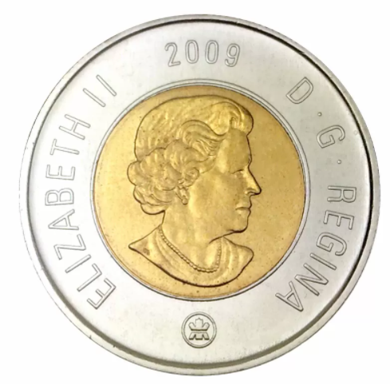
Game
Find a spare coin in your pocket
Do you remember what was in the news the year your coin was minted?
Notes:
[SAY] Let’s start things off with a little game.
[DO] Ask an audience member to pull out a coin and tell you the year on it.
[ASK] Who remembers what was in the news that year?
[DO] Referring to the chart on the next slide, say what happened in that year which kept some people out of the market
[DO] Repeat the above: Ask for another coin, and share what happened that year, referring to the chart on the next slide.

Slide 7
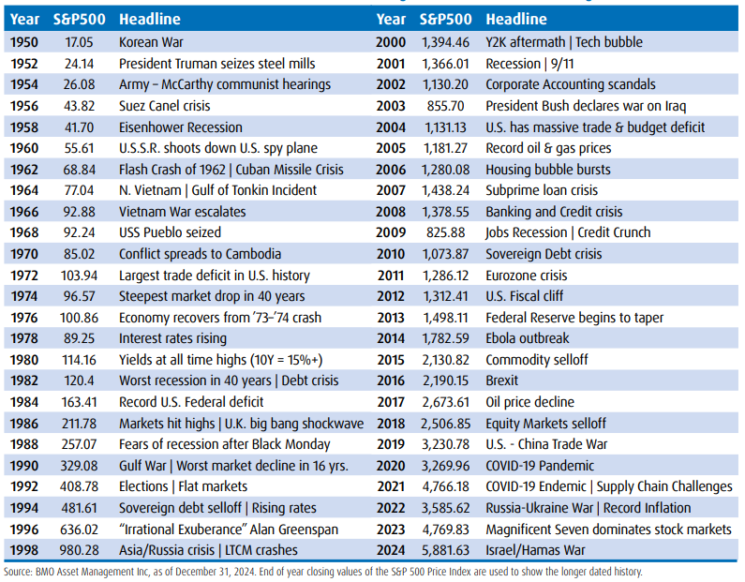
You Can Always Find a Reason Not to Invest
Notes:
[SAY]
This chart just shows that there is always a reason not to invest. There is always some economic uncertainty, political instability, or other wild card that will keep some people out of the markets. But what I hope today’s presentation will show you is that when you take steps to avoid the biggest investing pitfalls, you can have confidence that you’re on the right track to realize your financial goals – a comfortable retirement, money to travel or cover your kids’ education, a cottage to enjoy summer weekend getaways – whatever you’re saving for, even when the markets seem a bit unwelcoming.

Slide 8
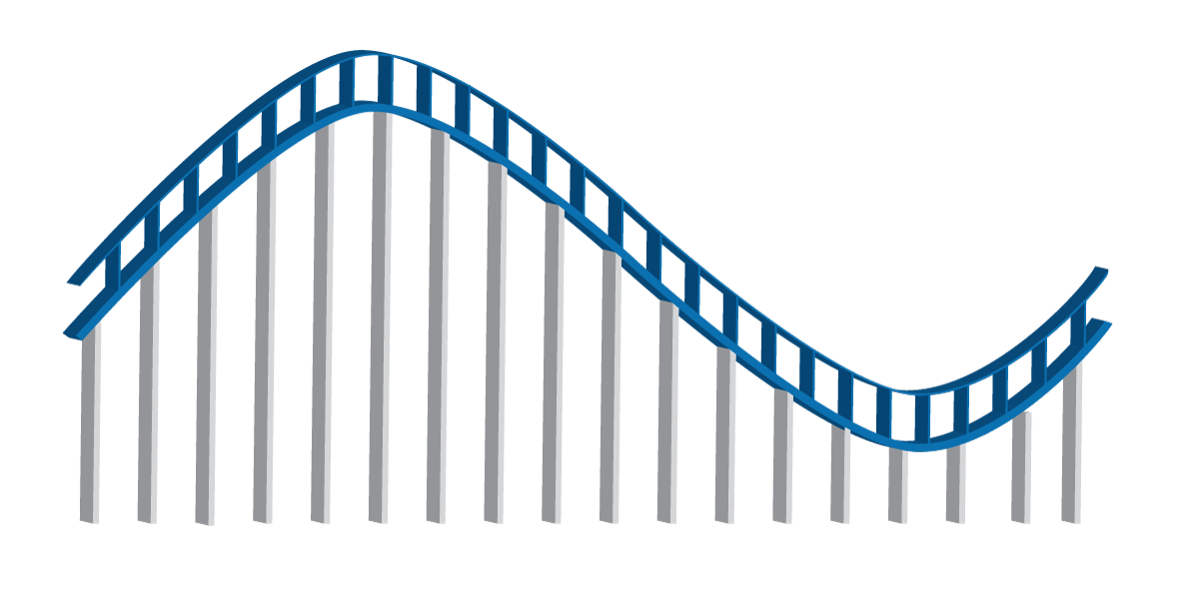
Pitfall #6: Investing Based on Emotion
6
Anxiety
Euphoria
Denial
Point Where Most People Sell
Thrill
Fear
Excitement
Desperation
Optimism
Panic
Capitulation
Optimism
Point Where Most People Invest
Despondency
Relief
Depression
Hope
Point of Most Opportunity
The emotional roller coaster can lead you into bad investment choices – don’t get on.
Notes:
[SAY]
So let’s introduce investing mistake #6: Emotional investing.
Have you ever fallen in love with an investment?
This sounds like an odd question, but the truth is that investing can sometimes feel a lot like new love. You’re full of hope and excitement about your new relationship, and you feel that thrill when things advance to the next level, as your investment keeps reaching higher highs. When this happens, you’re in the stages on the far left on our chart – optimism, excitement, euphoria.
Maybe after a little while you notice some things that you want to change, but it’s not a deal-breaker for you – yet. You rationalize it and explain it away when the investment has some missteps. You’re in this for the long-haul, and you believe that they’ll change. Poor performance, hints of financial trouble, some deals that don’t work out - now we’re scratching the anxiety and denial part of our chart.
[SAY]
It can be very hard to know what to do when you’re on that ride. Some investments do end up having great long-term performance, but many don’t. What if you’ve invested both your emotions and your money into an investment that doesn’t perform how you had hoped, in spite of all the chances you’ve given it? Is it time to break up? Now you’re moving quickly to the bottom of the chart – fear, panic, depression. Should you cut your losses and sell?
Maybe. But be careful not to decide based on your emotions.
[SAY]
Any time you make an investment decision – to buy, sell, or keep holding, there should always be a strong reason. You may not always make the right decision, but the chances are you’ll make better decisions than investors who are on the emotional roller coaster and decide based on feelings instead of facts.
The first step to avoid the roller coaster is to be aware that it exists. This way you can catch yourself when your emotional investment is as big as your financial investment.

Slide 9
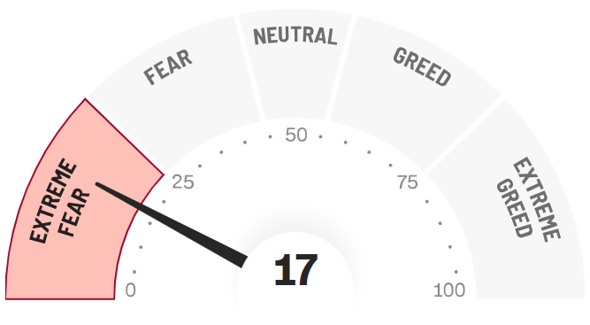
Pitfall #6: Investing Based on Emotion
6
CNN Fear & Greed Index
Now: Fear
17
Extreme Fear
Extreme Greed
Don’t let greed or fear control your investment decisions.
Source: CNN
Notes:
[SAY] What we’ve just talked about is what an individual investor feels. But what if a large number of people are feeling the same thing at the same time about the same investment? This can happen too. It’s like when you tell all your friends about the amazing person you’ve just met – well, in this case, thousands of people are talking about the same person. And there’s going to be a lot of disappointment if those hopes weren’t built on something solid.
Remember, stock markets can be volatile, especially over the short term, and prices can sometimes move in ways that don’t reflect what they’re worth.
When headlines in the papers and business analysts on TV are touting some stock that is supposed to outperform the market, it’s easy to get caught up in the hype – even when the facts don’t support it.
If someone you know has also gotten on board with that hot investment that’s the talk of Wall Street at the moment, this can be a powerful one-two combo that’s hard to dodge. Maybe its your colleague, your in-law, your golf partner – this immediately gives it an aura of credibility. Just as we’re more likely to trust someone that our friends trust, we’re more likely to trust an investment if someone we know, and respect also trusts it. Your friends may be good judges of character – after all, they’re friends with you! – but this probably doesn’t carry over to knowing what investments are right for you.
Your financial decisions are just too important to base on second-hand hopes and assurances. There has to be something more before you place down your money.
[ASK] Does anyone remember any tech companies that imploded when the tech bubble popped? (Some answers: 1)The Learning Company (Creator of Where in the World is Carmen Sandiego? Acquired by Mattel for $3.6 billion in 1999, and sold for one tenth that price a year later 2) Pets.com, online pet supply retailer, shares went from $14 to under $1 before the company folded in 2000 3) Etoys, online toy retailer , went from $86 to 9 cents per share and shut down in 2001 (although it actually came back to life later under new ownership).
[SAY]
In reality, many of the new internet businesses were run poorly with no real long-term strategy, and it was inevitable that this bubble would pop spectacularly, which happened in 2000-2001, when companies with sky-high stock prices a few short years before filed for bankruptcy.
It works the other way as well. Sometimes, investors rush to sell off their shares of a company that has good management and products, healthy finances and a strong market. When this happens, it will push the company’s share price down over the short-term, and many investors will interpret this as confirmation that the company really is a loser, even if the facts don’t support this. If you follow the crowd, you may end up selling a good investment for a lower price than it’s really worth.
CNN has an interesting tool called the “Fear and Greed Index” on their website [Action: CLICK ON GRAPHIC TO OPEN HYPERLINK], which reports the sentiment of the market in real time, and shows just how quickly it can shift – going from extreme greed to extreme fear, often with little warning. [Action: LEAVE CNN PAGE AND RETURN TO POWERPOINT]
It may make sense for you to buy or sell, or maybe not – just make sure you have a strong reason in either case. Don’t let fear or greed control your investment decisions
The lesson is clear: Following your heart might be a good idea for your love life, but it’s rarely a good idea for your investments.
That’s why even the pros use models or even AI to help take the emotion out of investing – after all, we’re all human – and portfolio managers use special models and processes that help them stay true to what their investors are counting on them to do – invest according to the fund’s mandate, and not let their own emotions drive their decisions.

Slide 10
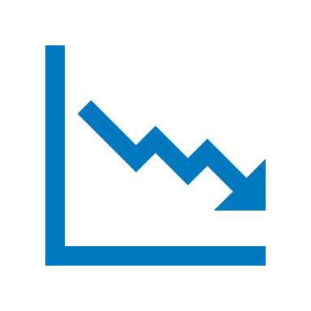
Pitfall #6: Investing Based on Emotion
6
If you found $100, how happy would you be? If you lost that same $100, how upset would you be?
Research shows we fear loss twice as much we desire the equivalent gain. This doesn’t really make sense, but it affects how people invest.
Remember to put the good and the bad into proper perspective.
Notes:
[SAY] Before we move onto the next pitfall, let’s finish with a little thought experiment to show how our emotions affect the way we look at money and investing:
Imagine that you’re walking down the street, and you find a nice, crisp $100 bill right in front of you on the sidewalk Nobody’s around, and you have no way to know who it belongs to. It’s yours now. How would you feel? Pretty good, right? Has this ever happened to you? Solicit reactions from audience.
Now, imagine that you get home and the bills gone. You must have somehow dropped it outside, unbelievable! How would you feel? Would you say, “Easy come, easy go”? Or would it bother you a bit more than that? Solicit reactions from audience.
Research shows that people tend to fear a given loss twice as much as they value an equivalent gain. This means that in our thought experiment, for a lot of people, losing the $100 is enough to ruin their whole day. But this doesn’t make sense, does it? After all, you just wound up back at zero, right? Getting upset about this makes as much sense as getting upset that you didn’t find $100 today.
But even though this doesn’t make sense, this is how a lot of people think about their investments. They feel the losses more than the gains. Now, I’m not talking about losses they can’t afford – I’m talking about the normal ups and downs that always happen with any investment. A lot of people feel the loss a lot more than the gains, and they end up selling at times that don’t necessarily make sense for their overall goals. Which leads us nicely to our next mistake…

Slide 11
Pitfall #5: Investing Too Conservatively
5
5
What do you think is the biggest risk that long-term investors face?
Short-term volatility in the markets?
Inflation? Taxes? Interest rates?
The biggest risk is NOT hitting your investment goals!
Risk isn’t something to be feared. Instead, it should be managed.
Volatility: Measures how much the price of a security, derivative, or index fluctuates.
Notes:
[ASK] So what do you think is the biggest risk for long-term investors? (Solicit answers). Is it short-term volatility? Inflation? Taxes? Interest rates
[SAY]
The risk for long-term investors is not hitting their investment goals.
This leads us right to our next mistake: investing too conservatively.
This is a basic principle of investing: the higher the risk, the higher the return you may earn. The lower the risk, the lower the return will likely be on your investment. There is no free lunch for investors – although you’re welcome to our snacks right there (pointing at snacks)! Virtually any investment has some risk. The trade-off for that risk is the chance to earn a higher return on your investment.
When you’re building your portfolio, the key is to find the sweet spot, where you have the best chance of reaching your goals without taking on too much risk for your own circumstances. This sweet spot will be different for every person in this room.
If you invest too conservatively, you may run the risk of falling short of what you’re saving for: a comfortable retirement, money for the kids’ education, money to buy a cottage – whatever your goals are. On the other hand, you don’t want to bet the farm and lose more than you can afford, especially if you’re in the later stages of your career with less time to recoup any losses on your investments.
The lesson is this: Risk isn’t something to be avoided in your portfolio. Instead, risk should be managed – according to your own situation.

Slide 12
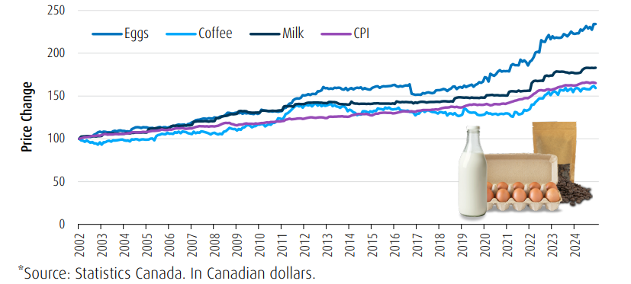
Pitfall #5: Investing Too Conservatively
5
This chart illustrates the average total cost of one dozen eggs, one litre of partly skimmed milk,
and a loaf of bread in Canada each year.
If you want to keep up with the rising cost of living and eventually enjoy a financially secure retirement, you need to ensure that your money is growing at a higher rate than inflation.
Source: Statistics Canada. BMO Asset Management Inc. The cost illustrates the total cost of one litre of milk, a dozen eggs and a loaf of bread.
Notes:
[SAY]
Let me ask you a question: How much do you think a cup of coffee at Tim Horton’s cost in 1964? (Take guesses from audience).
In 1964, a cup of coffee at Tim Horton’s cost just 10 cents. Today it is $2.29 - that’s a huge increase! This shows how much inflation can threaten the value of your portfolio. If your portfolio is too conservative, there’s a real risk that it won’t even keep pace with inflation, let alone outperform the market and give you the higher returns you’re looking for.
1964 was a long time ago. But if you think that inflation isn’t a threat over the shorter term, think again. Have a look at this chart:
In the 10-year period from 2008 through 2018, we see a 18% increase in the average cost of groceries. That’s a big increase. What you bought at the grocery store for $100 in 2008 cost you $118 by the end of 2018. Maybe you don’t really notice it when bread goes up 10 cents, or milk goes up 15 cents. It doesn’t seem like a lot, but make no mistake, inflation really adds up over time.
And it doesn’t just affect things you buy every day like food or clothing. It is also one of the biggest threats to the real value of your portfolio, especially if cash, GIC’s or bonds make up a large part of it.
Who here likes GICs? Don’t get me wrong – it may make sense for you to hold some of your money in GICs. But if too much is in GICs, it’s unlikely that you’ll see the growth you need, especially after inflation eats away at your returns.
[SAY]
Remember, it isn’t enough for your investments to grow. They need to grow at a higher rate than inflation. Otherwise, you’re not getting any richer. And even beating inflation probably isn’t enough – you need to beat it by enough for your returns after inflation and taxes to meet your goals. So inflation is just one hurdle to get over.

Slide 13
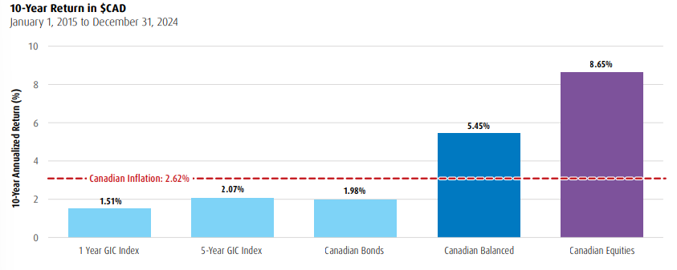
Pitfall #5: Investing Too Conservatively
5
5
5
Did you know?
Inflation has a big impact on our day-to-day life. A cup of coffee in 1964 at Tim Hortons cost 10 cents. Today, that same cup of coffee costs $2.07*
Source: Tim Hortons, February 2025
Source: Morningstar, as at December 31, 2024. Past Performance is not indicative of future results. Canadian Equities and Canadian Bonds are represented by S&P/TSX Composite Total Return Index and FTSE Canada Universe Bond Index. Canadian Balanced is represented by a 50/50 blend of Canadian Bonds and Canadian Equities, rebalanced monthly. 1 and 5-Year GIC Indices are represented by weighted average of posted GIC rates of the major financial institutions. BMO Global Asset Management is a brand name under which BMO Asset Management Inc. and BMO Investments Inc. operate. “BMO (M-bar roundel symbol)” is a registered trademark of Bank of Montreal, used under licence
Notes:
[SAY]
So what can you do to protect your capital from inflation? The key is to make sure that your portfolio holds enough in equity-based investments, like mutual funds that invest in stocks. Over the long term, equities have proven to be an effective way to help insulate your portfolio from inflation.
Looking back to rolling 10-year time periods, equities have proven to significantly outperform both 1-year and 5-year GICs. This means that if you’re looking to grow your wealth with an investment time horizon of more than 10 years, long-term equity investments are your most effective option. Long-term investment in equities is the best way for you to maximize upside potential and reach your financial goals.
[ASK]
Does anyone know what an index is? The first person to answer wins a free Dow Jones! (Let attendees share answers)
[SAY]
Basically, an index is a grouping of a certain type of investments like stocks or bonds that is used to measure how that type of security is performing in general. For example, the S&P 500 index contains the stocks of 500 of the biggest American companies, and it gives an idea of how the stocks of large American companies are performing in general.
So moving on, what do we see? Inflation averaged 1.59% per year during this time. The 1-year GIC Index trailed inflation, at 0.93%, so clearly 1-year GIC’s weren’t the way to go in terms of beating inflation. The 5-year GIC index beat inflation, but just barely, with a 1.65% average return. Canadian bonds and Canadian balanced (a mix of bonds and stocks) beat inflation handily, but the real star of this show is Canadian equities, which returned close to 5.2% per year.
Cash, GICs and bonds may play other important roles in your portfolio, but equities are key to help protect your portfolio from inflation.

Slide 14
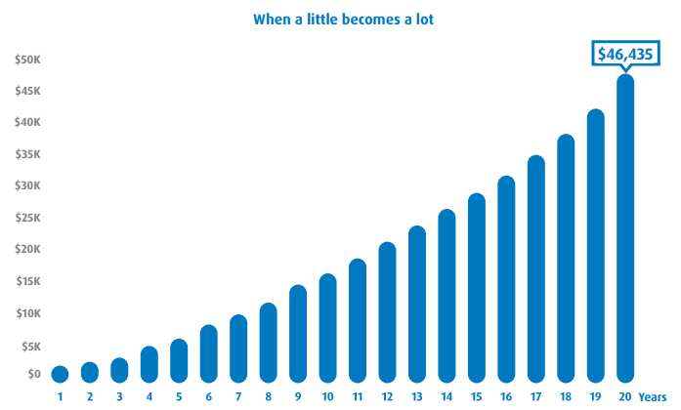
Pitfall #4: Underestimating the power of compounding
4
If you invest $100 a month for 20 years with a 6% annual compounded rate of return, you will end up with $46,435! RRSPs, TFSAs and RESPs are just some of the tax-smart vehicles that can help protect your wealth.
"For illustrative purposes only"
Investing is not only about how much money you have; it’s about how much time you have.
Source: This scenario assumes an investors is making a $100 monthly contribution for 20 years, with a 6% annual compounded rate of return. https://www.bmo.com/en-us/main/personal/calculators/
Notes:
Compounding is one of the most effective ways for investors to increase their wealth over time. Compounding is the reinvestment of earnings back into the initial investment, meaning you can earn income on top of income. By making regular contributions you can enjoy the long term benefit of compounding. The longer you stay invested, the longer your money works for you and the more your wealth can grow!
Making use of RRSPs, TFSAs, and perhaps spousal RRSPs, RESPs, and RDSPs can help your money grow further by protecting your assets from the taxman. All of these can help you build and protect your wealth.
Let’s quickly look at some of the main ways that these plans can help.
Contributions to your RRSP reduce the taxable income you have to report when you do your taxes. This is an immediate benefit, and one of the main reasons why it makes sense to maximize your contributions each year – something most Canadians don’t do. Once your money is in your RRSP, it is free to grow and compound tax-sheltered, as long as it stays in your RRSP. Since RRSPs are about saving for retirement, you will probably be in a lower tax bracket once you do start to take money from your RRSP, which means that you’ll probably pay less taxes. It just makes sense – reduce your taxable income today, grow your money without the burden of taxes, and then take it out when you’re in a lower tax bracket.
TFSAs are another great option available to Canadians. You can contribute up to $6,000 this year, and you may be able to contribute as much as $63,500 this year if you’ve never contributed before. While your TFSA contributions aren’t tax-deductible like RRSP contributions, you will never be taxed on your TFSA. Tax-free growth on $6,000 can really add up over the years. Plus, unlike RRSP’s, there is no maximum age, so a TFSA can help you build your wealth for the rest of your life.
Have a look at this chart. It shows just how powerful TFSAs can be – a difference of more than $100 thousand from investing $6,000 annually for 25 years, assuming an 6% annual return, when compared with a non-registered account with earnings taxed annually at 40%.
RESPs are also a great way for you to save for a loved one’s post-secondary education, which I’m sure you know can be very expensive. A 4-year university degree often costs upwards of $60,000, and this cost is expected to keep growing. An RESP can help you tackle high tuition costs by providing valuable grants and bonds to eligible beneficiaries: Including up to $7,200 per beneficiary for the CESG grant, up to $2,000 Canada Learning Bond per beneficiary, plus other grants or bonds that may be available.
An RESP can go a long way toward making post-secondary affordable.

Slide 15
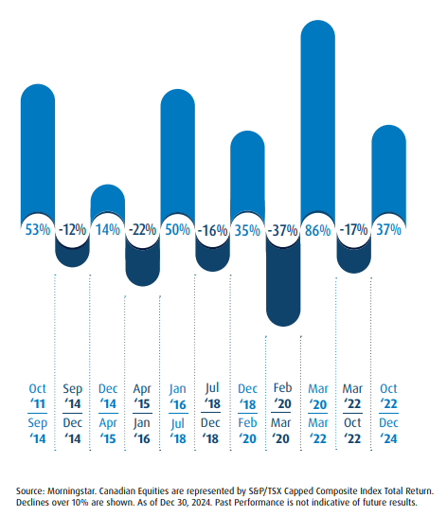
Pitfall #3: Not Staying Invested
3
Staying Invested for the long term and benefit from the rise.
Day-to-day fluctuations and market noise can cause you to react and potentially miss out on market opportunities. It’s not about timing the market – it’s time in the market that pays off in the long run.
Notes:
[SAY]
Our next mistake is Not staying invested.
At any moment, you can find a dozen reasons not to stay invested, or not to invest in the first place. In just the last 30 years of so, we’ve seen crisis after crisis: the Black Monday stock market crash in 1987, wars and terrorism, the subprime mortgage crisis and credit crunch in 2007-8, and the trade disputes and political discord making headlines in many countries today, to name a few.
As we talked about for emotional investing, the stock market can be volatile, especially over the short-term. These day-to-day fluctuations and noise in the market can be scary and cause you to miss out on opportunities.
However, over the longer term historically, stock market returns have tended to be a lot more attractive, with a bias to the upside, meaning that those investors who kept a diversified portfolio were generously rewarded over the long term.
Have a look at this graph: it shows that Canadian equities have significantly recovered after taking falls, while also beating inflation and 5 year GICs. In fact, during the time this chart covers, Canadian equities would have given you over 10 times the return on your initial investment, even with all of the short-term turmoil that took place during that time period.

Slide 16
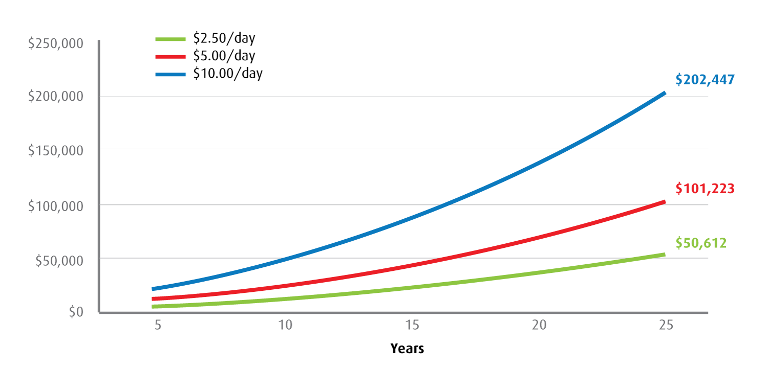
Pitfall #3: Not Staying Invested
3
3
"For illustrative purposes only"
A Continuous Savings Plan (CSP) makes it easy and affordable to start investing for your long-term goals.
Assumptions: Payments are made at the end of each month and a nominal annual rate of return of 6% is compounded monthly.
Source: BMO Investments Inc.
Notes:
[SPEAKING POINTS]
The key is to start investing as early as possible, so that your investments have the most time to benefit from the potential long-term growth of the equity markets.
One great way to do this is by setting up a Continuous Savings Plan (CSP). A CSP helps you build and preserve your wealth by automatically investing into mutual funds on a set schedule, like every month or every week, using money in your bank account. This simple approach is convenient and affordable, and also helps to take emotions out of investing.
I’m sure you’ve heard the expression “Buy low, sell high”. This is Investing 101. A CSP can help with the “Buy low” half of this equation, by something called “dollar cost averaging”. What this means is that when you regularly invest a set amount, like $100 per month, you will end up buying more mutual fund units when prices are low, and fewer when prices are high, and this helps reduce the average cost that you pay per unit. This is especially useful when markets are volatile, and potentially gives you a better return. Just have a look at this chart.
Another long-term benefit of CSPs is compounding. Compounding is one of the most effective ways for you to increase your wealth over time. Compounding is the reinvestment of earnings back into your initial investment, meaning that you can earn income on top of income. The longer you stay invested, the longer your investments have to grow from compounding to help you build your wealth.
With a CSP, even a small amount regularly adds up over a small time!

Slide 17
Pitfall #2: Putting All Your Eggs in One Basket
2
Spreading your investments across asset classes helps protect your portfolio while leaving room for upside gains.
Notes:
[SPEAKING POINTS]
The next mistake we’ll talk about is putting all of your eggs into one basket.
As an investor, it is crucial to hold the right mix of asset classes for your investment goals and your risk level. Studies have shown that the mix of asset classes can explain up to 92% of the variation in returns on long-term investments.
First, what is an asset class? An asset class is a type of investment like equities (such as stocks), fixed income (like bonds), real estate or cash. Canadian stocks are an asset class. US stocks are another. So are corporate bonds, Japanese stocks, and commodities, to name a few. There are a lot of asset classes you can get exposure to through your investments, and each one will react to what’s happening in the economy and the markets in its own way.
Some have the potential for higher returns than others. Some tend to be quite risky, like emerging markets stocks, and some are very safe, like Treasury bills. Generally, the higher the potential return, the higher the risk. That’s the trade-off.
We touched on this fact when we talked about how Canadian equities have outperformed 5-year GIC’s over the long term.

Slide 18
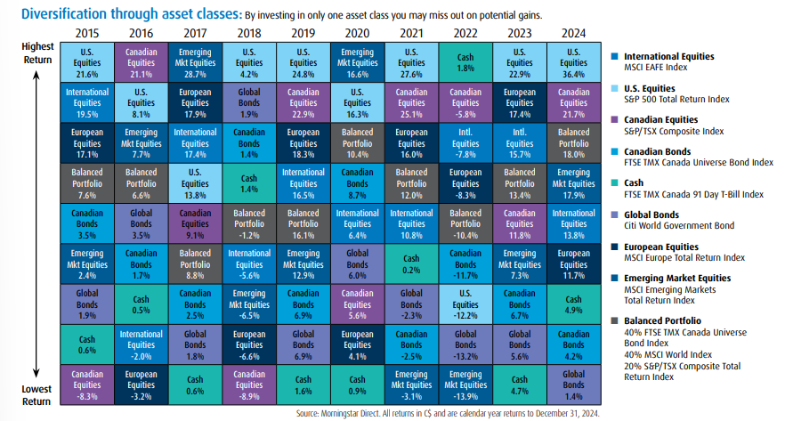
Pitfall #2: Putting All Your Eggs in One Basket
2
2
Performance of Major Asset Classes: 2015 - 2024
A well-diversified portfolio has the right mix of asset classes to maximize potential returns without taking on too much risk.
Notes:
[SPEAKING POINTS]
So why do you need to have a variety of asset classes? If stocks are doing well, why shouldn’t you invest your whole portfolio in stocks? How can you have too much of a good thing?
The reason is simple: You shouldn’t put all of your eggs in one basket. By spreading out your investments across asset classes, you’re spreading out your risk. This gives you more safety while keeping some potential for growth.
How does this work? Lets say that stocks start to underperform. Well, if you’re also holding fixed income (like bonds or mutual funds that invest in bonds), those fixed income investments may perform better than stocks, and this might offset some or all of the stock underperformance.
How much you should hold in equities, fixed income, or other asset classes will depend on things like how soon you’ll need draw on your investments, your income, your debt level, your personal assets, etc.

Slide 19
A Quick Recap of the Top Investing Mistakes
Mistake
Key Lesson
6
Investing based on emotion
Make decisions based on a plan
5
Investing too conservatively
Risk should be managed, not feared
Underestimating the power of compounding
Take advantage of tax-free and tax-deferred accounts
4
3
Not staying invested
Staying in market long enough to capture long-term growth
Putting all your eggs into one basket
Diversification is key to protecting your portfolio from downside risk
2
Notes:
[SPEAKING POINTS]
This point about not putting all of your eggs in one basket leads directly to our number one mistake investors make. But before we look at this, let’s have a quick recap of what we’ve talked about so far:
Number 6: Investing Based on Emotions
Number 5: Investing Too Conservatively
Number 4: Underestimating the Impact of Tax on Your Wealth
Number 3: Not Staying Invested
Number 2: Putting All Your Eggs Into One Basket

Slide 20
And the
1
mistake investors make is…
Notes:
[SPEAKING POINTS]
So let’s have a drum roll for number one…

Slide 21
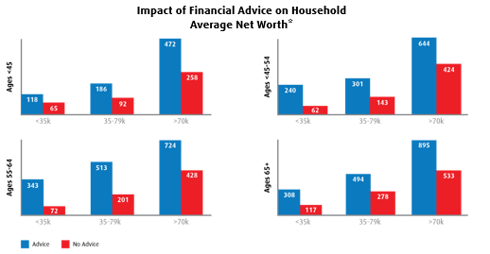
Pitfall #1: Not Having a Financial Plan
1
1
A financial plan can add tremendous value in the long run.
Source: Reach Your Financial Goals, IFIC, April 2016, referencing from Canadian Investors’ Perceptions of Mutual Funds and the Mutual Fund Industry, Pollara, 2016
Notes:
[SPEAKING POINTS]
Not having a financial plan. Everything we’ve talked about so far leads to this, and it is the single biggest investing mistake you can make. A financial plan can help you avoid all of the other mistakes we’ve looked at.
Lets look at a couple of statistics. What percentage of Canadians do you think plan to rely on lottery winnings to help fund their retirement? (Solicit guesses from audience). 34%! I wonder how many of these people would say investments are too risky, while betting their retirement goals on something that they’re virtually guaranteed to lose money on.
What percentage of Canadians have a financial plan? Only 50% and only a 3rd of those with a plan updated it in the last year. So most Canadians either have no plan, or have an outdated plan that may no longer be optimized to meet their needs.
But what about those people that do have a financial plan that is regularly updated to meet their needs? These investors have confidence and peace of mind: In fact,
93% of survey respondents agreed they can trust their advisor to give sound advice, and 84% agreed they realize a better return on their investment.

Slide 22
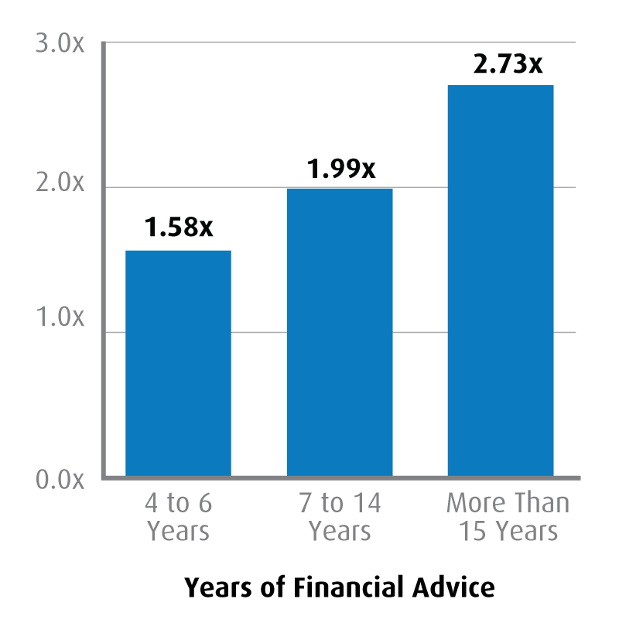
Pitfall #1: Not Having a Financial Plan
1
Effect of Financial Advice on Level of Household Assets Compared with Non-Advised Households
3.0x
2.3x
Research shows that receiving financial advice results in far greater assets than forgoing advice. In fact, the longer you receive advice, the better the results seen
Financial advice may add the equivalent of up to 3% in net returns over non-advised accounts.*
2.0x
2.1x
1.58x
1.0x
0.0x
4 to 6 Years
7 to 14 Years
More than 15 years
Years of Financial Advice
A financial plan adds enormous value in the long run.
* *Source: More on the Value of Financial Advisors, by Claude Montmarquette and Alexandre Prud’Homme, CIRANO, 2020. The average household with a financial advisor for 15 years or more had asset values 2.3x higher than an average “comparable” household without a financial advisor.
Notes:
[SPEAKING POINTS]
There’s also a lot of confusion about what a plan is. Many Canadians would say, “I do have a plan. I have an RRSP”. An RRSP, a TFSA, a pension plan – these are just vehicles to get you where you want to go. Having an RRSP without a financial plan is like driving a car with no destination.
Let’s say that you’re taking a trip. Maybe you decide to drive to Florida with the family for a vacation – you would never just drive due south and hope you’ll eventually get there without driving into the ocean. No – you would bring a map, or a GPS, to make sure you arrive safely and on schedule – according to plan.
An RRSP without a plan is like getting on a plane without knowing where it will take you – something I doubt most of us would do.
As ridiculous as these examples sound, this is how many people invest and plan for their future financial goals – they have no real plan other than to “make money”.
Or maybe they used to have a plan, but it’s gone so far off-target over the years that they’ll never reach their goals if they don’t stop to figure out where they are and what direction they’re heading.
A financial plan should take stock of your own situation right now, and be regularly reviewed to make sure you’re still on track. It provides a framework to assess how close you are to your goals, and has a strategy to get there.
A BMO Financial Planner can provide you with the roadmap you need to reach your financial goals.
Everything depends on a plan, and that plan is as unique as you are, reflecting your lifestyle and values.
There is no one size-fits all solution. This image shows just some of what goes into a BMO financial plan. Your plan is comprehensive – it takes into account your income and expenses today and in the future, your personal assets, your personal and family situation, current and future economic circumstances and much more. This is the level of detail you need in order to have real confidence. A lot of things can impact your finances along the way, for good or for bad, and a financial plan will help you stay on track when there are some bends in the road.

Slide 23
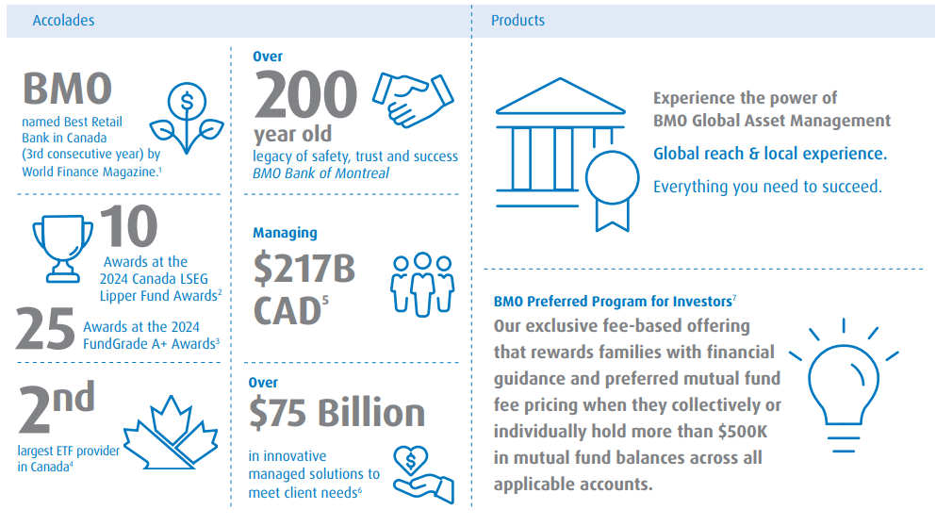
Your Destination of Choice for Comprehensive, Award-Winning Investment Solutions
See Footnotes: https://bmogamhub.com/system/files/bmo_gam_accolades_retail_eng.pdf
Notes:
[SPEAKING POINTS]
So we know that a plan is absolutely crucial to having piece of mind about your retirement and financial goals. But why should you make BMO your partner as you work toward those goals?
The answer is simple: We have the most comprehensive suite of wealth management solutions. No other group in Canada can match our range of capabilities to provide the right solutions, to the right clients, at the right time.
BMO Global Asset Management is one of the top 10 asset managers in Canada, managing more than $380 billion on behalf of clients.
We have wide selection of investment options and products to let you benefit from our expertise ranging from Mutual Funds, Managed Solutions, Speciality Funds and more…
Most importantly, we’re committed to providing advice-led, outcome-oriented investment solutions to exceed your expectations.
Please feel free to speak to me after the presentation if you have any questions or would like to book an appointment with a Financial Planner.

Slide 24
A BMO Financial Planner is Here to Help
Insert Picture of FP
FP Name – Financial Planner
Phone Number
email@bmo.com
Saving and Investing
Major Purchases and Managing Debt
Retirement and Education Savings
A BMO Financial Planner is your partner to help you reach all of your financial goals.
Notes:
[SPEAKING POINTS]
So the most important question is this: Do you have a plan? Or if you do have a plan, are you sure that it’s on track? Can you and your loved ones afford to be unsure?
If you don’t have a plan, a BMO Financial Planner can create a plan that is customized for you. Your Planner will take the time to get to know you and understand your goals and your needs – now and in the future, and build a plan that fits with the rest of your life and your values.
Your Planner will guide you through the important steps and decisions to keep you moving forward from day 1.
You might have more than one goal – with some nearer than others. Maybe you want to buy a summer cottage in 3 years, your daughter will go to university in 6 years, or you’re planning to retire in 15 years. Your BMO Financial Planner can build a plan to help you get there.
Aside from creating a customized investment plan to meet your needs, a BMO Financial Planner can help you with estate planning, managing debt, and other goals.
A “set-it-and-forget-it” approach to planning sounds easy, but it won’t work for something this important. Instead, your Planner will be a partner over the years to help you fine-tune your plan along the way as your life changes, to make sure you stay on track.
If you already have a financial plan, a BMO Financial Planner can give you a free review to see how close you are to reaching your goals, and help you make any adjustments.
A financial plan will help you avoid all of the mistakes we’ve talked about: It will keep you rooted and help you avoid the flash-in-the-pan market frenzies. It will give your portfolio the right mix of investments to help you reach your goals without taking on too much risk. It will structure your investments to protect your wealth from inflation and taxes. A financial plan can do all of this and more, and a BMO Financial Planner can be your partner to help you save and invest for the future while enjoying your life today.
[SAY]
Please feel free to speak to (Name of FP) of I after the presentation, or call 1-888-389-8030 to get started.

Slide 25
Questions?
Notes:
[SPEAKING POINTS]
Does anyone have any questions?
(After questions have been answered) I would like to thank you all for coming this presentation.

Slide 26
Thank you!
For more information, please visit
www.bmo.com/mutualfunds

Slide 27
Disclaimer
Any statement that necessarily depends on future events may be a forward-looking statement. Forward-looking statements are not guarantees of performance. They involve risks, uncertainties and assumptions. Although such statements are based on assumptions that are believed to be reasonable, there can be no assurance that actual results will not differ materially from expectations. Investors are cautioned not to rely unduly on any forward-looking statements. In connection with any forward-looking statements, investors should carefully consider the areas of risk described in the most recent simplified prospectus.
The viewpoints expressed by the presenters represents their assessment of the markets at the time of publication. Those views are subject to change without notice at any time. The information provided herein does not constitute a solicitation of an offer to buy, or an offer to sell securities nor should the information be relied upon as investment advice. Past performance is no guarantee of future results. This communication is intended for informational purposes only.
This presentation may contain links to other sites that BMO Global Asset Management does not own or operate. Any content from or links to a third-party website are not reviewed or endorsed by us. You use any external websites or third-party content at your own risk. Accordingly, we disclaim any responsibility for them.
Certain statements included in this material constitute forward-looking statements, including, but not limited to, those identified by the expressions "expect", "intend", "will" and similar expressions. The forward-looking statements are not historical facts but reflect BMO AM’s current expectations regarding future results or events. These forward-looking statements are subject to a number of risks and uncertainties that could cause actual results or events to differ materially from current expectations. Although BMO AM believes that the assumptions inherent in the forward-looking statements are reasonable, forward-looking statements are not guarantees of future performance and, accordingly, readers are cautioned not to place undue reliance on such statements due to the inherent uncertainty therein. BMO AM undertakes no obligation to update publicly or otherwise revise any forward-looking statement or information whether as a result of new information, future events or other such factors which affect this information, except as required by law.
BMO Global Asset Management is the brand name for various affiliated entities of BMO Financial Group that provide investment management, retirement, and trust and custody services. BMO Global Asset Management comprises BMO Asset Management Inc., BMO Investments Inc., BMO Asset Management Corp., BMO Asset Management Limited and BMO’s specialized investment management firms. Certain of the products and services offered under the brand name, BMO Global Asset Management are designed specifically for various categories of investors in a number of different countries and regions and may not be available to all investors. Products and services are only offered to such investors in those countries and regions in accordance with applicable laws and regulations.
All Rights Reserved. The information contained herein: (1) is confidential and proprietary to BMO Asset Management Inc. (“BMO AM”); (2) may not be reproduced or distributed without the prior written consent of BMO AM; and (3) has been obtained from third party sources believed to be reliable but which have not been independently verified. BMO AM and its affiliates do not accept any responsibility for any loss or damage that results from the use of this information.
About the LSEG Lipper Fund Awards: The LSEG Lipper Fund Awards, granted annually, highlight funds and fund companies that have excelled in delivering consistently strong risk-adjusted performance relative to their peers. The LSEG Lipper Fund Awards are based on the Lipper Leader for Consistent Return rating, which is a risk-adjusted performance measure calculated over 36, 60 and 120 months. The fund with the highest Lipper Leader for Consistent Return (Effective Return) value in each eligible classification wins the LSEG Lipper Fund Award. For more information, see lipperfundawards.com. Although LSEG Lipper makes reasonable efforts to ensure the accuracy and reliability of the data contained herein, the accuracy is not guaranteed by LSEG Lipper. The highest 20% of funds in each classification are named Lipper Leaders for Consistent Return, the next 20% receive a rating of 4, the middle 20% are rated 3, the next 20% are rated 2 and the lowest 20% are rated 1.

Slide 28
Disclaimer
BMO Mutual Funds are managed by BMO Investments Inc., which is an investment fund manager and a separate legal entity from Bank of Montreal.
Investment Professionals include Financial Planners who are representatives of both Bank of Montreal and BMO Investments Inc. ("BMO II"), a financial services firm and separate legal entity from Bank of Montreal. Financial Planners provide financial planning, investment & retirement planning services – including mutual funds investing advice – through BMO II. Ask us to learn more about the services BMO II does and doesn’t provide – click here to learn how it gets paid.
About the Fundata FundGrade A + Rating FundGrade A+® is used with permission from Fundata Canada Inc., all rights reserved. The annual FundGrade A+® Awards are presented by Fundata Canada Inc. to recognize the "best of the best" among Canadian investment funds. The FundGrade A+® calculation is supplemental to the monthly FundGrade ratings and is calculated at the end of each calendar year. The FundGrade rating system evaluates funds based on their risk-adjusted performance, measured by Sharpe Ratio, Sortino Ratio, and Information Ratio. The score for each ratio is calculated individually, covering all time periods from 2 to 10 years. The scores are then weighted equally in calculating a monthly FundGrade. The top 10% of funds earn an A Grade; the next 20% of funds earn a B Grade; the next 40% of funds earn a C Grade; the next 20% of funds receive a D Grade; and the lowest 10% of funds receive an E Grade. To be eligible, a fund must have received a FundGrade rating every month in the previous year. The FundGrade A+® uses a GPA-style calculation, where each monthly FundGrade from "A" to "E" receives a score from 4 to 0, respectively. A fund's average score for the year determines its GPA. Any fund with a GPA of 3.5 or greater is awarded a FundGrade A+® Award. For more information, see http://www.fundgradeawards.com. Although Fundata makes every effort to ensure the accuracy and reliability of the data contained herein, the accuracy is not guaranteed by Fundata. The FundGrade A+ Awards and the FundGrade Ratings being referenced are calculated based on comparisons of performance of investment funds within a specified category established by the CIFSC.
Commissions, trailing commissions (if applicable), management fees and expenses all may be associated with mutual fund investments. Please read the fund facts or simplified prospectus of the relevant mutual fund before investing. Mutual funds are not guaranteed, their values change frequently and past performance may not be repeated. Distributions are not guaranteed and are subject to change and/or elimination.
For a summary of the risks of an investment in BMO Mutual Funds, please see the specific risks set out in the simplified prospectus.
“BMO (M-bar roundel symbol)” is a registered trademark of Bank of Montreal, used under licence.

